Slide 1
Why? Because…
Kindergarten ‒ HOOK Lesson
Cause and Effect

Slide 2
The mouse…
CAUSE

Slide 3
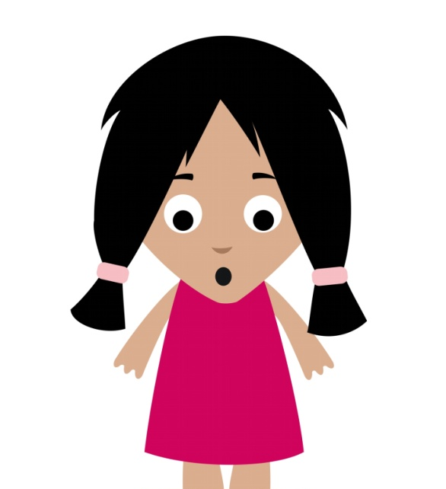
The girl…

Slide 4
The girl saw the mouse.

Slide 5
What happened when the girl saw the mouse?
The girl jumped on the stool.
EFFECT

Slide 6
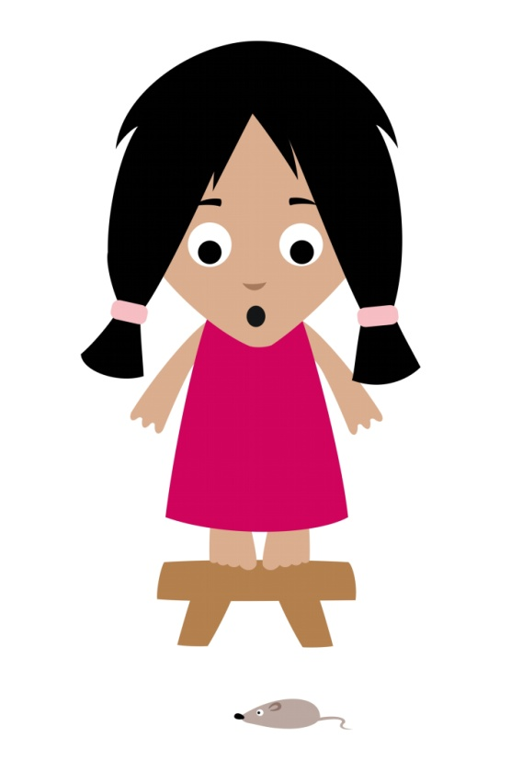
Why did the girl jump on the stool?
Because she was afraid of the mouse.
CAUSE

Slide 7
CAUSE EFFECT
the mouse
The girl jumped on the stool

Slide 8
Which one is the CAUSE?
The girl jumped on the stool because she was afraid of the mouse.

Slide 9
TRY AGAIN…
Next

Slide 10
GOOD JOB!
Next

Slide 11
Which one is the EFFECT?
The girl jumped on the stool because she was afraid of the mouse.

Slide 12
GOOD JOB!
Next

Slide 13
TRY AGAIN…
Next

Slide 14
Which one is the CAUSE?
The girl jumped on the stool because she was afraid of the mouse.

Slide 15
GOOD JOB!
Next

Slide 16
TRY AGAIN…
Next

Slide 17
The light turned green.

Slide 18
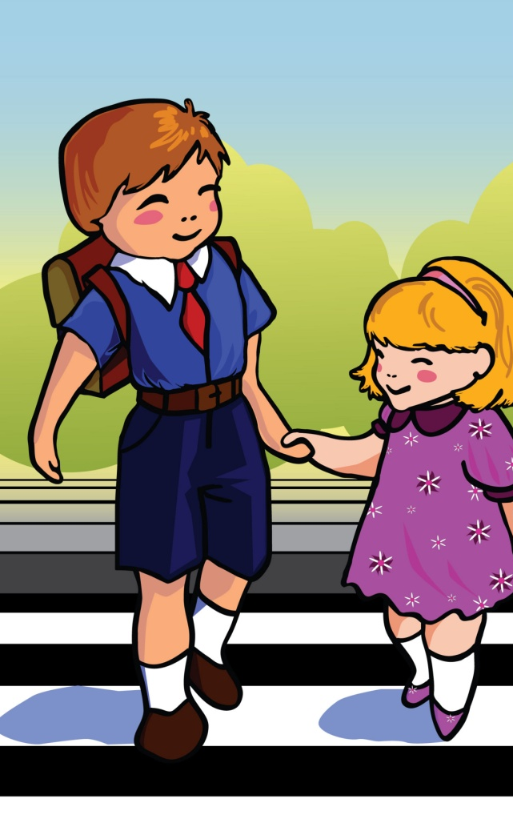
The kids crossed the street.

Slide 19
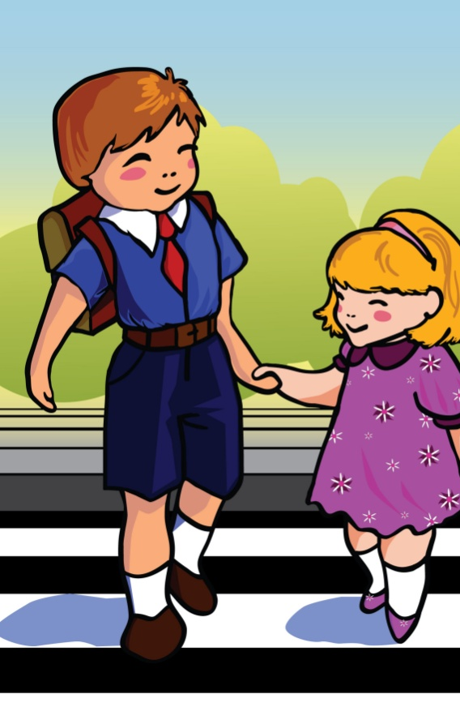
The light turned green so the kids crossed the street.
SO
CAUSE
EFFECT

Slide 20
Which one is the CAUSE?
The light turned green so the kids crossed the street.

Slide 21
TRY AGAIN…
Next

Slide 22
GOOD JOB!
Next

Slide 23
Which one is the EFFECT?
The light turned green so the kids crossed the street.

Slide 24
TRY AGAIN…
Next

Slide 25
GOOD JOB!
Next

Slide 26
We can also say the same thing another way…

Slide 27
The kids crossed the street because the light turned green.
because
EFFECT
CAUSE

Slide 28
Which one is the CAUSE?
The kids walked across the street because the light turned green.

Slide 29
TRY AGAIN…
Next

Slide 30
GOOD JOB!
Next

Slide 31
Which one is the EFFECT?
The kids walked across the street because the light turned green.

Slide 32
TRY AGAIN…
Next

Slide 33
GOOD JOB!
Next

Slide 34
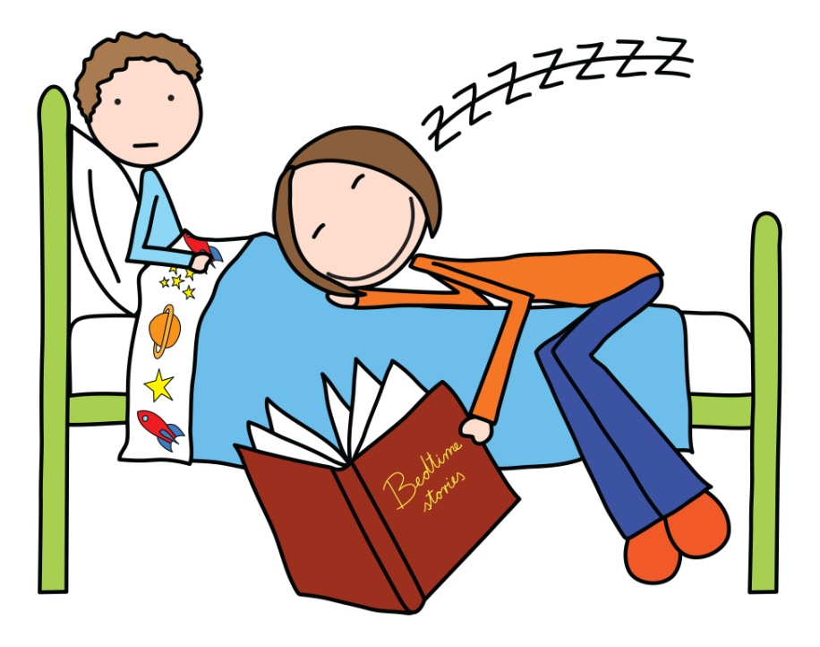
Which one is the CAUSE?
My mom was tired when she read me a bedtime story so she fell asleep on my bed.

Slide 35
TRY AGAIN…
Next

Slide 36
GOOD JOB!
Next

Slide 37
Which one is the EFFECT?
My mom was tired when she read me a bedtime story so she fell asleep on my bed.

Slide 38
TRY AGAIN…
Next

Slide 39
GOOD JOB!
Next

Slide 40
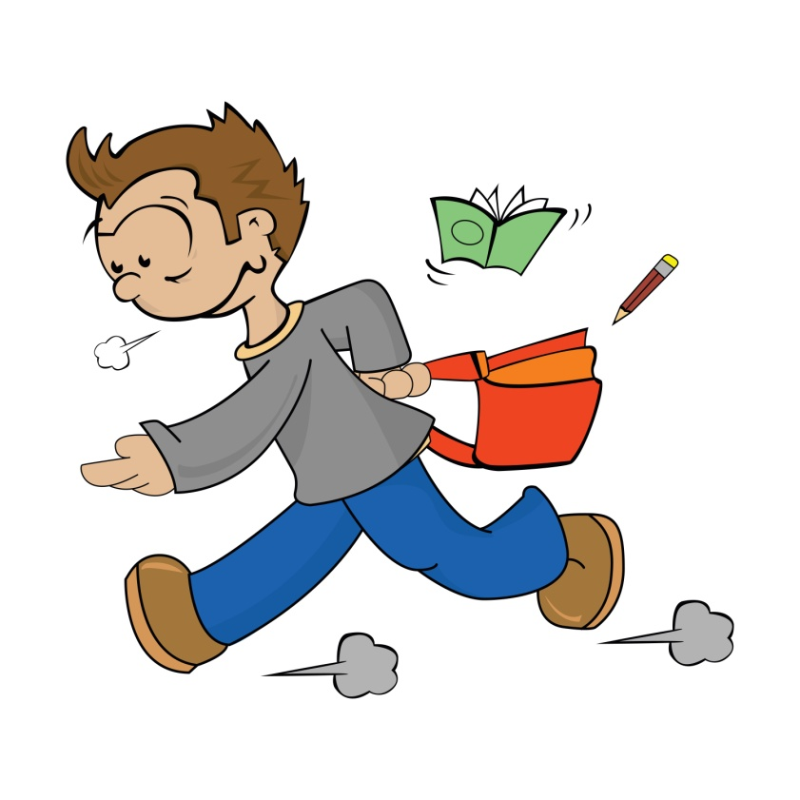
Which one is the CAUSE?
I ran to school because I was late.

Slide 41
TRY AGAIN…
Next

Slide 42
GOOD JOB!
Next

Slide 43
Which one is the EFFECT?
I ran to school because I was late.

Slide 44
TRY AGAIN…
Next

Slide 45
GOOD JOB!
Next

Slide 46
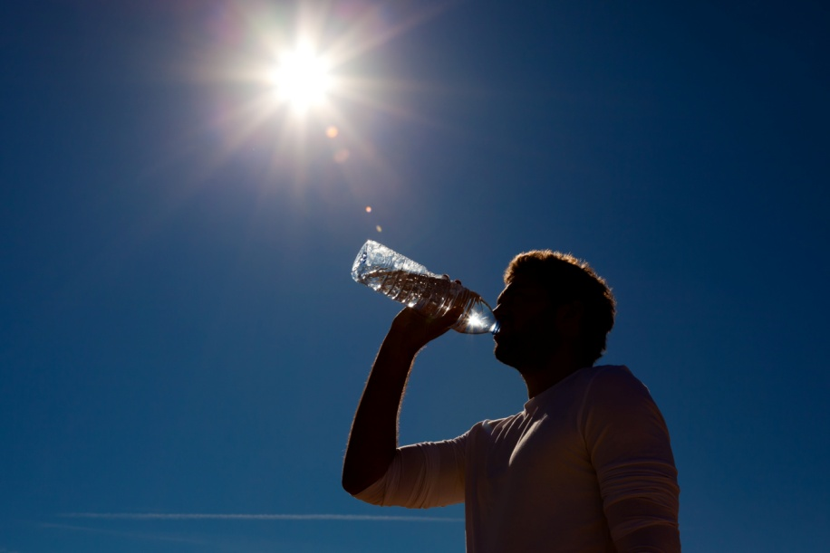
Which one is the EFFECT?
The sun was hot outside so the man drank some water.

Slide 47
TRY AGAIN…
Next

Slide 48
GOOD JOB!
Next

Slide 49
Which one is the CAUSE?
The sun was hot outside so the man drank some water.

Slide 50
TRY AGAIN…
Next

Slide 51
GOOD JOB!
Next

Slide 52
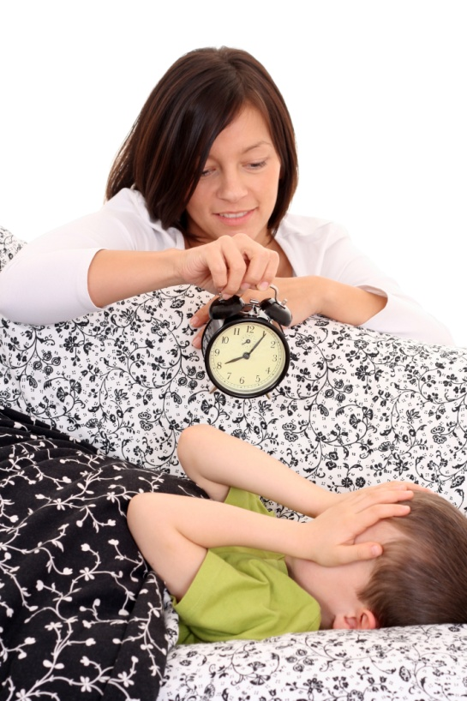
Which one is the CAUSE?
The boy was late for school because he overslept.

Slide 53
TRY AGAIN…
Next

Slide 54
GOOD JOB!
Next

Slide 55
Which one is the EFFECT?
The boy was late for school because he overslept.

Slide 56
TRY AGAIN…
NEXT

Slide 57
GOOD JOB!
NEXT

Slide 58
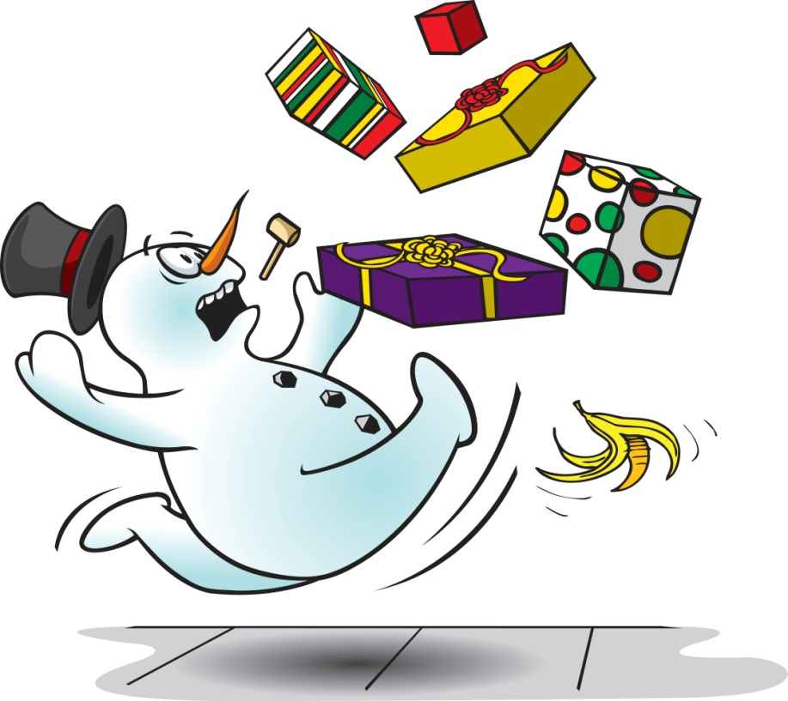
Which one is the CAUSE?
The snowman dropped his gifts because he slipped on the banana.

Slide 59
TRY AGAIN…
Next

Slide 60
GOOD JOB!
Next

Slide 61
Which one is the EFFECT?
The snowman dropped his gifts because he slipped on the banana.

Slide 62
TRY AGAIN…
Next

Slide 63
GOOD JOB!
Next

Slide 64
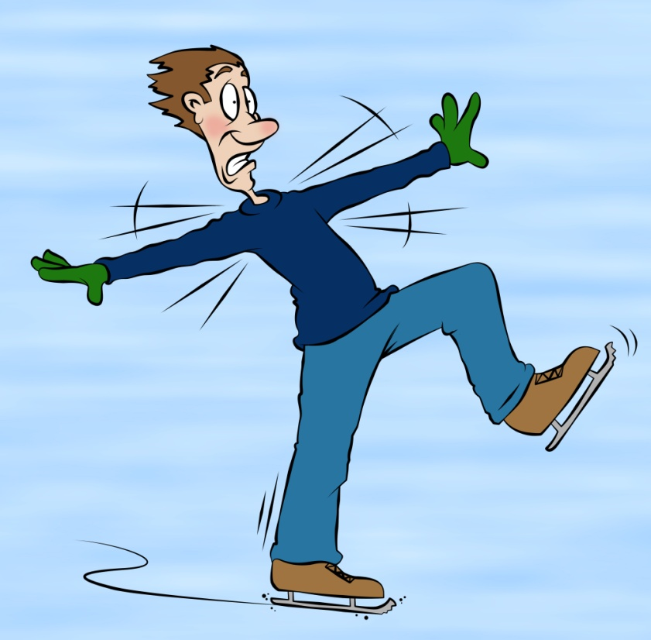
Which one is the EFFECT?
The ice was too slippery so the man lost his balance.

Slide 65
TRY AGAIN…
Next

Slide 66
GOOD JOB!
Next

Slide 67
Which one is the CAUSE?
The ice was too slippery so the man lost his balance.

Slide 68
TRY AGAIN…
Next

Slide 69
GOOD JOB!
Next

Slide 70
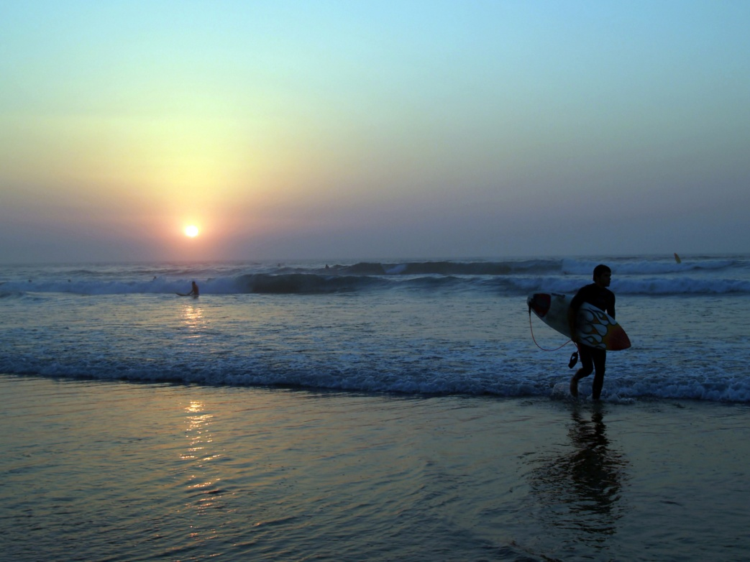
Which one is the EFFECT?
The surfer left the beach because the sun was going down.

Slide 71
TRY AGAIN…
Next

Slide 72
GOOD JOB!
Next

Slide 73
Which one is the CAUSE?
The surfer left the beach because the sun was going down.

Slide 74
TRY AGAIN…
Next

Slide 75
GOOD JOB!
Next

Slide 76
THE END!

