Slide 1
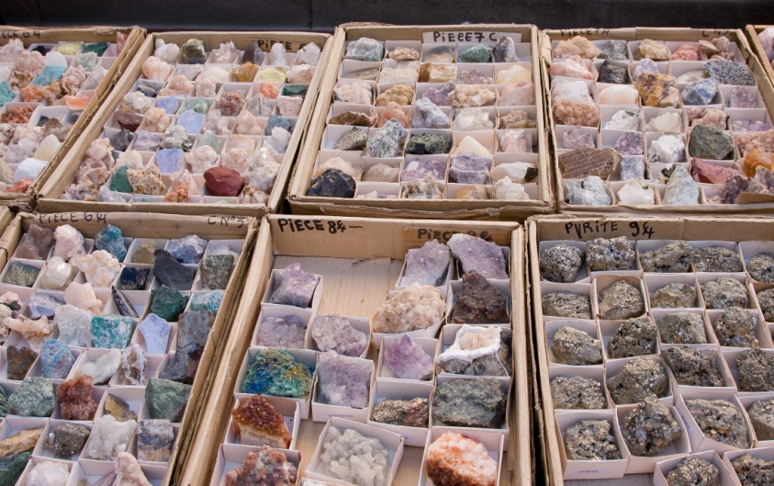
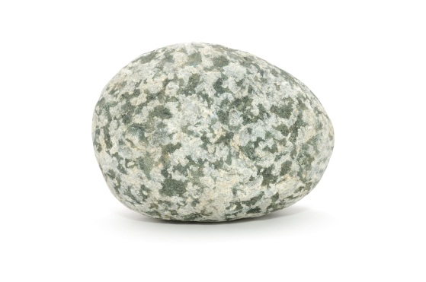
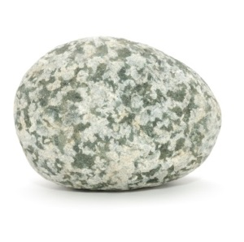
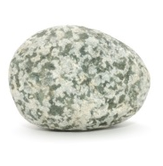
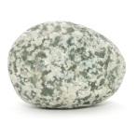
A Rock and Gem Show
Earth Materials—PreK
Lesson 24—Close

Slide 2
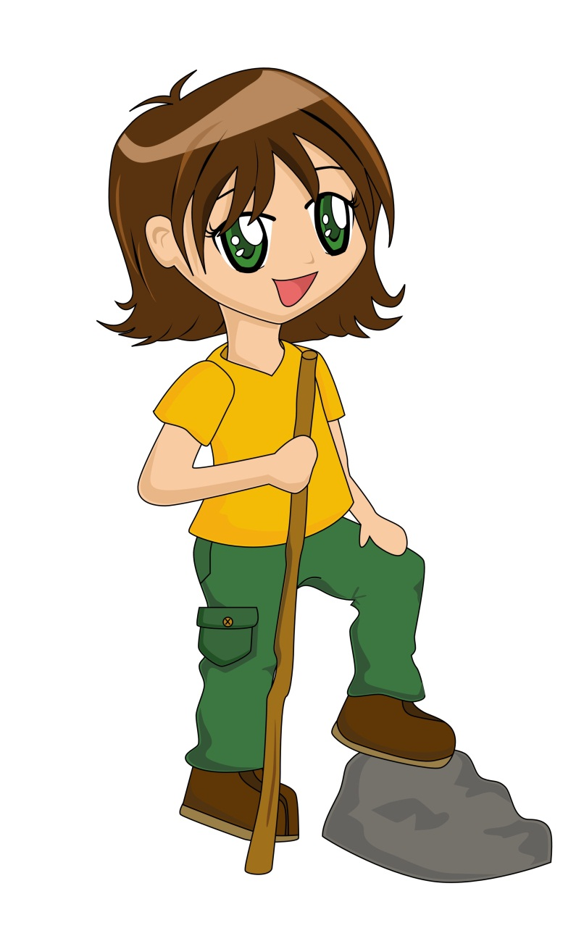
Hello!
Notes:
“Hello! My name is Pebbles. Today I want to show you around a rock and gem show. A rock and gem show is a place where people buy and sell different kinds of rocks. We will see and hear what the customers and sellers do and say at a gem show.

Slide 3
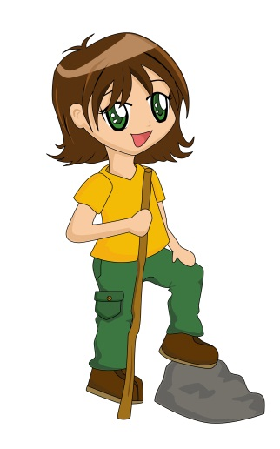
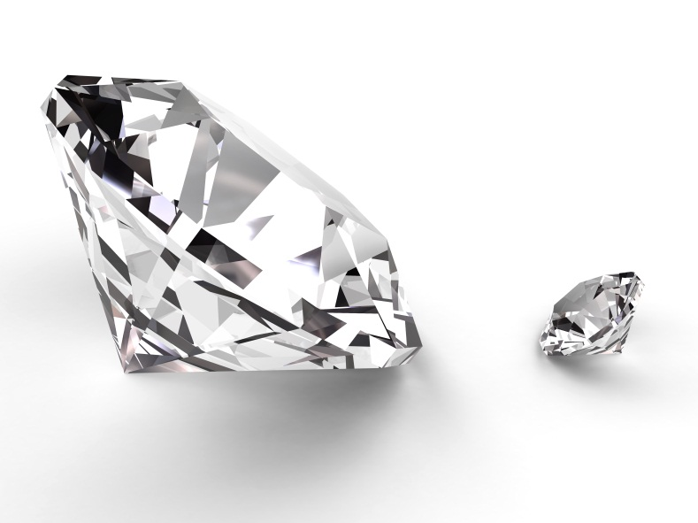
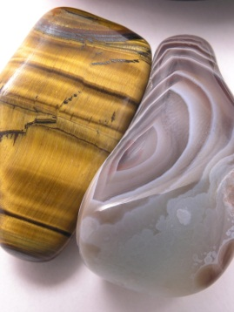
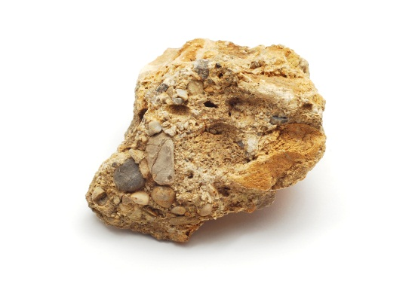
Describe!
Large
Small
Smooth
Speckled
Striped
Rough
Notes:
“First of all, let’s look at some gems, rocks, and minerals. There are so many different kinds and they can be described in so many ways! Some can be described as: smooth, rough, speckled, striped, large, or small! Can you help me describe these rocks? Which rock is smooth, rough, speckled, striped, large, and which is small?“

Slide 4
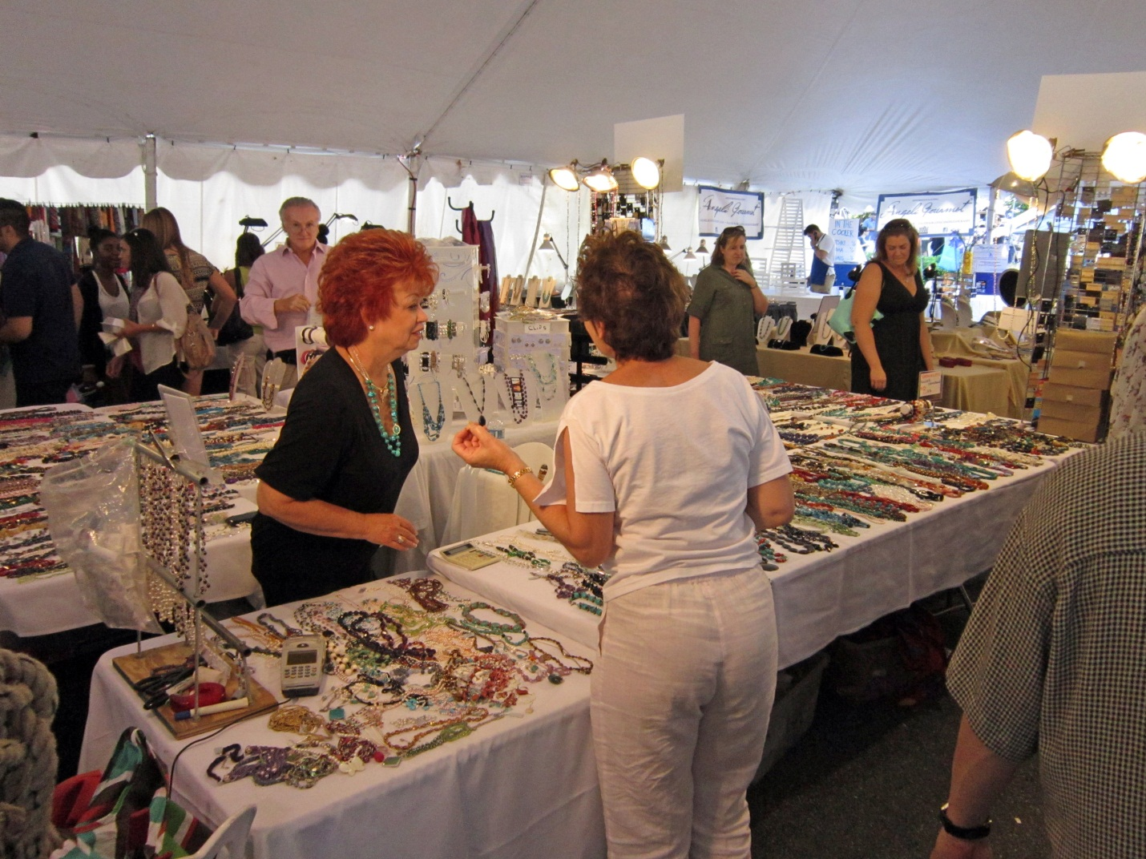
seller
buyer
Notes:
“Welcome to the rock and gem show! Here are two people attending the show! One woman is the buyer and one woman is the seller. Can you guess which woman is the buyer and which is the seller?”…

Slide 5
Buyer and Seller Dialogue
Notes:
“Lets listen to hear what they are saying to each other!”

Slide 6
Buyer and Seller Dialogue
Notes:
Lady #1: “Hello, What would you like to see?”
Lady #2: “ I would like to see a black and shiny rock.”

Slide 7
Buyer and Seller Dialogue
Notes:
Lady #1: “Here is a black and shiny rock! Would you like to buy it?”
Lady #2: “Yes, I would like to buy this one please.”

Slide 8
Buyer and Seller Dialogue
Notes:
Lady #1: “You need to pay the cashier. Thank you for coming.”
Lady #2: “ Thank you”

Slide 9
Notes:
“Let’s listen to two more people talking at the gem show. One is the buyer and one is the seller.”

Slide 10
Notes:
Buyer: I want to see this necklace please.
Exhibitor: You want to see this silver one?

Slide 11
Notes:
Buyer: Yes, this is the one I want to see.
Exhibitor: Do you want to buy this one?

Slide 12
Notes:
Buyer: I don’t know what I want to buy yet.

Slide 13
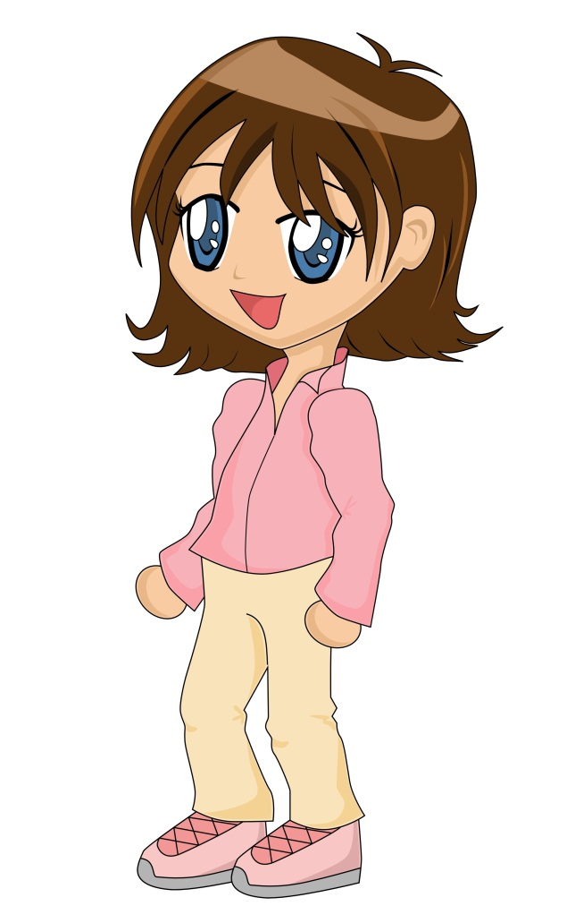
Buyer
Seller
Notes:
“ Here are a couple more women at the gem show”
Lady1: “I would like to see some obsidian.”

Slide 14
Buyer
Seller
Notes:
Lady #2: “ I do not have obsidian. Would you like to see some granite?”

Slide 15
Buyer
Seller
Notes:
Lady#1:”Yes, I would like to see a small piece of granite.”

Slide 16
Buyer
Seller
Notes:
Lady#2: “Would you like to buy this small piece?”

Slide 17
Buyer
Seller
Notes:
Lady#1:”Yes, thank you very much! Bye!”

Slide 18
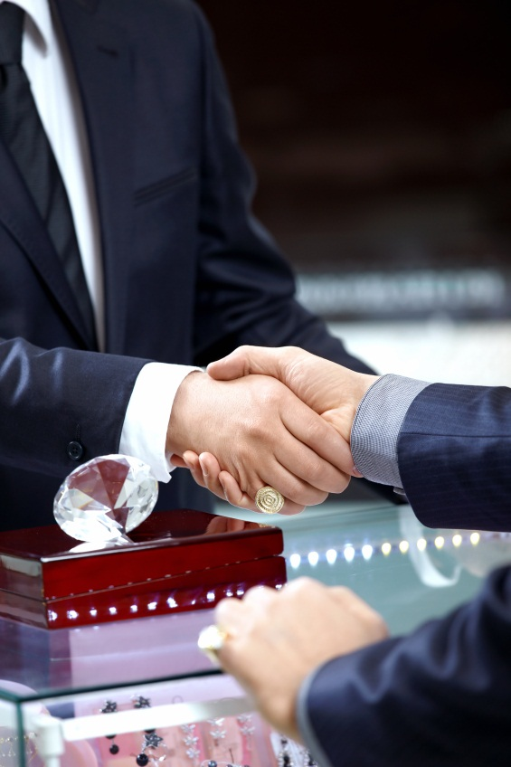
Come Again!
Notes:
“ Thank You for coming to my rock and gem show today! Now that you know about gem shows, you can have one of your own! Buying and selling beautiful rocks, gems, and minerals can be a lot of fun!”

Slide 19
http://www.kvoa.com/videos/2012-gem-show-preparations/

