Slide 1
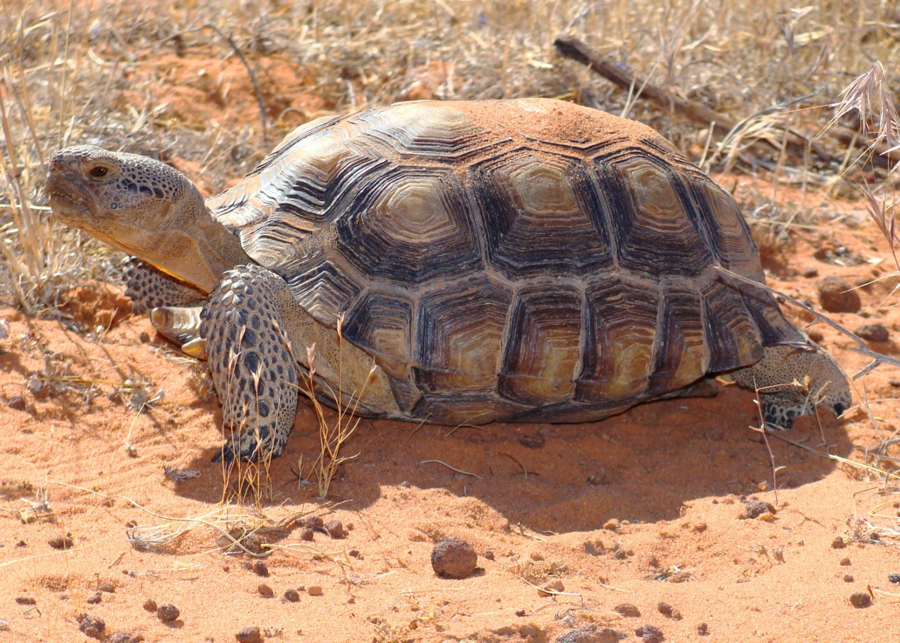
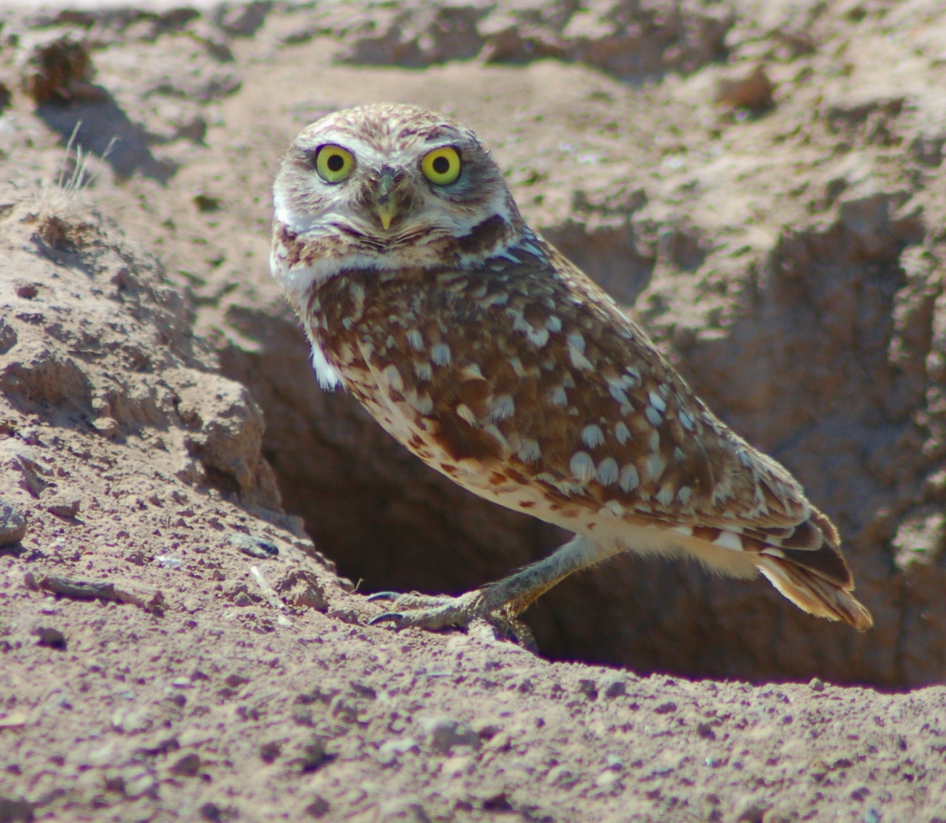
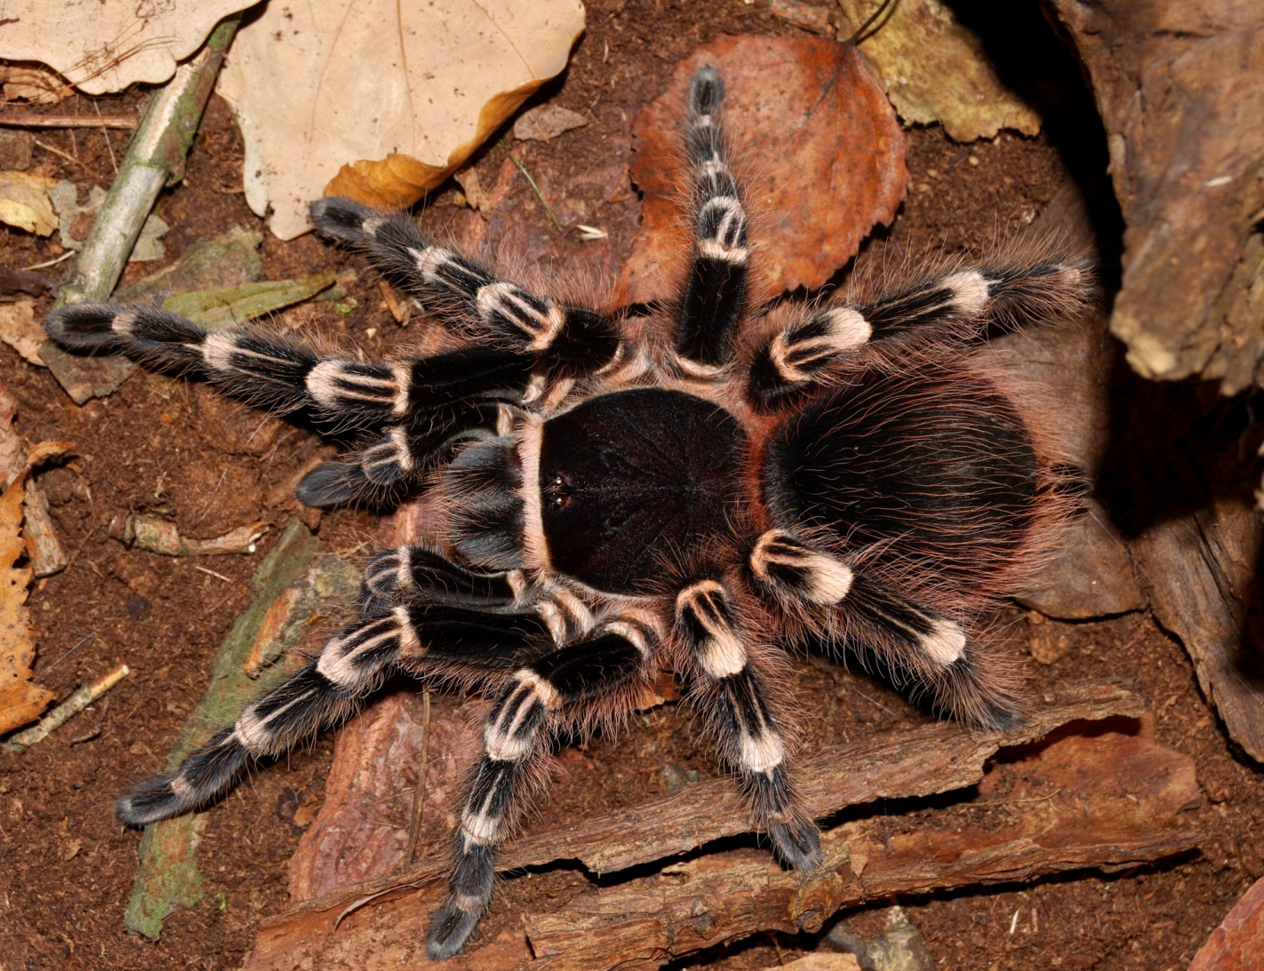
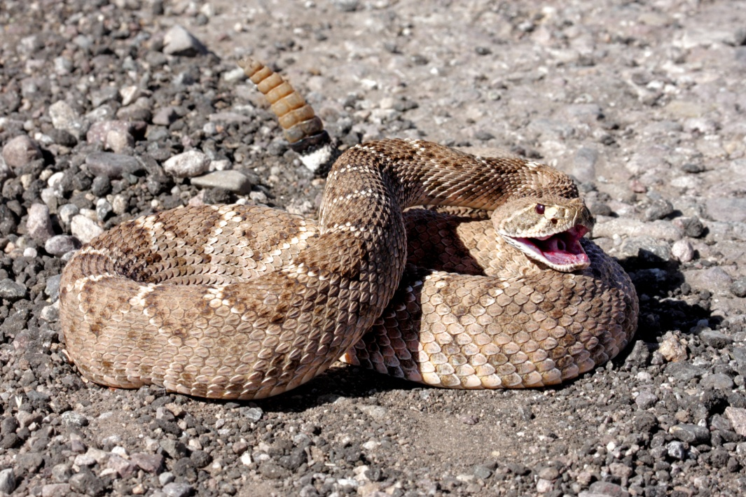
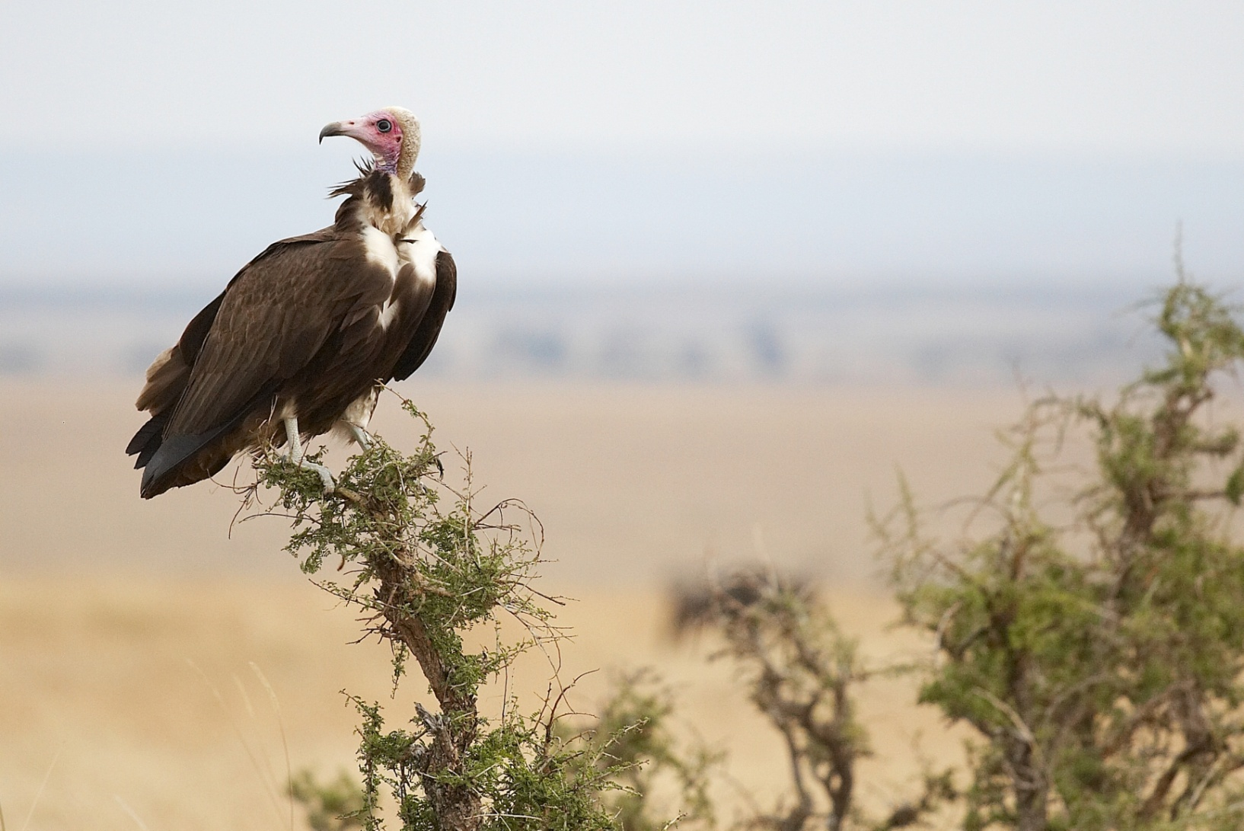
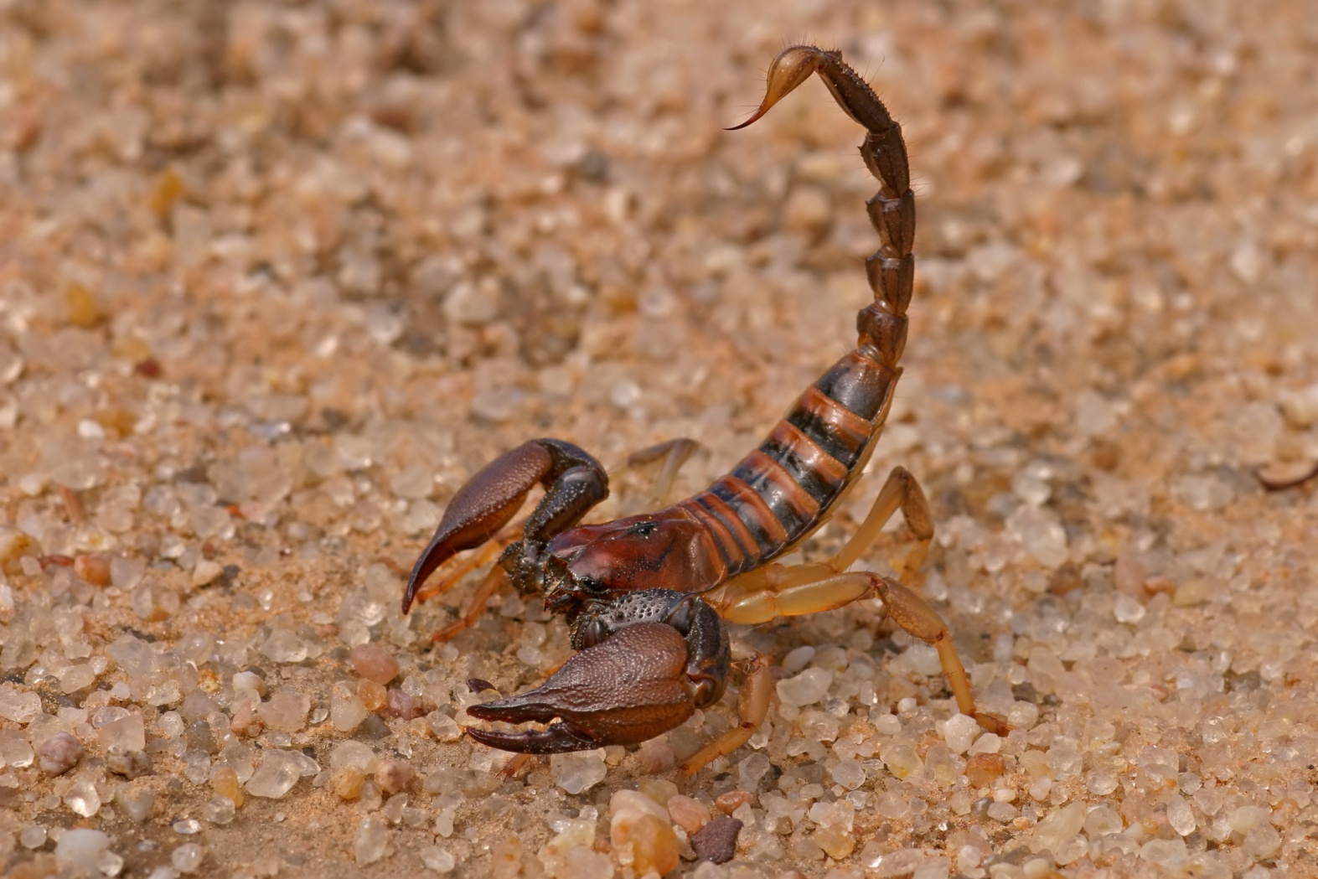
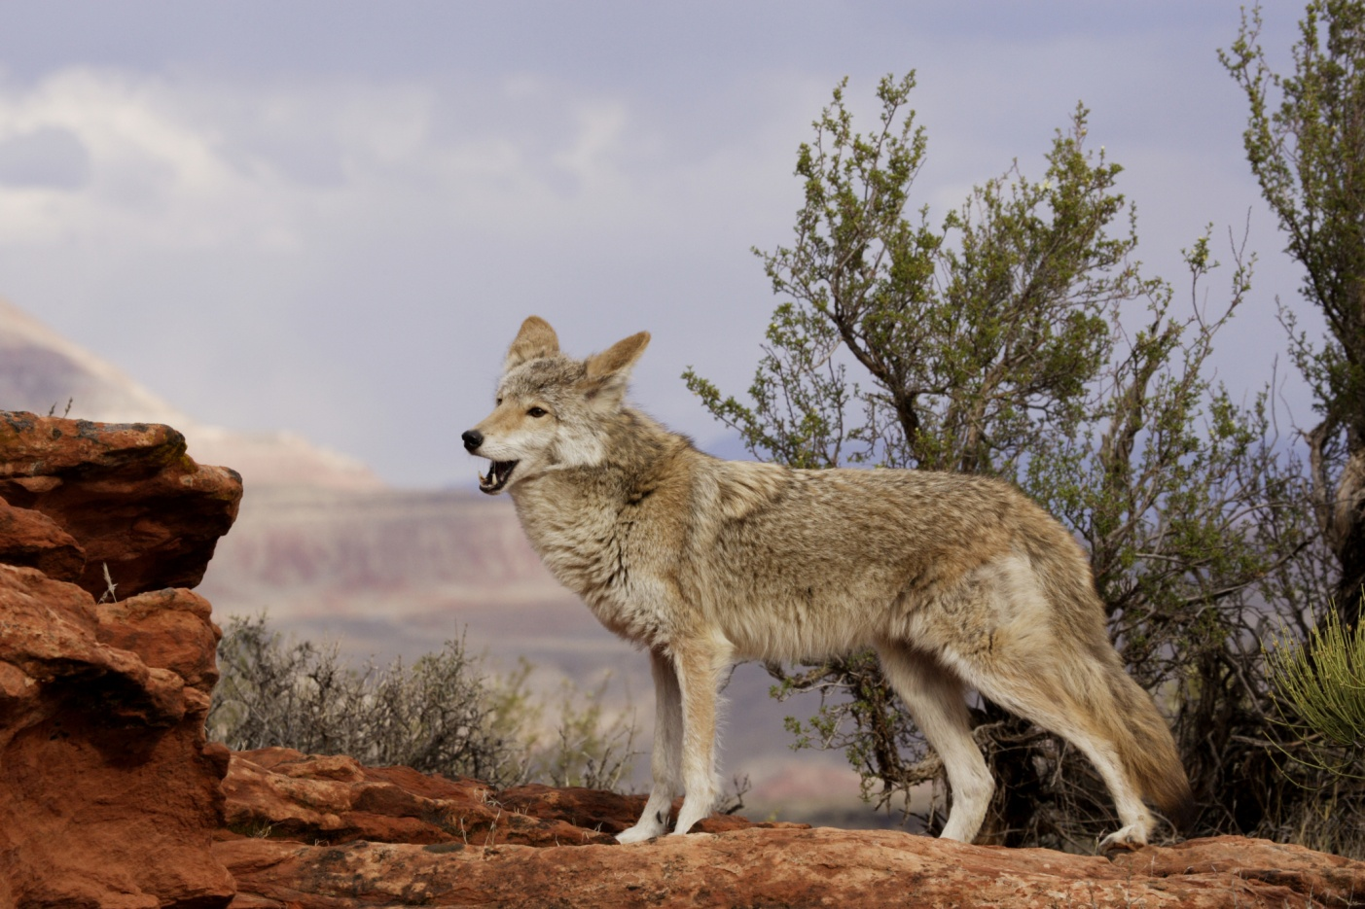
Desert ANIMALS
Animals – Kindergarten Lesson 7 – Integration
Notes:
Hi! Let’s talk about desert animals!

Slide 2
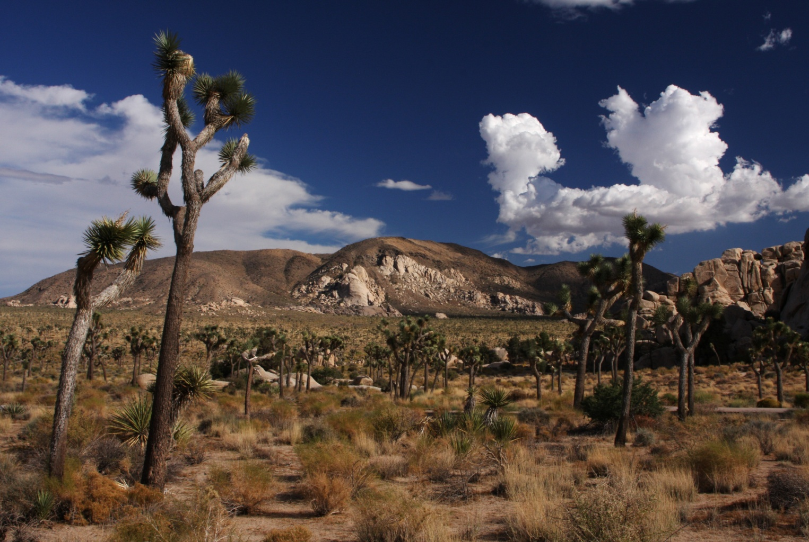
How do animals SURVIVE in the desert?
Notes:
Where animals live is related to what they eat, how they stay safe, and what they like to do.
In the desert, animals don’t have much water. It can be very hot during the day and very cold at night. They have to protect themselves from heat and sun, so many animals live underground. Some animals are good diggers; others find holes that are already there. Since food and water are often scarce, animals find clever ways to live long periods between meals. Many desert animals are camouflaged—that means that they grow to look like their environment, helping them to hide from predators.

Slide 3
I’m a Rattlesnake.
Notes:
I’m a meat eater. I like to eat rats, mice, and small birds.
I keep safe by hiding under rocks. I use my strong jaw, venomous fangs to protect myself or kill my prey.
I like to shake my tail. It makes a noise like a rattle so you know when I’m nearby.

Slide 4
I’m a vulture.
Notes:
I eat the leftover bits of dead animals.
I stay safe by keeping close to my volt.
I’m very good at flying long distances or making circles over my next meal. My large wings let me soar for many miles without having to flap them.

Slide 5
I’m a tarantula.
Notes:
I eat all kinds of insects and even small mice or frogs.
I keep safe by hiding in a burrow I dug into the ground and lined with my silk. I also hide by blending into the background, and I use my fangs to defend myself.
I'm very good at looking scary, and my bite will hurt a lot even though I'm not poisonous. But my hairs will make you itch!

Slide 6
I’m a coyote.
Notes:
I eat small animals or fruits, veggies, and grasses.
I live with my pack in a den, but I hunt alone.
I'm very good at howling to talk to my friends. I'm very clever, too. My den usually has two entrances; I will hide one by covering it with grass.

Slide 7
I’m a scorpion.
Notes:
I am a meat eater and like to eat insects. My slow metabolism lets me survive on just one meal a year. I have a special organ, called a pectine, that lets me feel even the smallest movement around me. This lets me track down my prey and warns me of danger. I usually grow about 3 inches long. I have 8 legs and a long tail with a stinger. My sting will paralyze my victim or attacker. Watch out! I am most dangerous when I am small, because I don’t know when to stop injecting my poison.

Slide 8
I’m a burrow owl.
Notes:
When I hunt for prey, I perch on a rock—somewhere high—until I see a big insect or a small rat. Then I swoop down and catch them.
I nest in burrows built and abandoned by other animals.
Unlike most owls, I am active during the day.

Slide 9
I’m A DESERT Tortoise.
Notes:
I am a plant eater. I eat a lot of grass, but I also like herbs, flowers, and cacti. Since my home is so dry, I get most of my water from my food. My shell keeps me safe. When it gets really hot, I dig an underground burrow to keep cool. I grow to be about 1 foot long and to weigh about 15 pounds. My front limbs are flattened and have claw-like scales to help me dig.

Slide 10
What do you know about your favorite desert animal?

