Slide 1
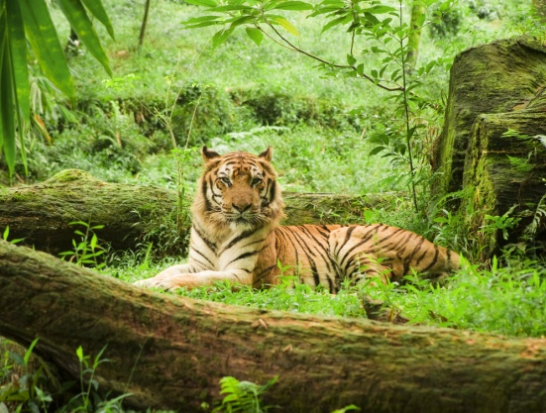
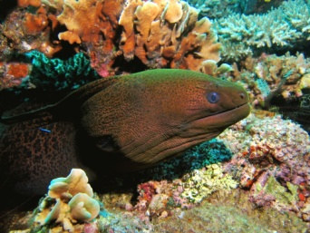
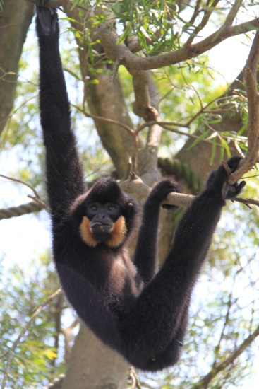
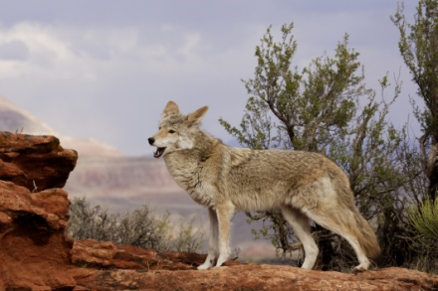
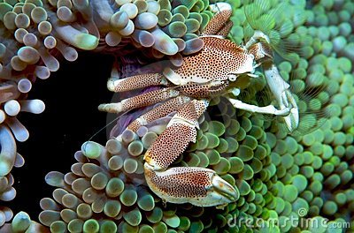
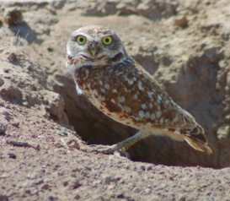
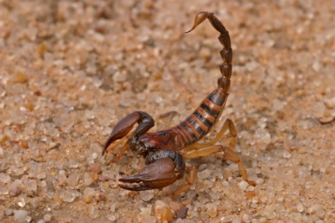
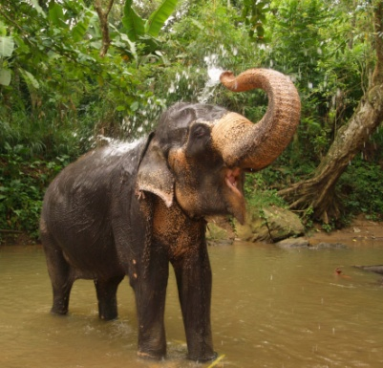
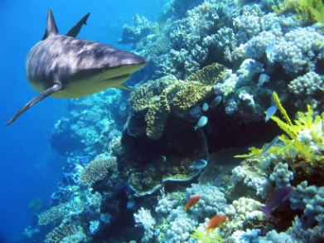
What Animals Need
Animals - Kindergarten - Hook
Notes:
Today is the first lesson from our Animals unit. I wonder what we’re going to find… Are you ready?

Slide 2
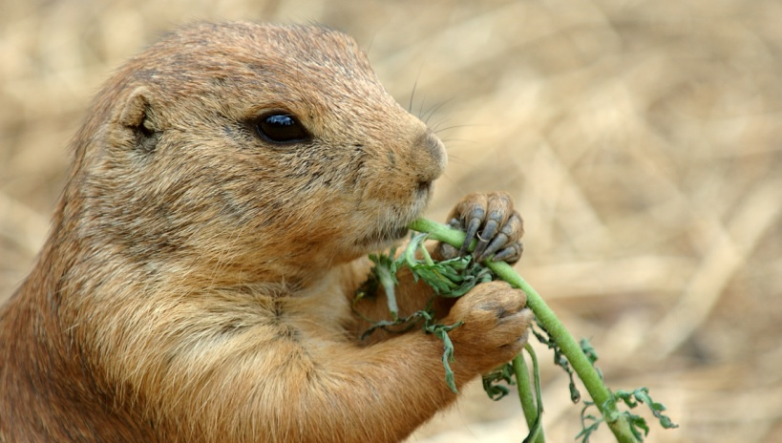
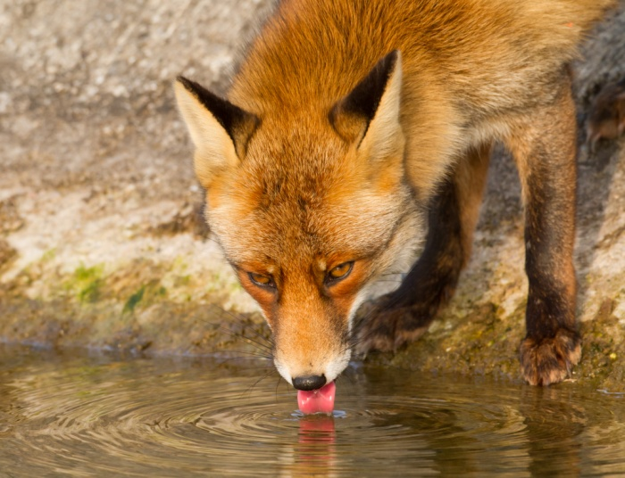
Animals need food, water, and a way to stay safe.
How do animals get these things?
Notes:
We know that all animals need water, food, and a way to stay safe. They also have things that make them special.

Slide 3
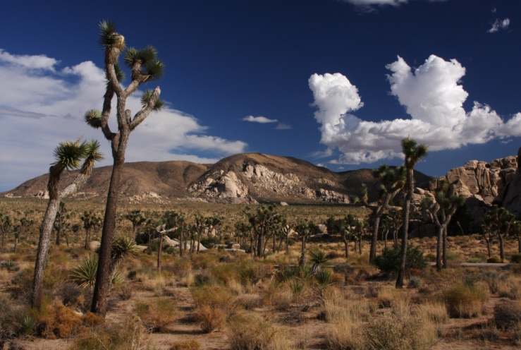
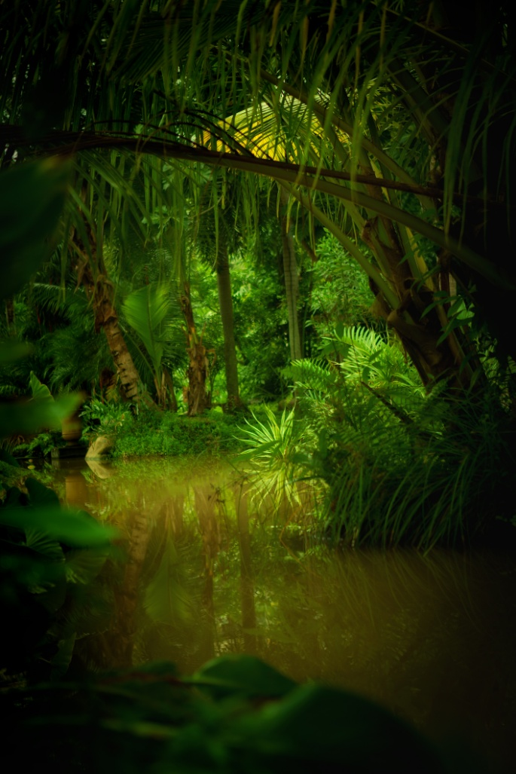
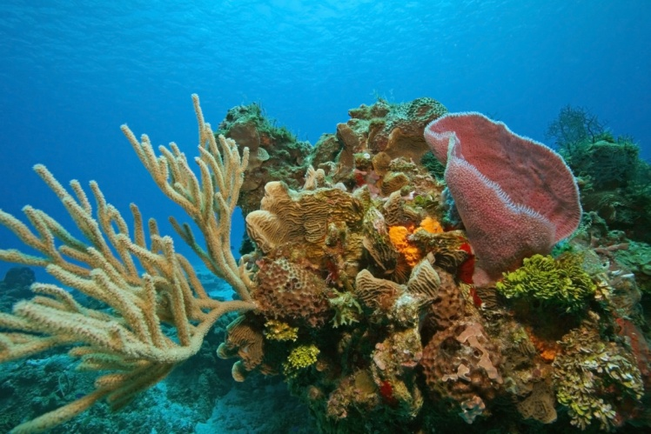
What animals need depends on where they live.
Notes:
What animals eat, how they stay safe, and what they like to do depend on where they live.

Slide 4
What do animals need in the desert?
Notes:
In the desert animals don’t have much water. It’s often very hot during the day so many animals live underground or come out at night when it’s cooler. It’s often hard to find food and water so animals find clever ways to live for a long time between meals. Many desert animals are camouflaged; that means that they look like their surroundings. This helps them hide from predators.

Slide 5
What do animals need in a coral reef?
Notes:
In the coral reef, animals live under water. Many animals live and depend on each other in the coral reef. Some animals hunt other animals for food and some animals eat plants and waste materials. The coral reef provides food and lots of places to hide.

Slide 6
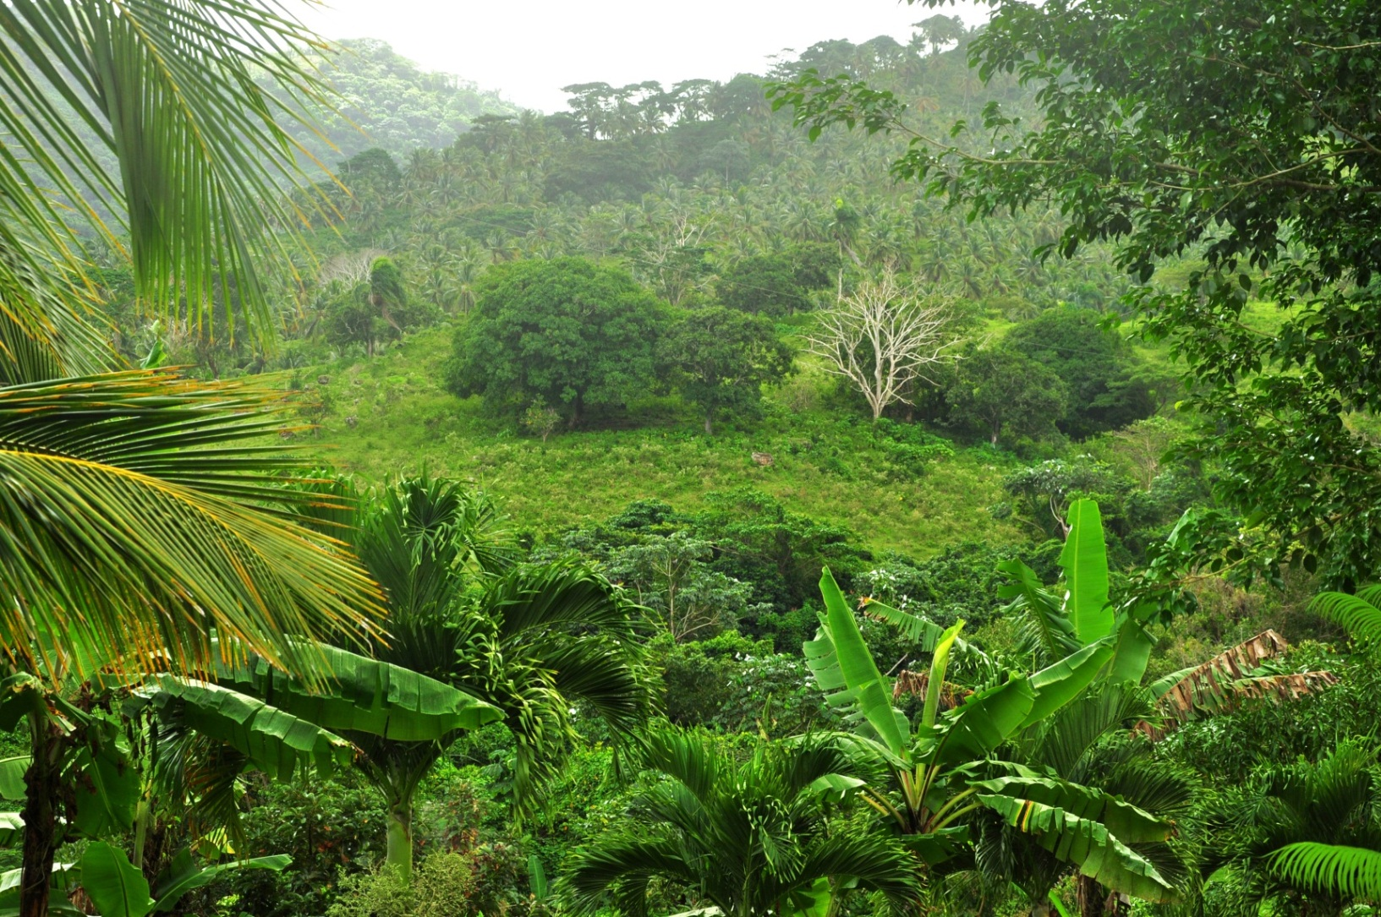
What do animals need in a jungle?
Notes:
The jungle is a rainforest that is usually hot and moist. There are many plants, insects, and animals for bigger animals to eat. Some animals learn to hide in the thick low plants or in the high tree branches. Many animals are camouflaged so predators can’t easily find them. Even big animals hide so they can hunt their prey without being seen.

Slide 7
We can compare animals that live in different habitats.
Notes:
We can compare animals that live in different habitats.

Slide 8
How do you compare things?
How is a baseball different?
How are they the same?
How is a golf ball different?
Bigger
Made of string and leather
Feels smooth
Baseball
Balls
Round
Used in sports
Smaller
Made of plastic
Feels bumpy
Golf
Notes:
When you compare things, you show how they are the same and different. Look at these two balls. We know they’re both balls, they’re round, and they’re used in sports. That’s how they are the same. But we can also think about what makes them different from each other. The size is different, what they’re made of is different, and what they feel like is different. This ball is used in baseball and this is a golf ball. Now let’s compare animals and think about how they’re the same and different.

Slide 9
I’m a tiger. I live in the jungle.
Notes:
I’m a tiger. I eat meat. I hunt small jungle animals. My stripes help me hide behind trees. I’m very good at jumping high, climbing, and swimming.

Slide 10
I’m a shark. I live in a coral reef.
Notes:
I am a shark. I eat any animal that lives in the ocean. My sharp teeth protect me from predators. If my teeth break or fall out, I grow new ones. I can smell blood miles away in the ocean.

Slide 11
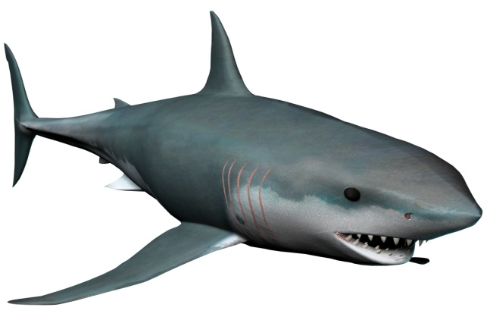
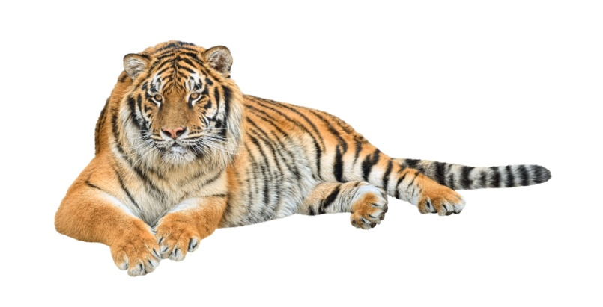
Compare a shark and a tiger…
How is the SHARK different?
How are they the same?
How is the TIGER different?
Lives in water
Fins
Scaly skin
Predator
Hunt for prey
Sharp teeth
Live alone
Lives on land
Four legs
Fur
Notes:
Now let’s compare a shark and a tiger. They are both predators, meaning that they hunt for other animals to eat. They have sharp teeth. They live and hunt alone. That’s how they’re the same. How are they different? Name one way the tiger is different… Name one way the shark is different… Now let’s look at two different animals.

Slide 12
I’m a giant stick insect. I live in the jungle.
Notes:
I am a walking stick. I eat fruit and insects. I look just like the branches of the trees I hide in. I’m very good at swinging from tree branches with my long arms and legs and tail. If a leg falls off, I can grow another one!

Slide 13
I’m a scorpion. I live in the desert.
Notes:
I am a scorpion. I am a meat eater and like insects. I can survive on just one meal a year. I can feel even the smallest movement around me. That’s how I find prey and avoid danger. I usually grow about 3 inches long, and I have 8 legs and a long tail with a stinger. My sting will paralyze my victim or attacker. Watch out!

Slide 14
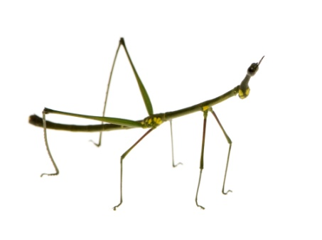
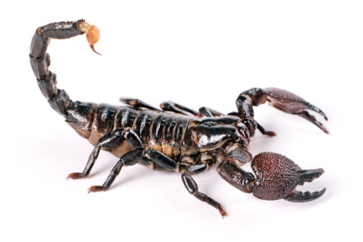
Compare a scorpion and a walking stick insect…
How is the SCORPION different?
How are they the same?
How is the WALKING STICK different?
Lives in the desert
8 Legs
Stinger
Hard outside skeleton
Small
Eat insects
Lives in the jungle
6 legs
Grows missing legs
Notes:
Now let’s compare a scorpion and a walking stick. How are they the same? …How are they different?

Slide 15
I’m a moray eel. I live in a coral reef.
Notes:
I’m a moray eel. I eat all kinds of fish. I hide in deep cracks in the coral and poke my head out to catch fish with my big sharp teeth. I can smell my prey. I can grow 12 feet long. My skin is very smooth.

Slide 16
I’m a rattlesnake. I live in the desert.
Notes:
I’m a rattlesnake. I like to eat rats, mice, and small birds. I use my strong jaw, fangs, and poison to kill prey and protect myself. I like to shake my tail. It makes a noise like a rattle so you know when I’m nearby. My skin is dry and scaly.

Slide 17
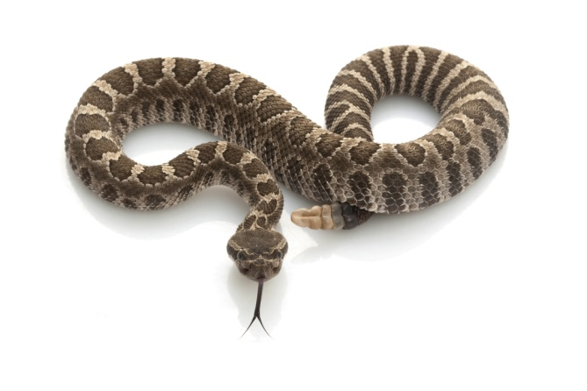
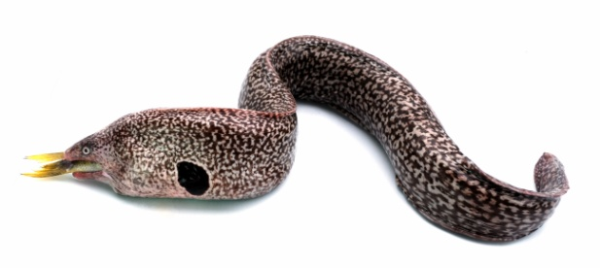
Compare a moray eel and a rattlesnake…
How is the MORAY EEL different?
How are they the same?
How is the RATTLESNAKE different?
Lives in the coral reef
Smooth skin
Eats fish
Long, thin body; no legs
Predator
Sharp teeth
Lives in the desert
Poisonous
Scaly skin
Eats mice
Notes:
How are a moray eel and a rattlesnake the same? …How are they different?

Slide 18
Now you do it!
What do animals need?
How are they the same or different?
Notes:
During our Animals unit, we’ll be looking at animals from the desert, jungle, and coral reef. We’ll learn many things about the animals, including what they need and how they are the same and different.

Slide 19
Compare a shark and a tiger…
Notes:
Compare a shark and a tiger. How are a shark and a tiger the same? What makes them different?

Slide 20
Compare a walking stick insect and a scorpion…
Notes:
What makes a walking stick and a scorpion the same? What makes them different?

Slide 21
Compare a rattlesnake and a moray eel…
Notes:
Compare a rattlesnake and a moray eel. How are these animals the same and different?

