Slide 1
Animals of the Coral Reef
Animals—Kindergarten
Lesson 19—Integration
Notes:
Hi. Let’s talk about the animals of the coral reef.

Slide 2
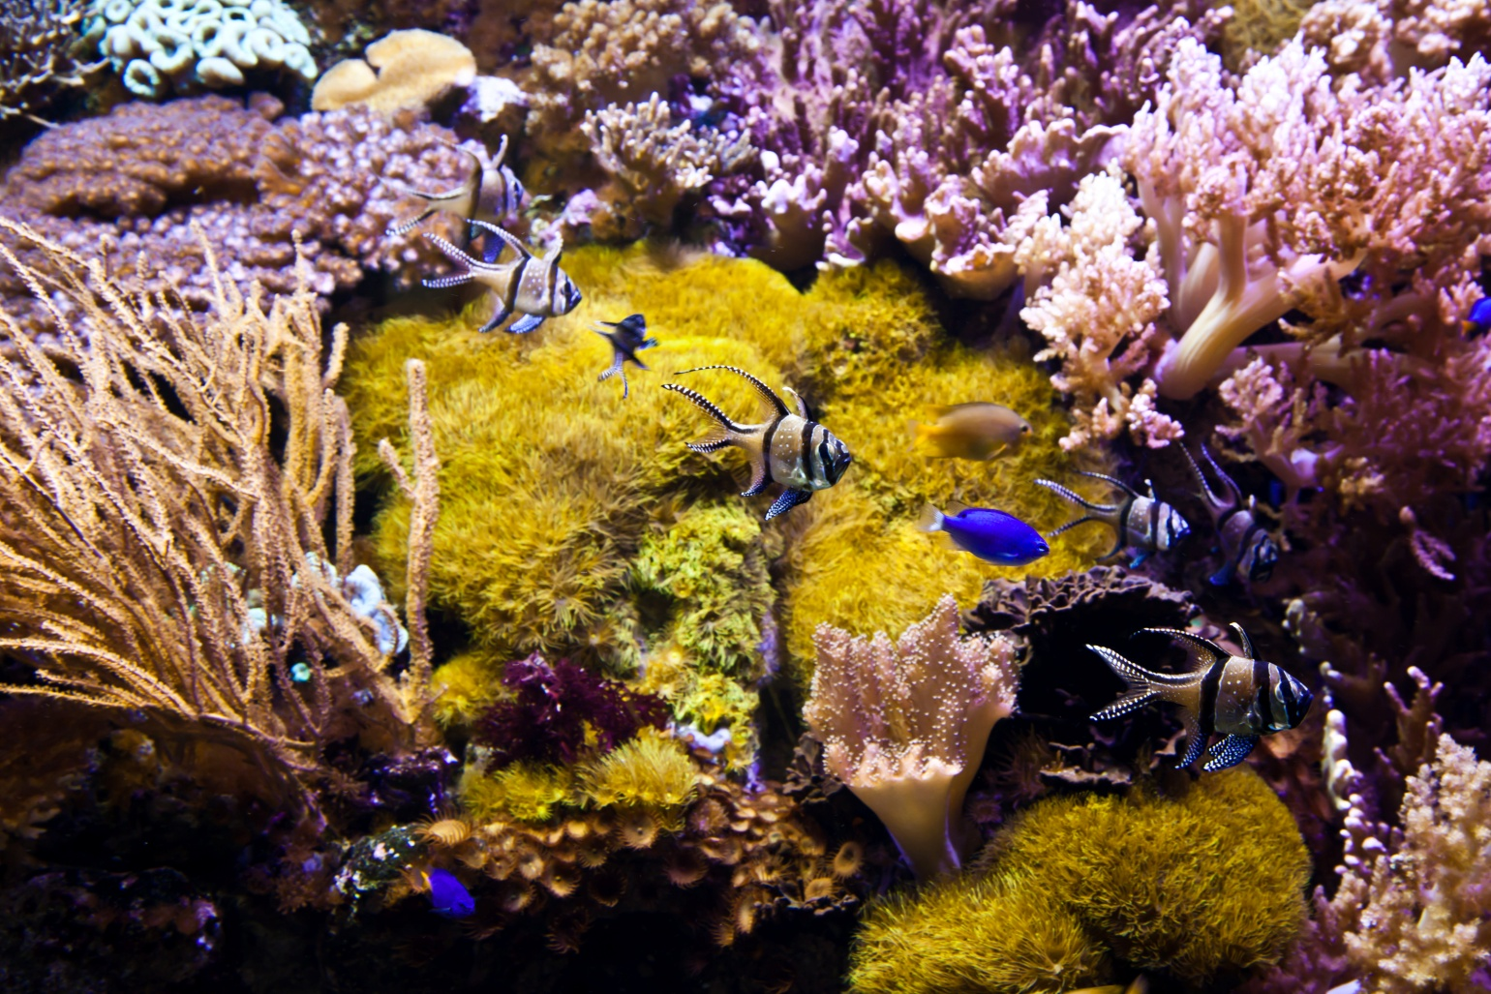
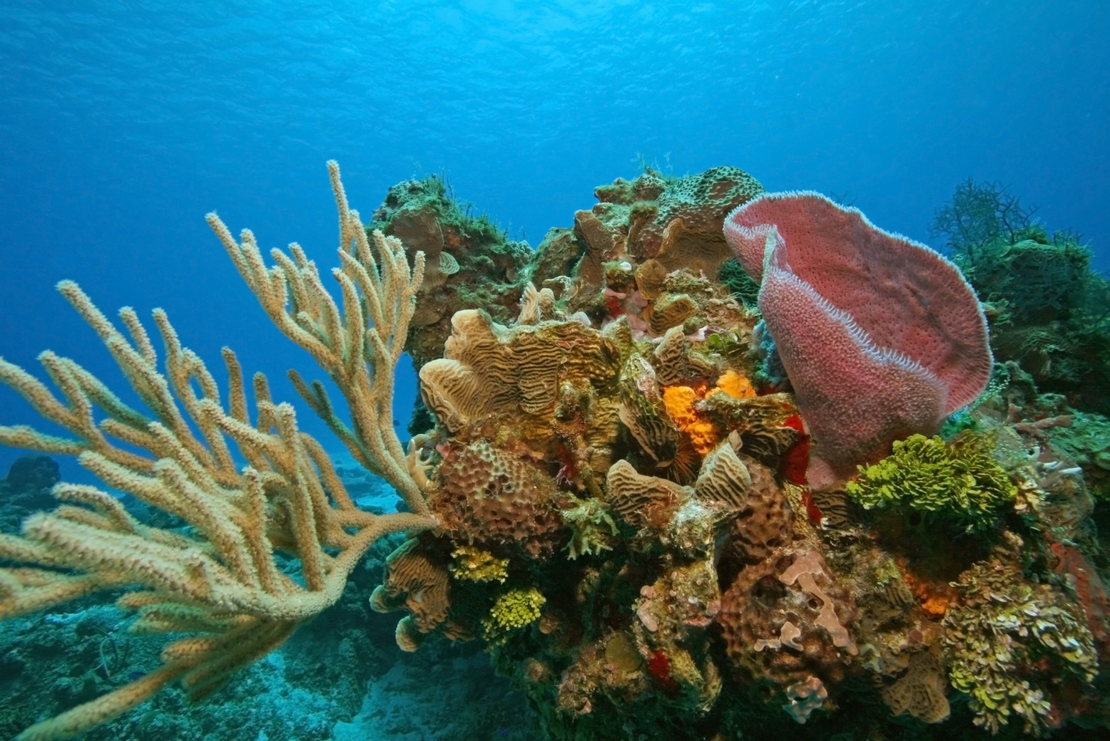
How do animals get what they need in the coral reef?
Notes:
Where animal live is related to what they eat, how they stay safe, and what they like to do.
In the coral reef animals live under water. The coral reef is a living habitat where lots of animals live and depend on each other. Some animals provide food for other animals, some animals work together to keep healthy and fed. The coral reef provides food and lots of places to hide.

Slide 3
I’m a shark.
I live in a coral reef.
Notes:
I eat fish, dolphins, and just about anything else that swims in the ocean.
I keep safe with lots of big teeth in my strong jaw. If my teeth break or fall out, I grow new ones.
I am very good at sniffing out my prey. I can smell blood miles away in the ocean.

Slide 4
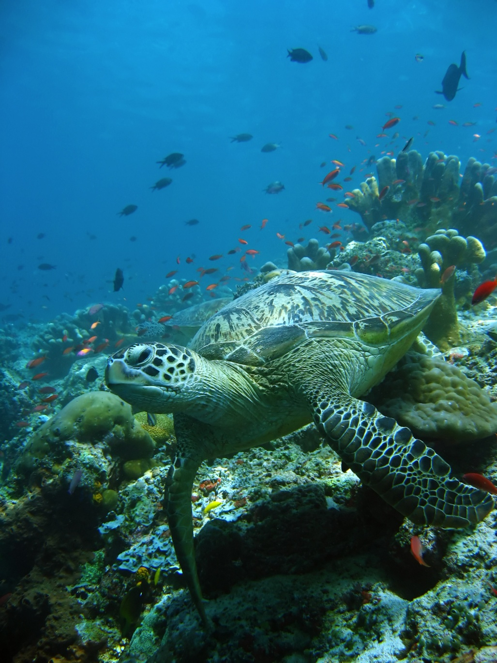
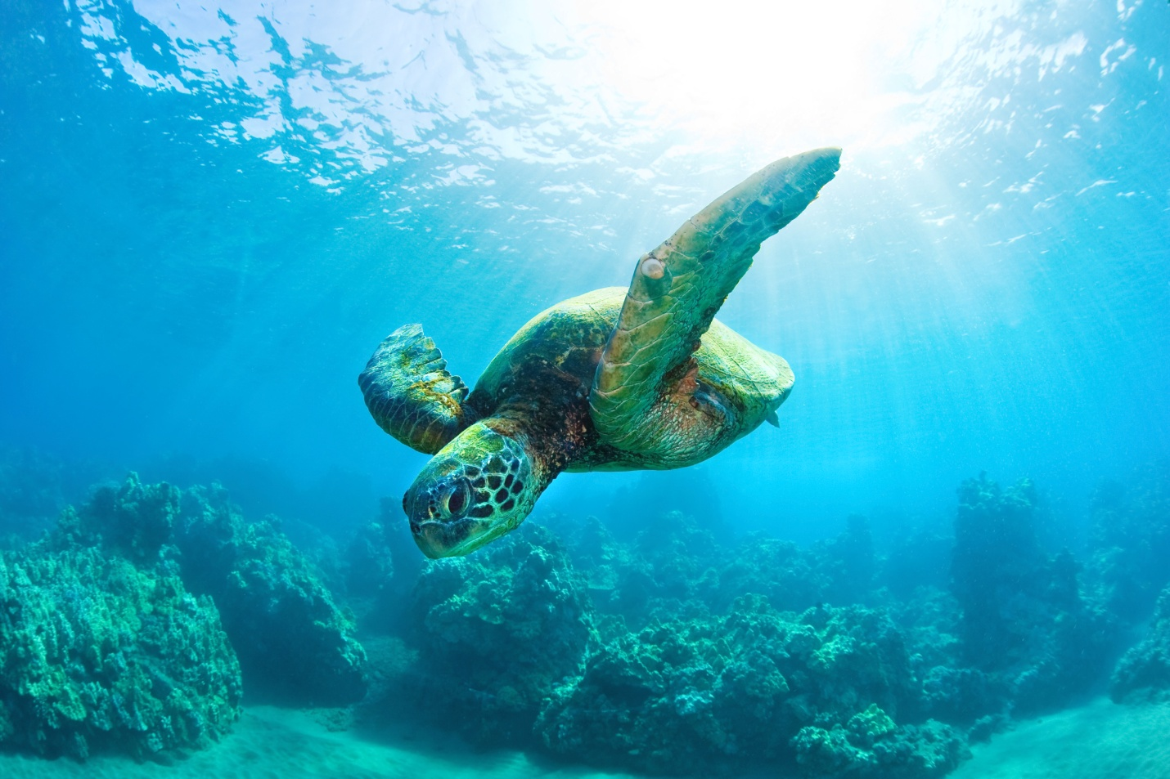
I’m a sea turtle.
I live in a coral reef.
Notes:
I eat plankton and jellyfish.
I stay safe by floating along with a loose bed of seaweed. It hides me from predators, but also hides lots of things that I like to eat.
I can grow to weigh as much as 1300 pounds and can live for a long as 80 years.

Slide 5
I’m a crab.
I live in a coral reef.
Notes:
I will eat just about anything I find, like squid, octupus, or even other crabs.
I stay safe with my hard shell and big, strong claws.
I like to walk sideways with my ten legs.

Slide 6
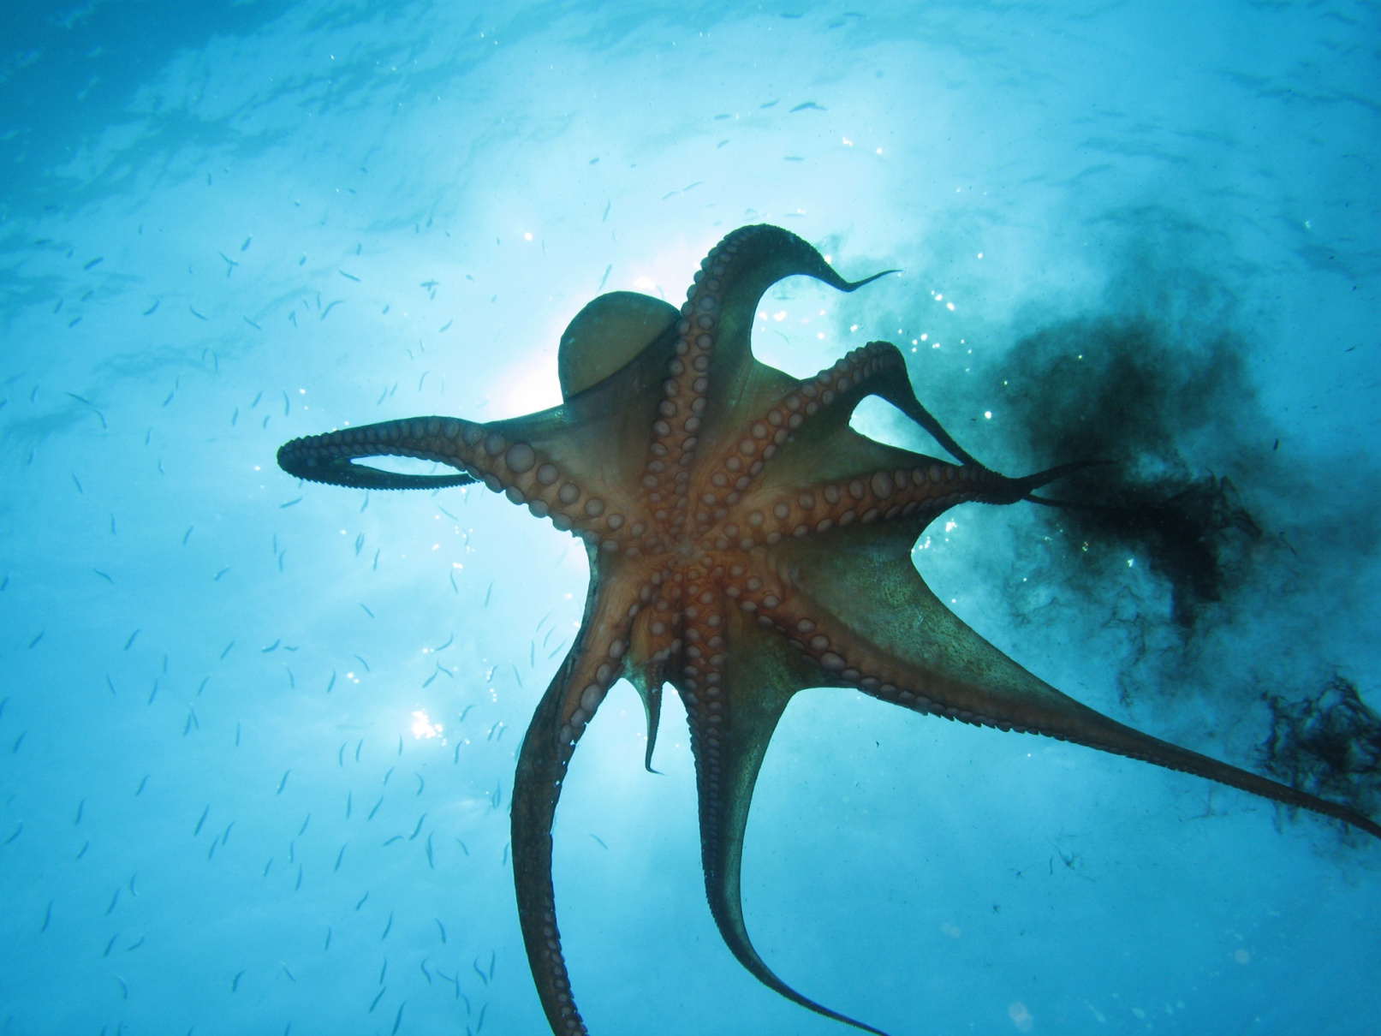
I’m an octopus.
I live in a coral reef.
Notes:
I eat fish but my favorite food is crab.
I can change what I look like to hide. If that doesn't work, I can also spray ink at enemies and swim away quickly.
I have no bones so I can squeeze through tight spaces in the coral to get to food.
I am very smart and can use my eight arms to use tools.

Slide 7
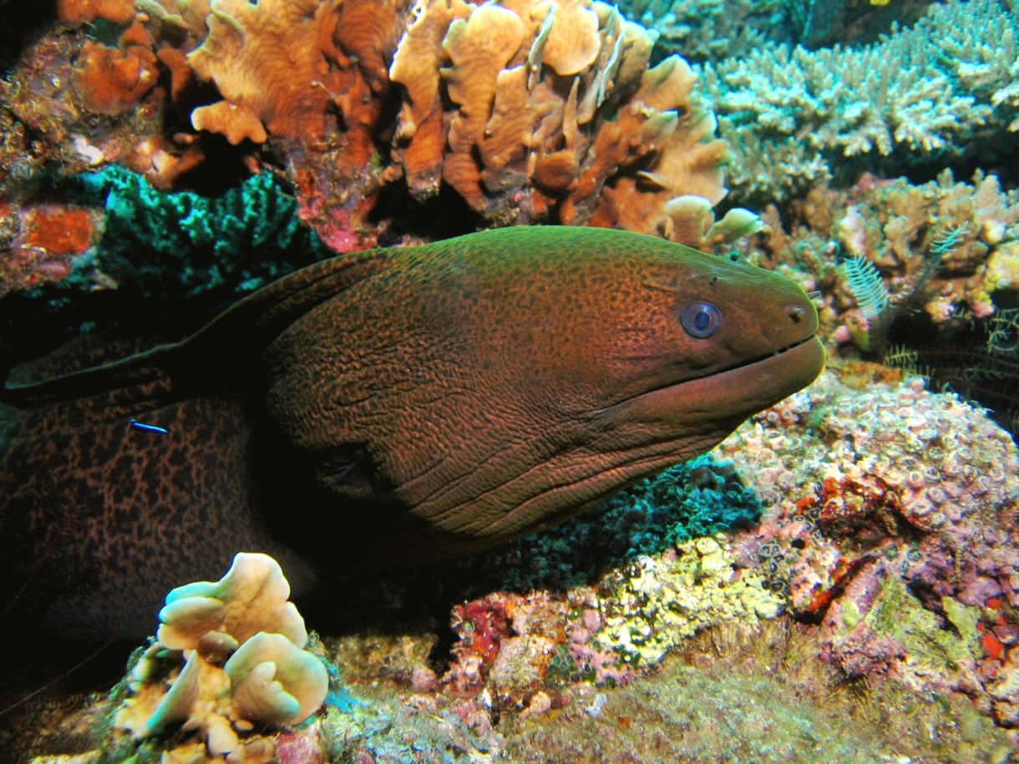
I’m a moray eel.
I live in a coral reef.
Notes:
I’m a meat eater. I eat all kinds of fish.
I stay safe by hiding in deep cracks in the coral and only poke my head out to catch some food with my big sharp teeth. I don't see very well so I wait until I can smell my prey.
I can grow as long as 12 feet long.

Slide 8
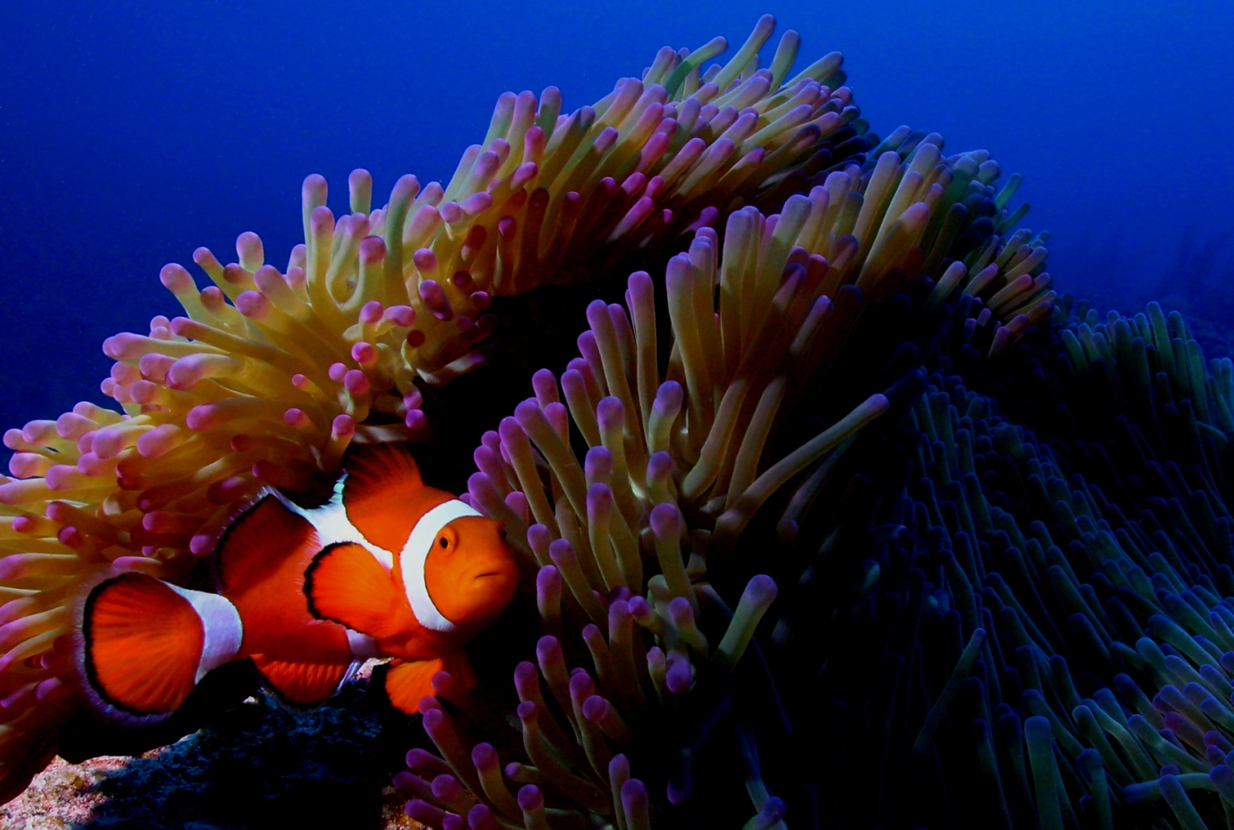
I’m a clown fish.
I live in a coral reef.
Notes:
I eat algae, plankton, and crustaceans I live in the tentacles of the sea anemone, which is poisonous to most fish so it keeps my predators away. My food would harm the anemone if I didn't eat it and it keeps me safe in return - this is called symbiosis.

Slide 9
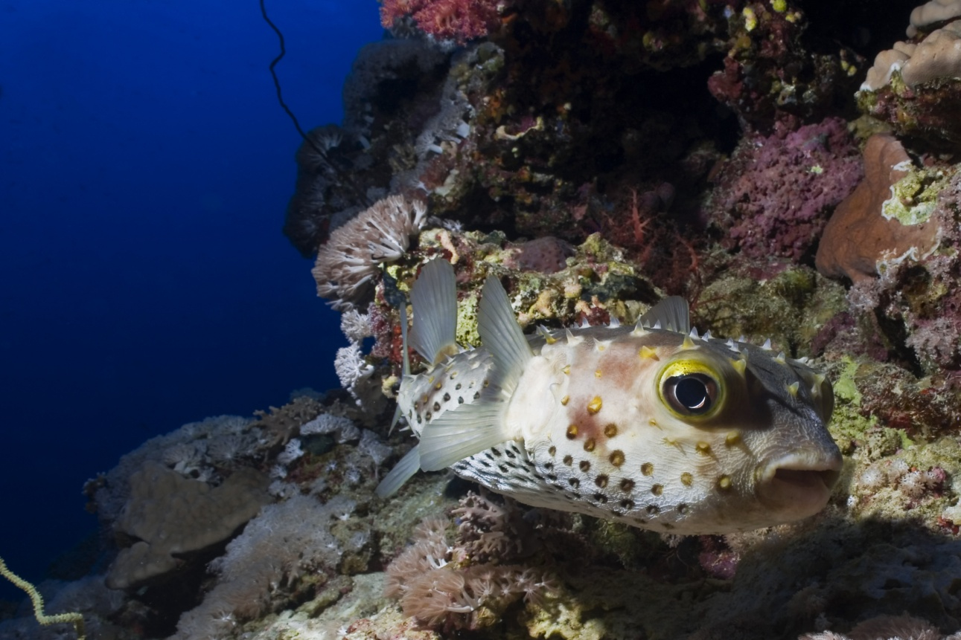
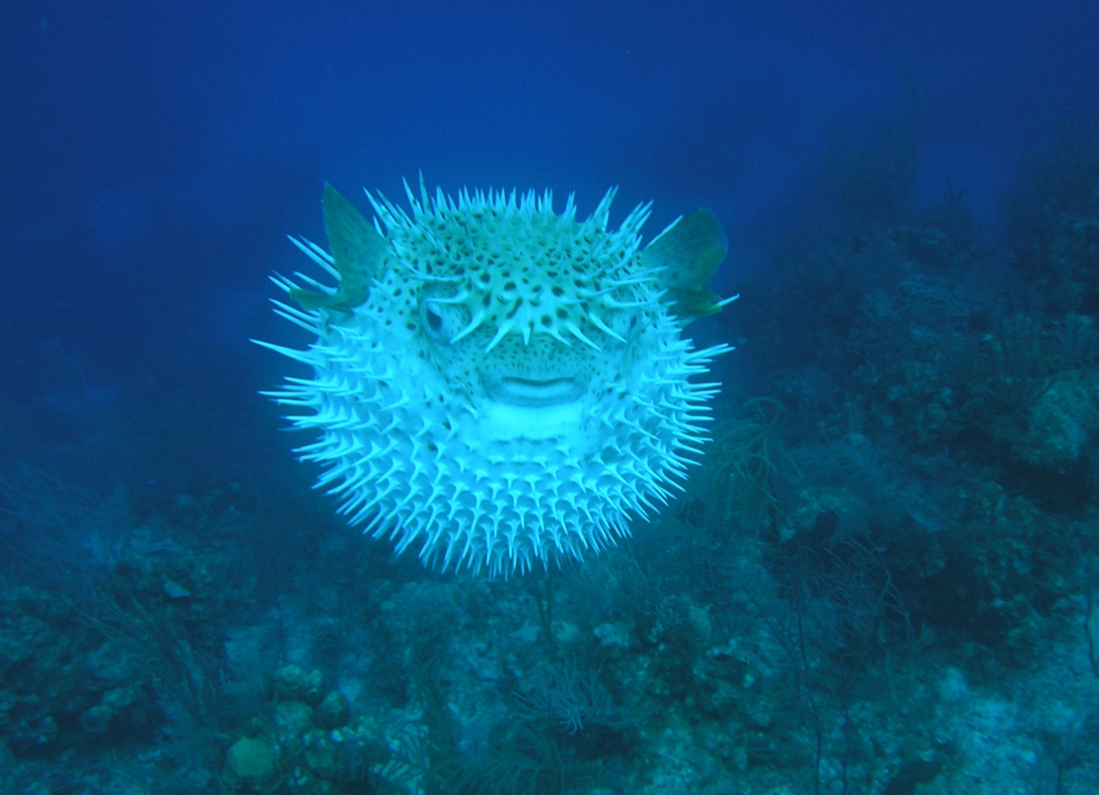
I’m a spiny puffer fish.
I live in a coral reef.
Notes:
I eat crustaceans and mollusks. I crush their shells with my four big teeth. When I feel threatened, I puff up to about twice my normal size by up gulping water. Also, I am the second most poisonous animal with a spine on earth.

Slide 10
Thanks for listening!
What do you know about your favorite coral reef animal?

