Slide 1
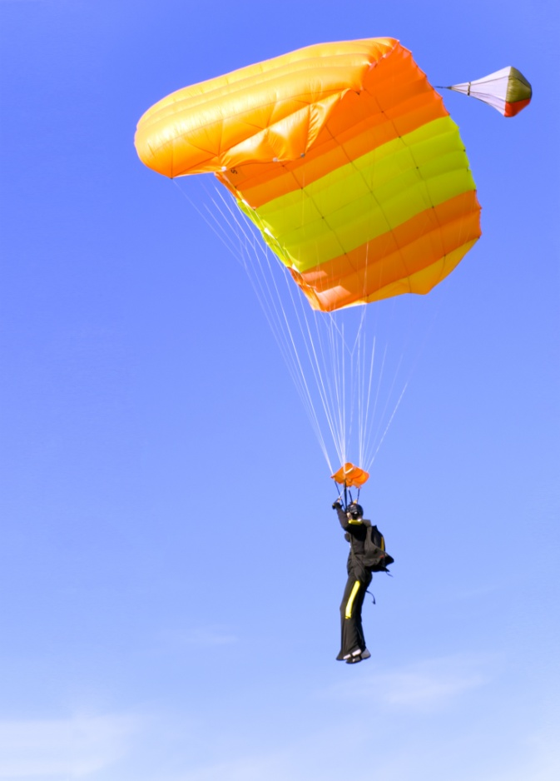
Prefixes and Suffixes
re-
-s
-ing
un-
-er
Animals
Kindergarten
Lesson 18 - Text Mapping
-ed
Notes:
Today’s lesson is about prefixes and suffixes. Are you ready?

Slide 2
He is jumping.
Notes:
Our language is very flexible. That means we can do many things with the words we say. I could say, he is jumping. That would tell me what he’s doing now.

Slide 3
He jumped.
Notes:
If I talked about what he did yesterday, I could also say that yesterday, he jumped. I changed the ‘is jumping’ to ‘jumped.’ Do you hear the difference? Jumping to jumped? That’s cool, huh?

Slide 4
He is a jumper.
Notes:
If I wanted to talk about what kind of a person he is, I could say that he is a jumper. I changed the ‘jumped’ to ‘jumper.’ Do you hear the difference? Jumped to jumper? That’s cool, huh?

Slide 5
2
Here are two jumpers.
Notes:
But what if there were more than one jumper? I could say that here are two jumpers. I changed the ‘jumper’ to ‘jumpers.’ Do you hear the difference? Jumper to jumpers?

Slide 6
Notes:
Now let’s see if you can tell me… what is happening?

Slide 7
He is jumping.
Notes:
He is jumping. Yes, he is.

Slide 8
Notes:
See the back arrow? What he did he do yesterday?

Slide 9
He jumped.
Notes:
Right. Yesterday, he jumped.

Slide 10
Notes:
See the person? What kind of a person is he is?

Slide 11
He is a jumper.
Notes:
He’s a jumper. He jumps so he is a parachute jumper.

Slide 12
2
Notes:
How many are there?

Slide 13
2
Here are two jumpers.
Notes:
There are two jumpers. We put a /s/ sound on the end the end of jumper to tell us there is more than one jumper.

Slide 14
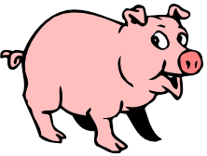
Prefixes
= not
un
un
=
Notes:
There are other ways we can change words in our language. There are tiny parts of words called prefixes. If we put the tiny part of a word UN in front of a word, it means NOT. Here is a clean pig. If I put the word part UN in front of clean, I get the word unclean. Unclean is another word for not clean. An Unclean pig is dirty.

Slide 15
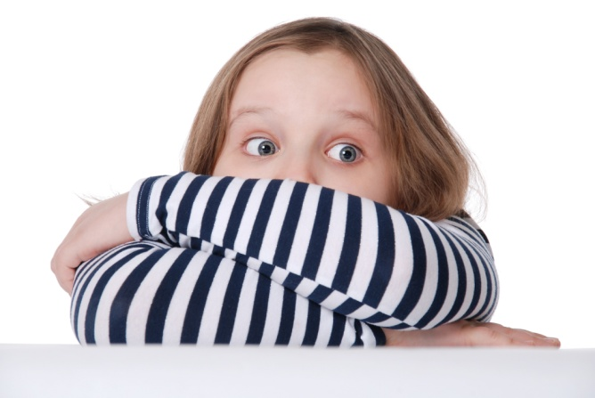
Prefixes
un = not
un
Notes:
Remember un means not. This girl looks afraid. But when we put the UN in front of afraid, what word do we say—un afraid, or unafraid. It means NOT afraid.

Slide 16
Prefixes
un
not afraid
Notes:
unafraid, or not afraid means that she’s not afraid if she’s unafraid.

Slide 17
Prefixes
re
= again
re
Notes:
There’s another prefix or small word part that we can use, re. Re means again. Here’s a circle or cycle. If we re cycle, what word to we get?

Slide 18
Prefixes
re
Notes:
Right recycle. We cycle things over again. We turn in our cans and bottles and they’re made again into new things.

Slide 19
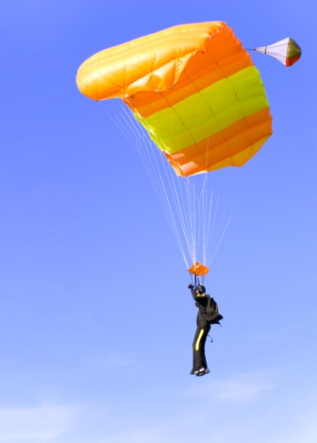
Prefixes and Suffixes Game
He is jumping.
He jumped.
Notes:
Now it’s time to play a game with our words. You’ll pick up a card and say a sentence. If the card has a picture, you’ll tell what is happening, like ‘he is jumping.’ If the card has a backward arrow, you’ll say a sentence about what happened yesterday, like ‘he jumped out of a plane yesterday.’

Slide 20
Prefixes and Suffixes Game
He is a jumper.
2
There are two jumpers.
Notes:
If the card has a person on it, you’ll say what the person is called, like ‘he is a jumper.’ If the card has a number on it, you’ll say how many people there are.

Slide 21
Prefixes and Suffixes Game
un + = ?
re + = ?
Notes:
If the card has an UN or a RE on it with a picture, you’ll say what the word is, like unclean or recycle. Then you’ll get to move on the game board. And maybe you’ll get all the way around. But if you use all of these words, you’ll be a winner every time! Good luck playing the prefixes and suffixes game!

