Slide 1

Fiction and Nonfiction
Animals – Kindergarten
Lesson 10 – Text Mapping
Notes:
Today we’re going to talk about two kinds of books, fiction and nonfiction books. Do you know the difference?

Slide 2
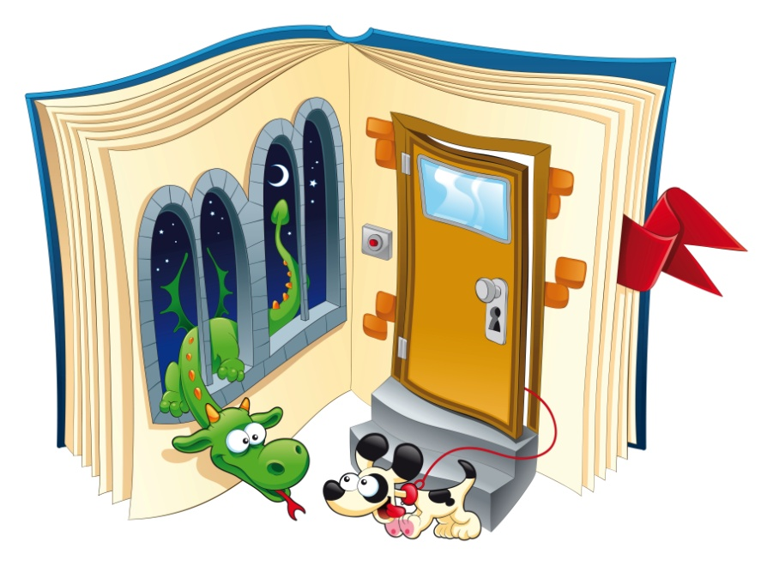
Fiction…
Tells a story that
isn’t true
Uses make-believe
and magic
Is very imaginative
Usually has illustrations that are not realistic
Includes animals
that talk
Notes:
In fiction books, authors write stories that they make up; the stories aren’t true. These stories may use make-believe and magic; they use the author’s imagination. Usually the illustrations are like cartoons—they are very imaginative and may not look like the real thing. In fiction books, animals can talk and do things that real animals can’t do.

Slide 3

Nonfiction…
Is true
Includes facts and
information
Tells about
things that really happened
Contains many photographs
or realistic drawings
Notes:
Nonfiction books are true-to-life. They tell you facts or include information about the topic. Nonfiction books tell about things that really happen or happened. Nonfiction books contain photographs or drawing that look like the real thing.

Slide 4
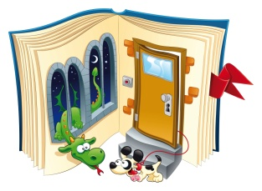
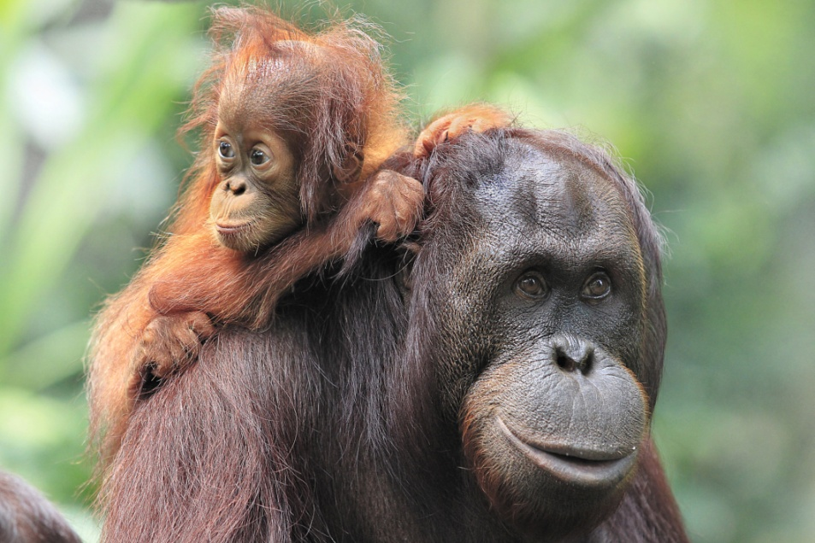

Fiction or Nonfiction?
The mother orangutan carries her baby on
her back.
Fiction
Nonfiction
Notes:
Now we’re going to see if we can figure out what comes from a fiction book and what comes from a nonfiction book. We’ll look at the big picture and read the words. Then we’ll choose either the storybook picture if we think the selection comes from a fiction book, or the girl reading a nonfiction book if we think it comes from a nonfiction book. Let’s look at this picture of an orangutan. The book says, “The mother orangutan carries her baby on her back.” Would that come from a fiction book or a nonfiction book? Choose either the storybook or the nonfiction book.

Slide 5
CORRECT!
Notes:
CORRECT!

Slide 6

TRY AGAIN…
Notes:
Sorry, try again..

Slide 7
Fiction or Nonfiction?
“A rattlesnake’s eyesight is very good. Its sense of smell is excellent. Rattlesnakes have no ears. They hear with their entire body.”
Fiction
Nonfiction

Slide 8
CORRECT!

Slide 9
TRY AGAIN…

Slide 10
Fiction or Nonfiction?
“Every day the selfish crocodile shouted to the creatures of the forest, ‘Stay away from the river! It’s MY river! If you come into my river, I’ll eat you up!’”
Fiction
Nonfiction

Slide 11
CORRECT!

Slide 12
TRY AGAIN…

Slide 13
Fiction or Nonfiction?
Tree snakes have ridges on their belly to help them grip onto the branches.
Tree frogs have large, sticky suckers under their toes.
Fiction
Nonfiction
Notes:
How about this selection… tree snakes have ridges on their belly to help them grip onto the branches. Tree frogs have large, sticky suckers under their toes. Fiction or nonfiction?

Slide 14
CORRECT!

Slide 15
TRY AGAIN…

Slide 16

Fiction or Nonfiction?
I am a prince, not a frog.
Fiction
Nonfiction
Notes:
Here’s another one for you. This book says, I am a prince, not a frog. Fiction or nonfiction?

Slide 17
CORRECT!

Slide 18
TRY AGAIN…

Slide 19
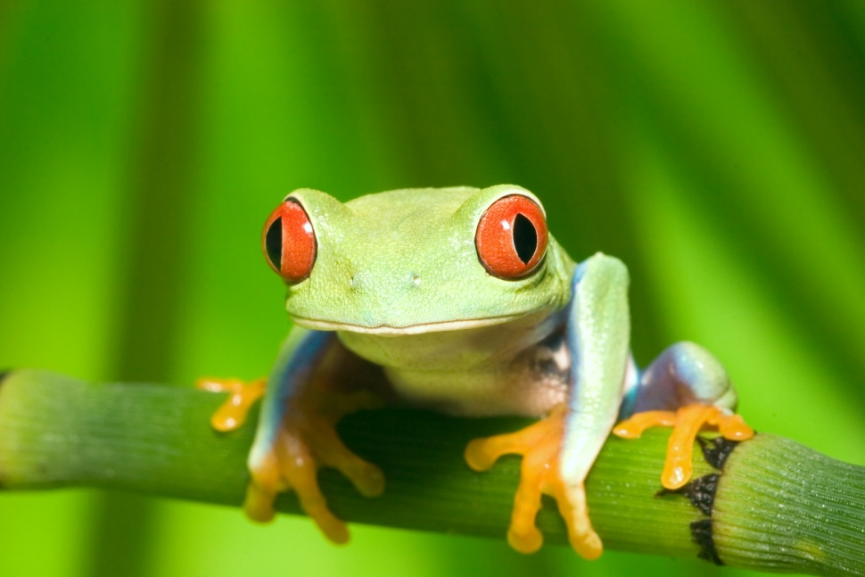
Fiction or Nonfiction?
Green tree frogs feed on insects.
Fiction
Nonfiction
Notes:
How about this one? The book says, Green tree frogs feed on insects. Fiction or nonfiction?

Slide 20
CORRECT!

Slide 21
TRY AGAIN…

Slide 22

Awesome job, friends!
Notes:
What an awesome job you did today! Would this monkey be in a fiction or nonfiction book?

