Slide 1
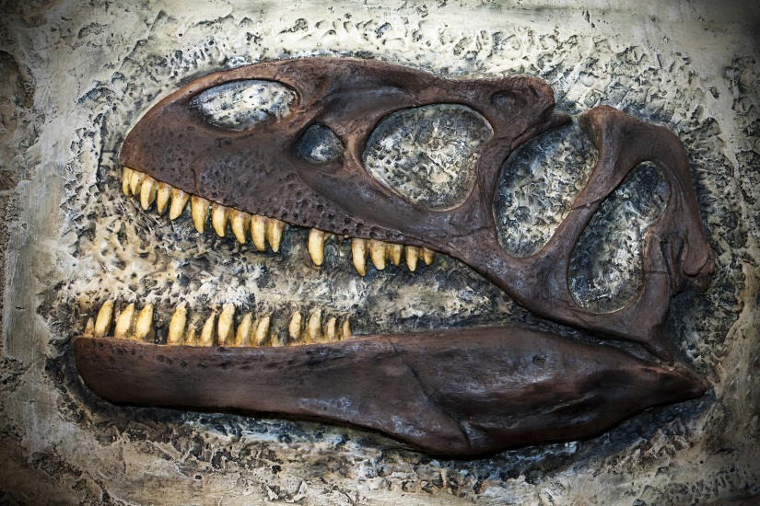

FOSSILS
Earth Materials – Kindergarten
Lesson 1 – Hook
Notes:
Today we are starting a new unit. We are going to learn all about fossils.

Slide 2
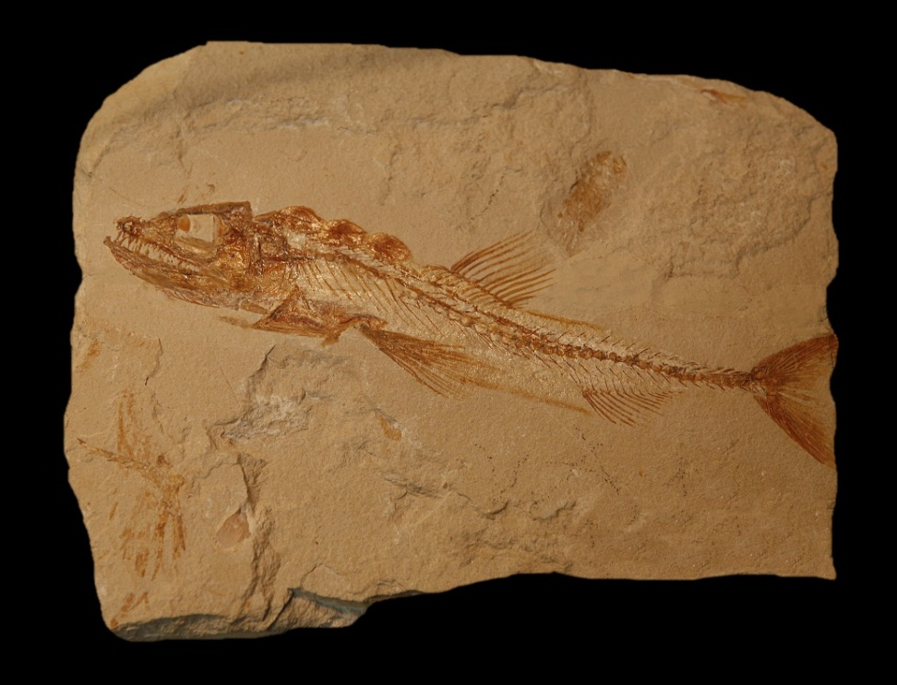
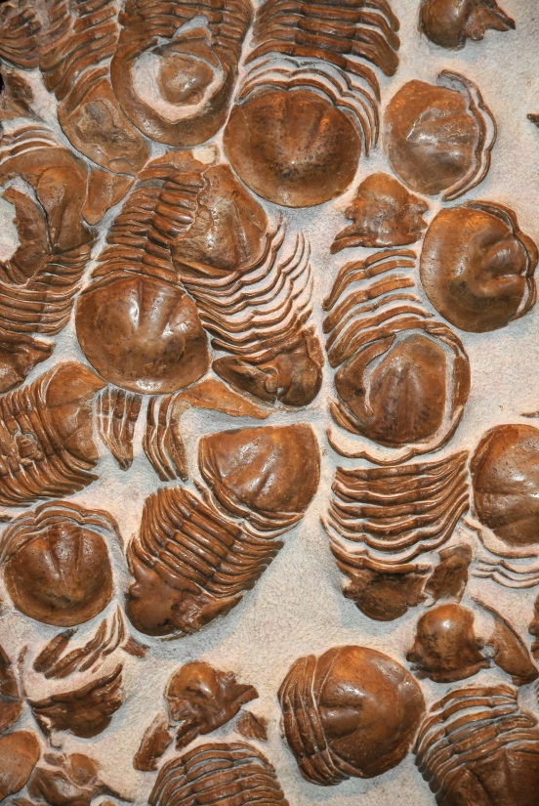
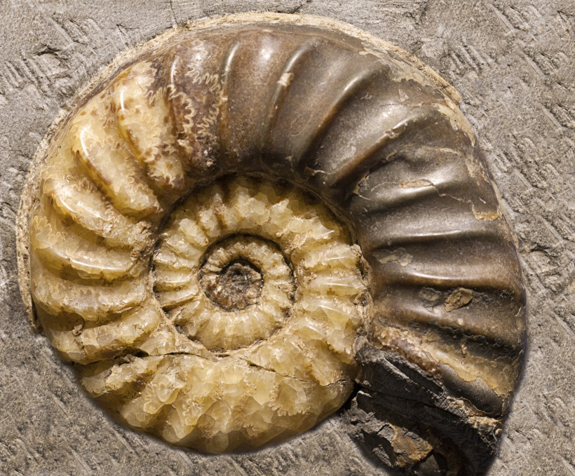
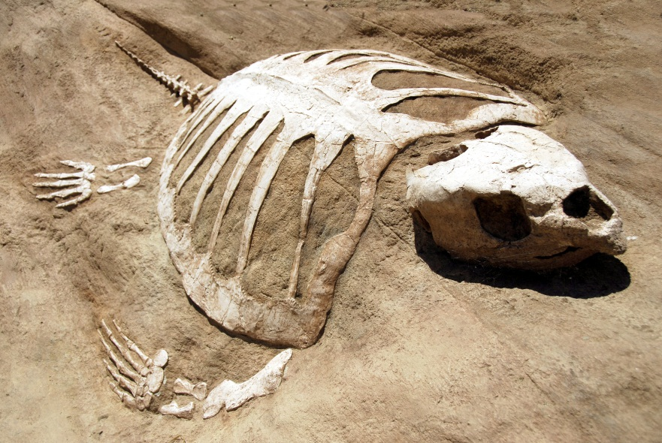
Notes:
There are many types of fossils. Look at all of these different kinds of fossils. Fossils can come from plants or animals that died thousands and even millions of years ago.

Slide 3
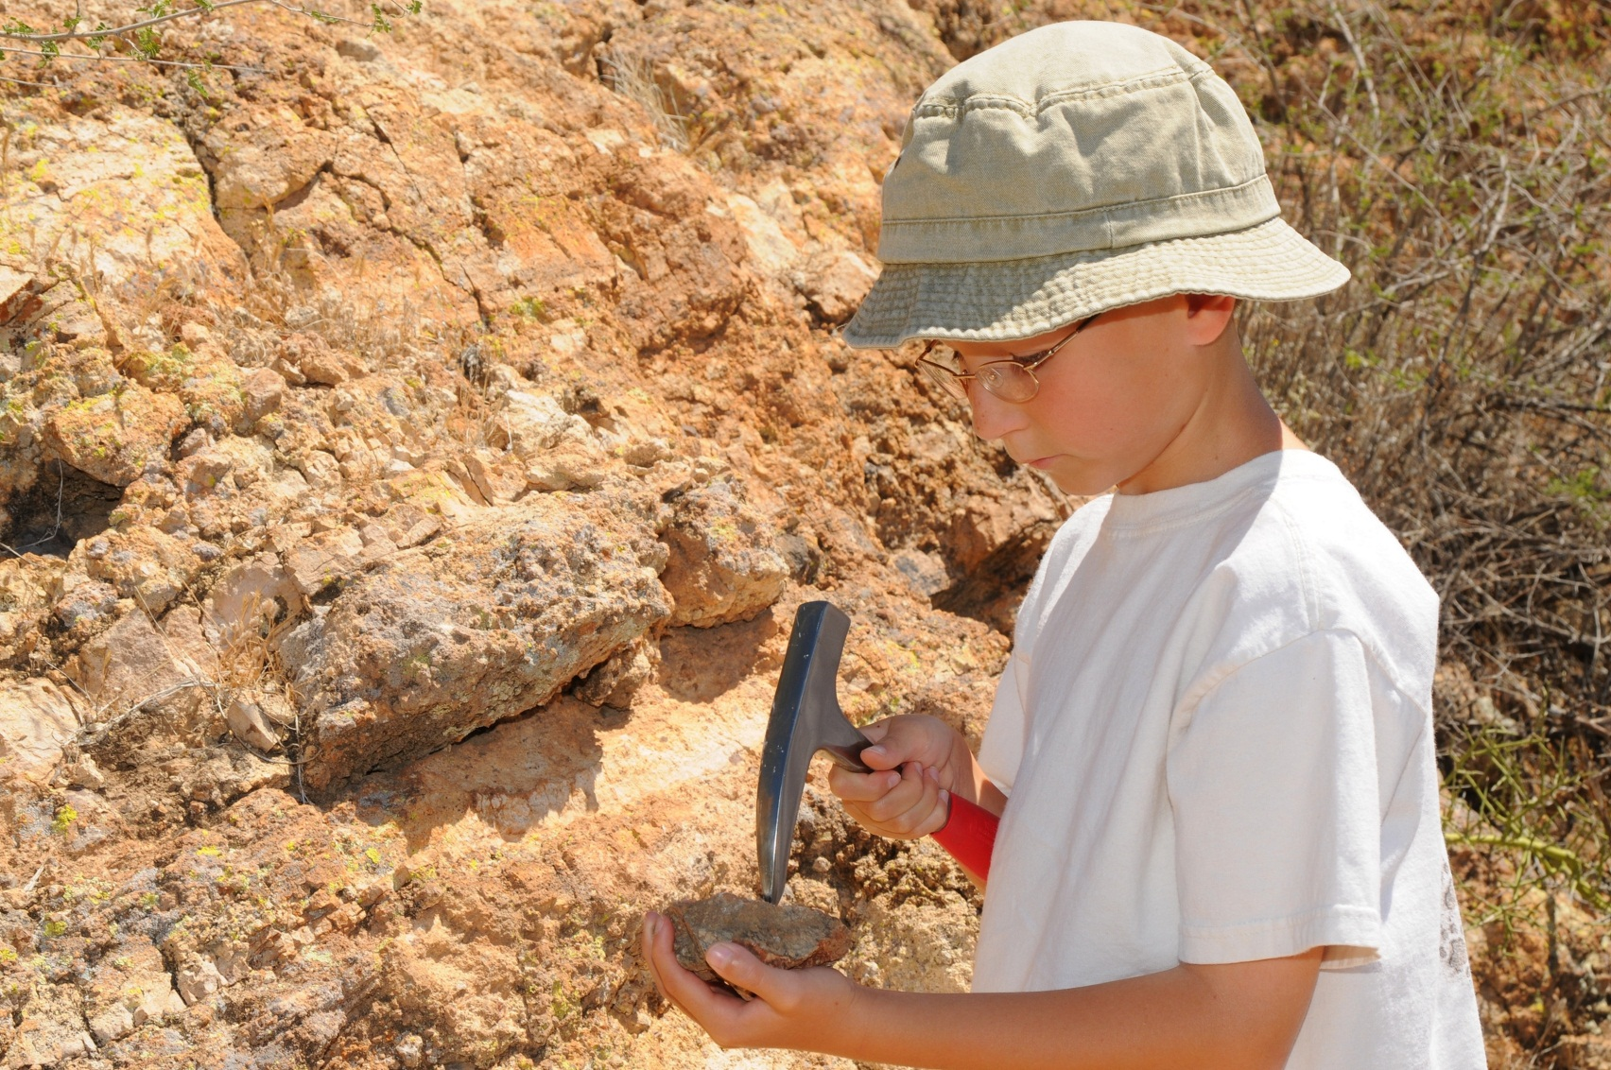
Notes:
This is a paleontologist. A paleontologist is someone who collects and studies fossils. Many times fossils are hidden in rocks. Paleontologists use a special hammer to chip away the rock. Once they find the fossil, the paleontologist must describe it. These descriptions help them decide what animal or plant they once were.

Slide 4
Notes:
Let’s be paleontologists and describe some fossils.

Slide 5
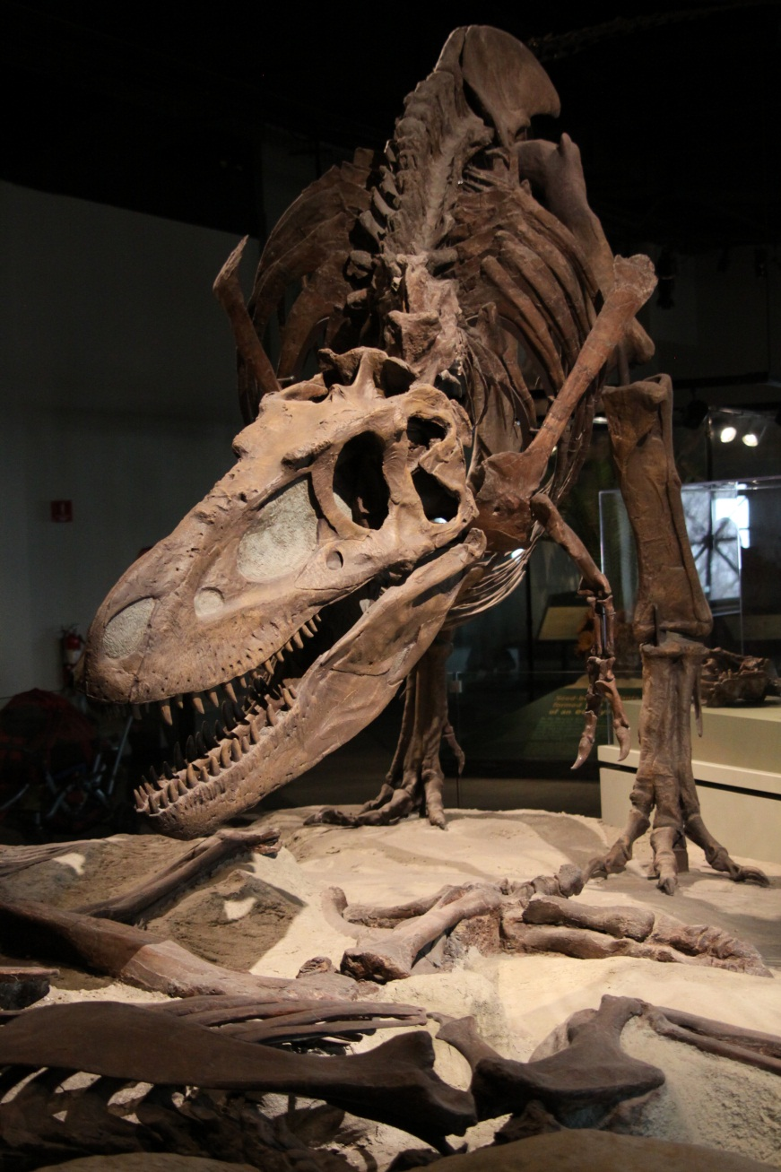
large
body
powerful
legs
short
arms
sharp teeth
Notes:
Fossils can be very large. This is a fossil of a dinosaur. Lets describe this fossil! He has sharp teeth, short arms, a large body and powerful legs.

Slide 6
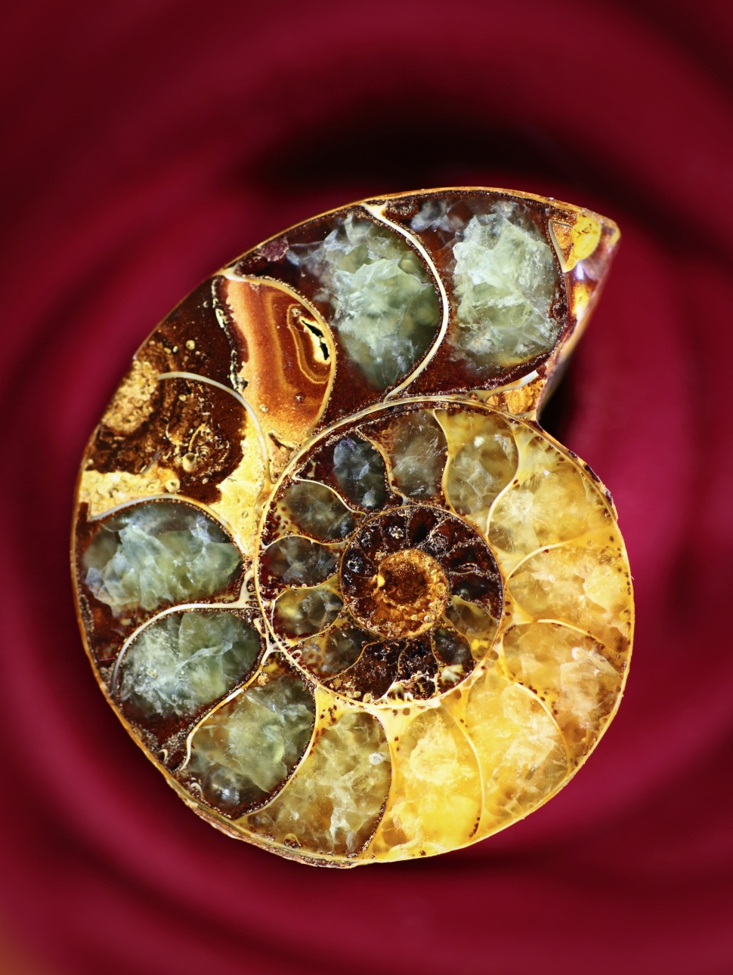
spiral shaped
colorful crystals
hardened shell
Notes:
Fossils can be very small. This fossil is spiral shaped, has a hardened shell and colorful crystals inside its shell.

Slide 7
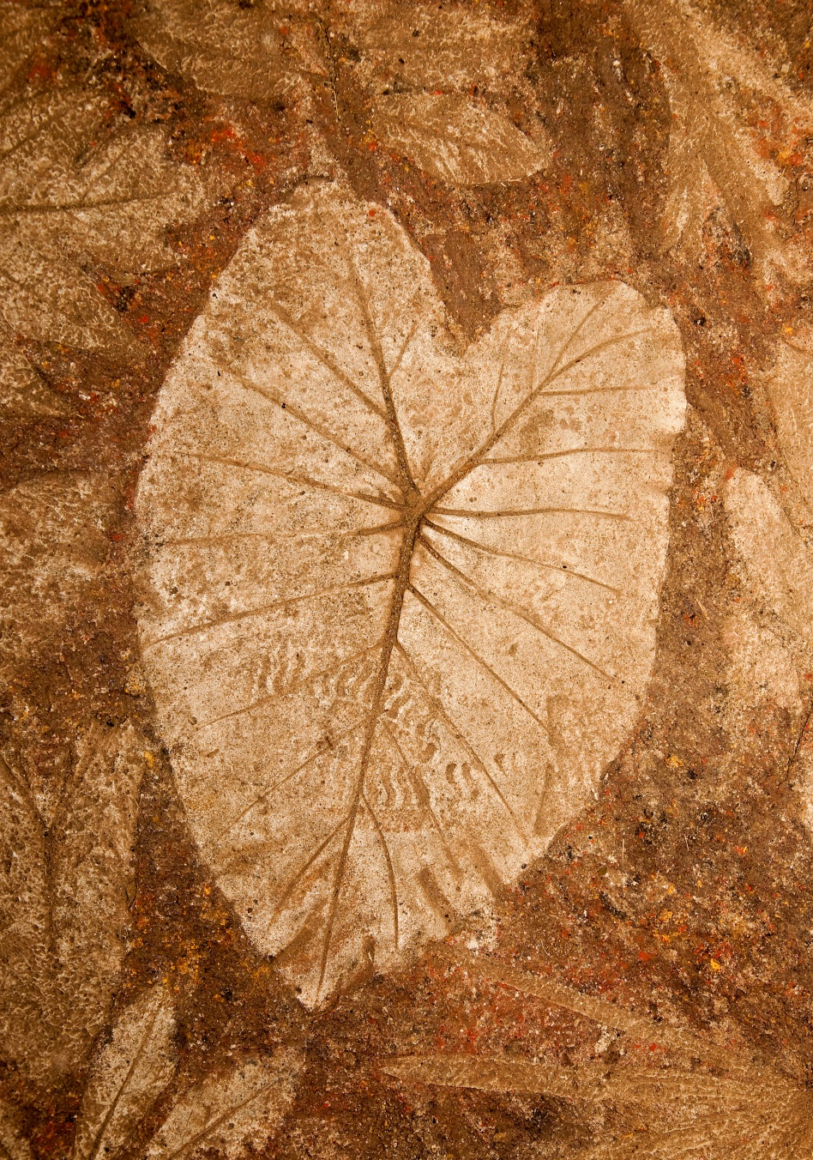
branched
veins
scalloped edges
light
colored
fossil
small animal
Notes:
This is an imprint or copy of a leaf. There is a very small animal fossil imprint on the bottom area. Can you see it? Let’s describe this fossil. It has branched veins, scalloped edges, has a small animal imprint and is light colored

Slide 8
Now it’s
your turn.
Can you describe
the next few fossils?

Slide 9
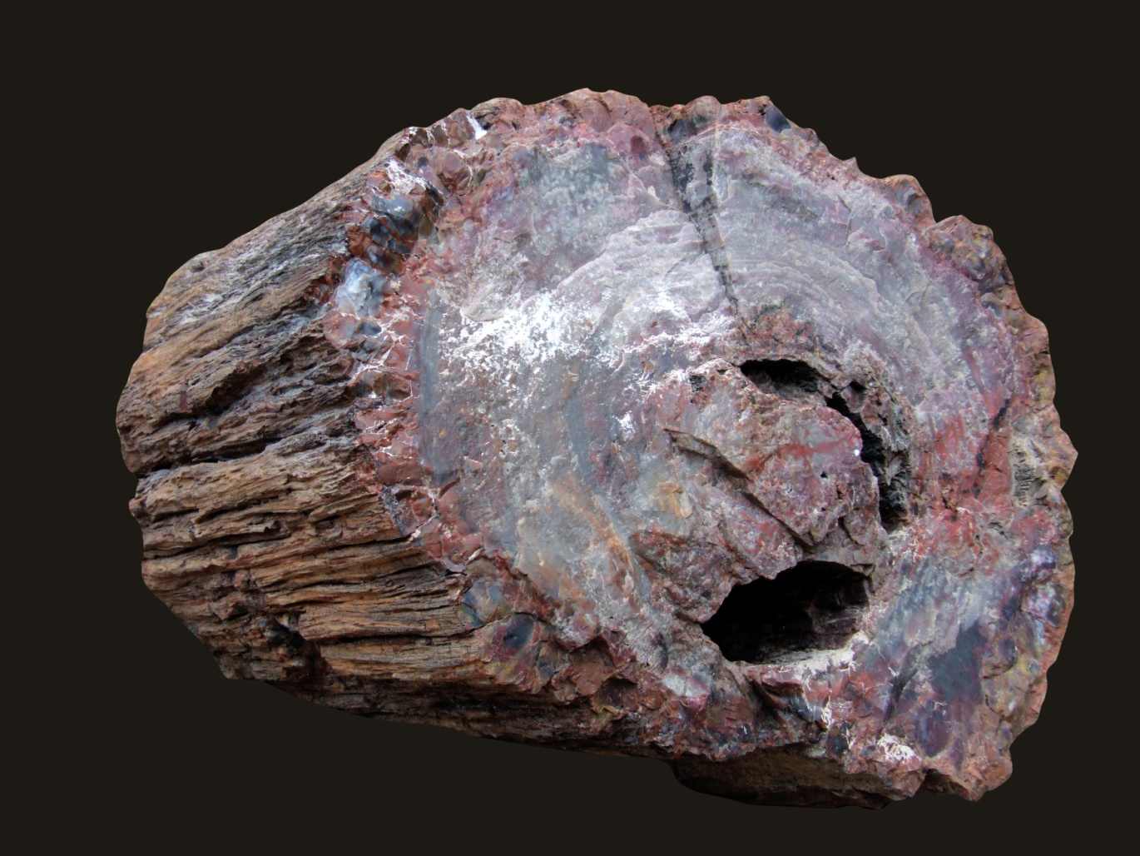

Slide 10
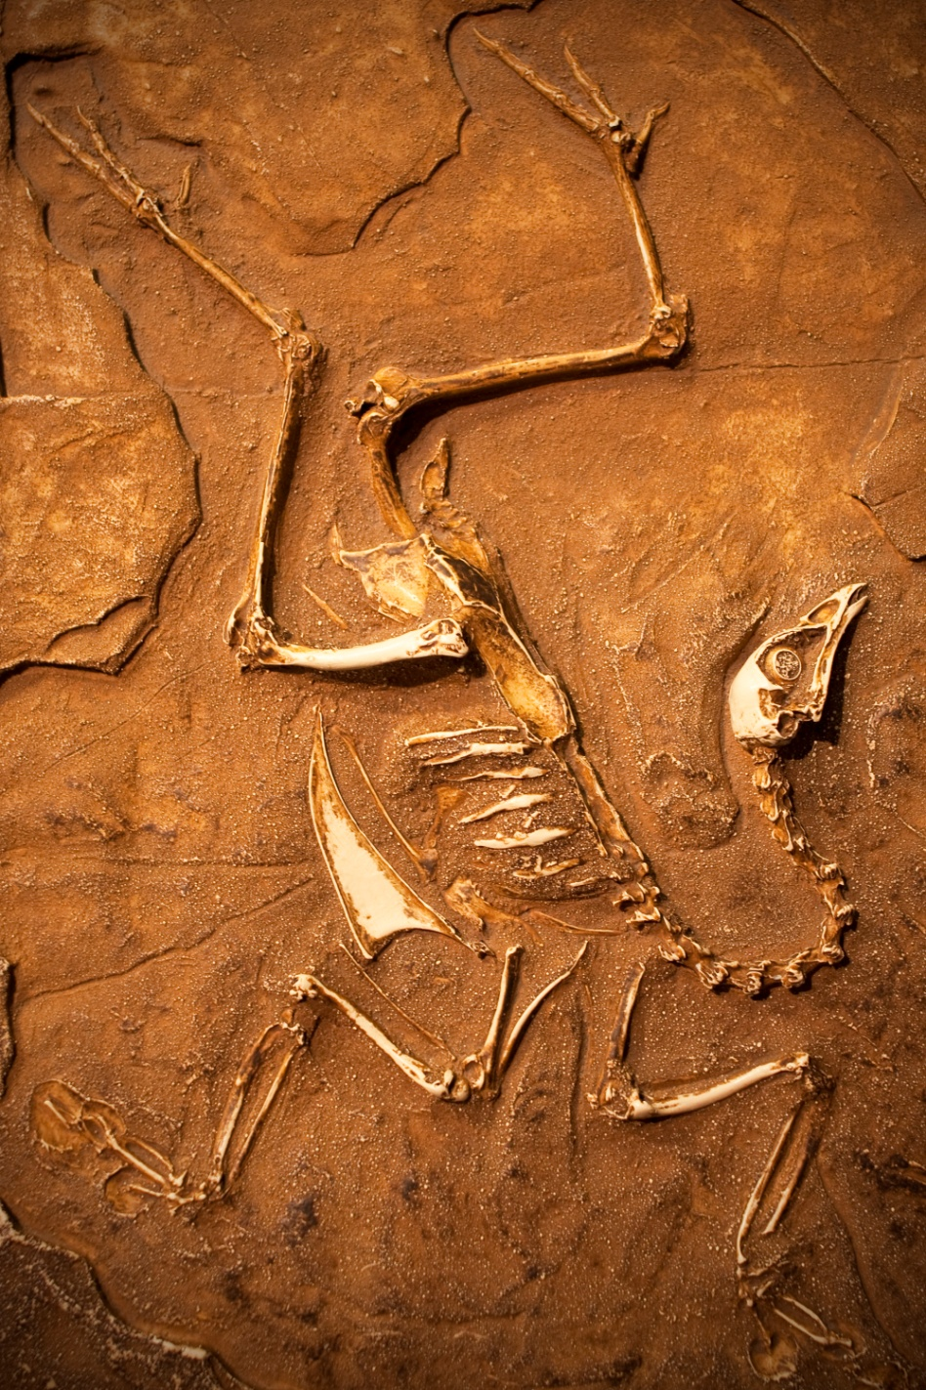

Slide 11
