Slide 1






Inferencing
Earth Materials ─ Grade 2
Integration ─ Lesson 7

Slide 2
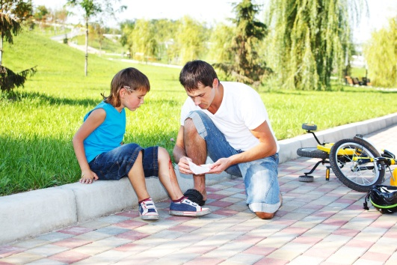

What I know…
What I can infer…
To infer means to look at the evidence and use what you know find a conclusion that makes sense.
What the book says…
What I know…
What I can infer…
Rocks and soil are nonliving.

Slide 3
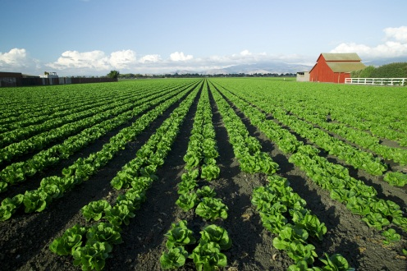
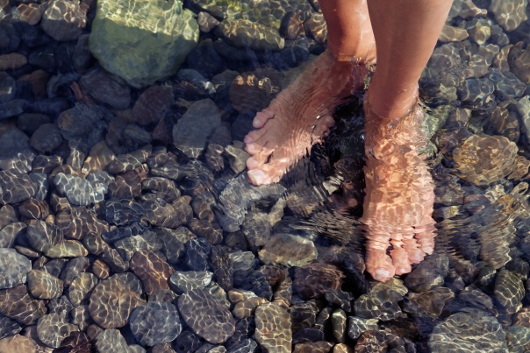
What the book says…
What I know…
What I can infer…
Chalk is not a good soil for growing plants.
There is a thick layer of rock all over Earth’s surface.

Slide 4


What the book says…
What I know…
What I can infer…
Beaches are made up of sand and pieces of rock.

Slide 5

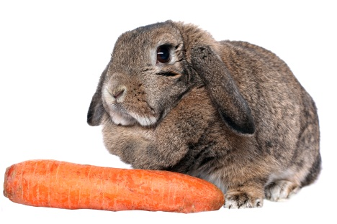
What the book says…
What I know…
What I can infer…
We use soil to grow plants for food.
I have a garden.

Slide 6
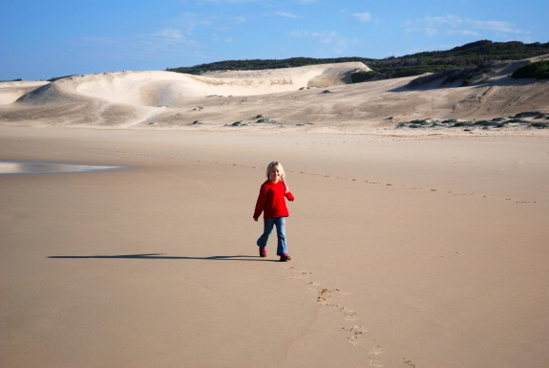
What the book says…
What I know…
What I can infer…
Beaches are made up of sand and pieces of rock.

Slide 7
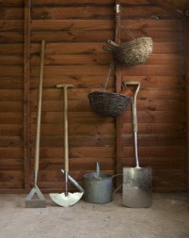


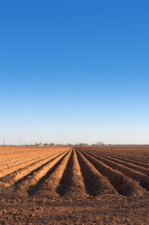
What the book says…
What I know…
What I can infer…
Tools
We use soil to grow plants for food.
Seeds
Weather
I have a garden.
Soil

