Slide 1
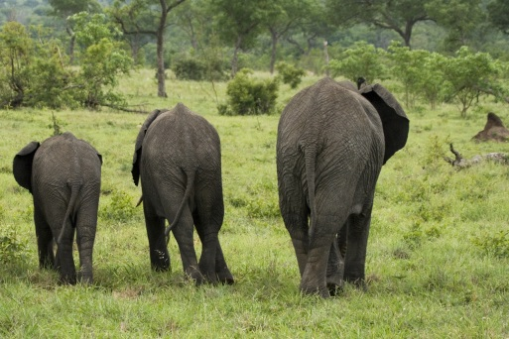
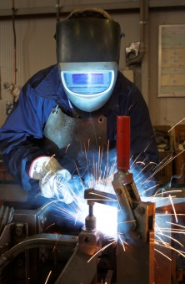
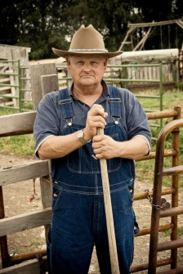
-est
-er
-est
Suffixes
Earth Materials ─ Grade 2
Text Mapping ─ Lesson 5
-er

Slide 2
bigg-est
big
bigg-er

Slide 3
tall-er
tall-est
tall

Slide 4
root word + suffix -er = one who
weld
-er
sing
-er
farm
-er

Slide 5
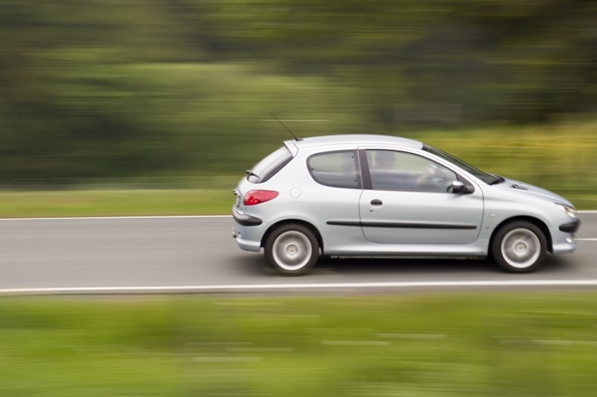
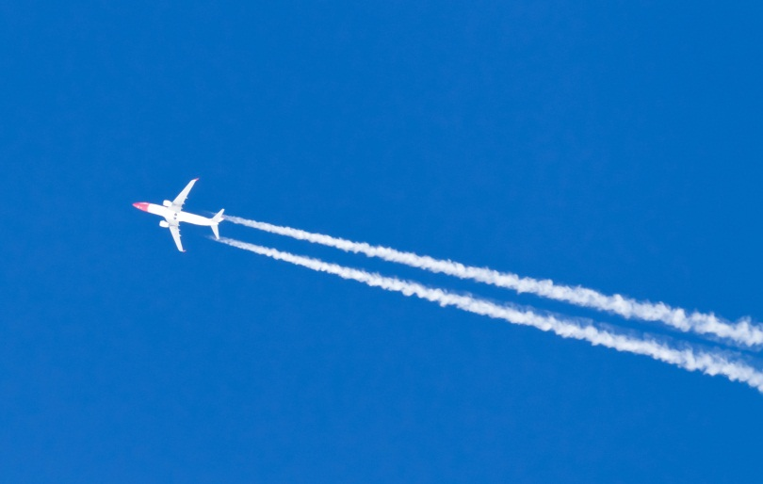
fast
fast
-er
fast
-est

Slide 6
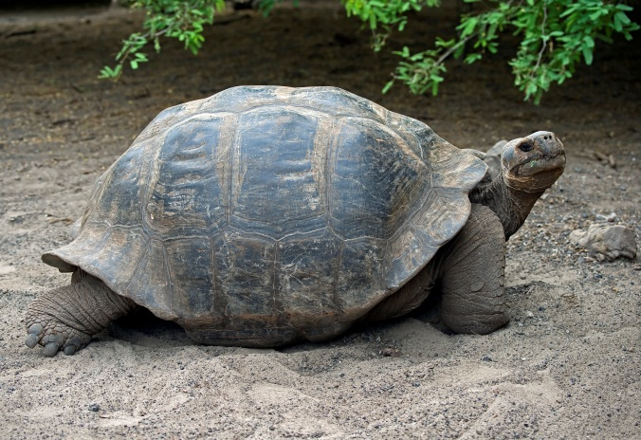
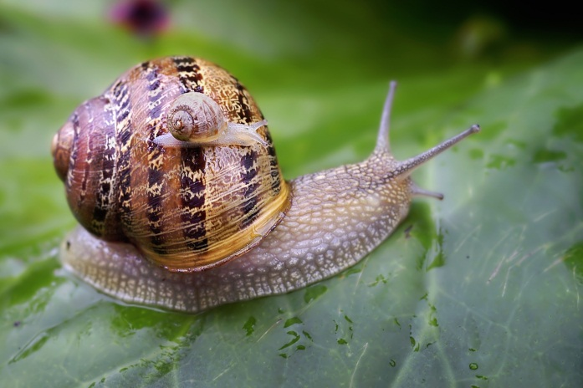
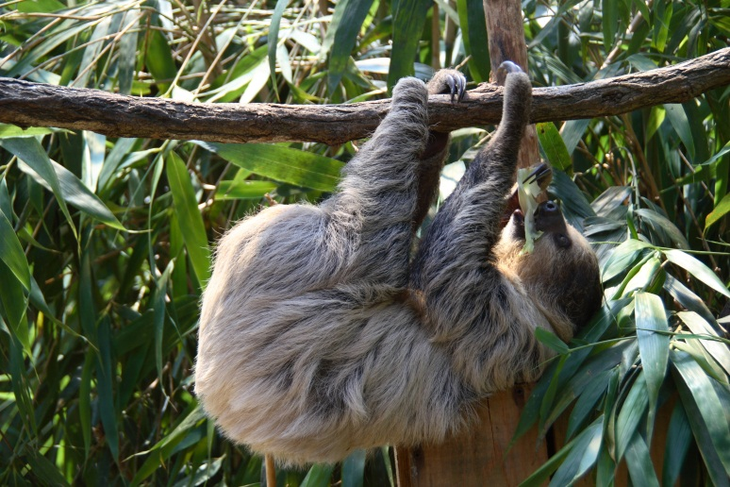
slow
slow-er
slow-est

Slide 7
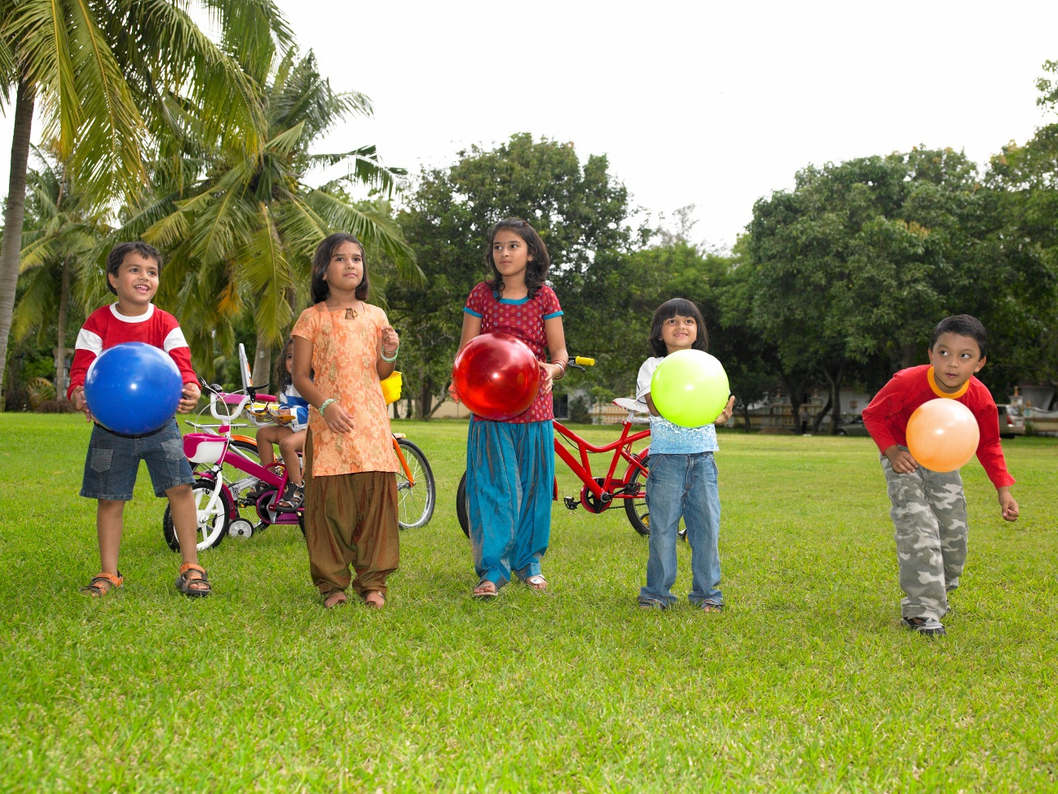
Write down as many –er and –est words you can make by looking at the picture!

