Slide 1
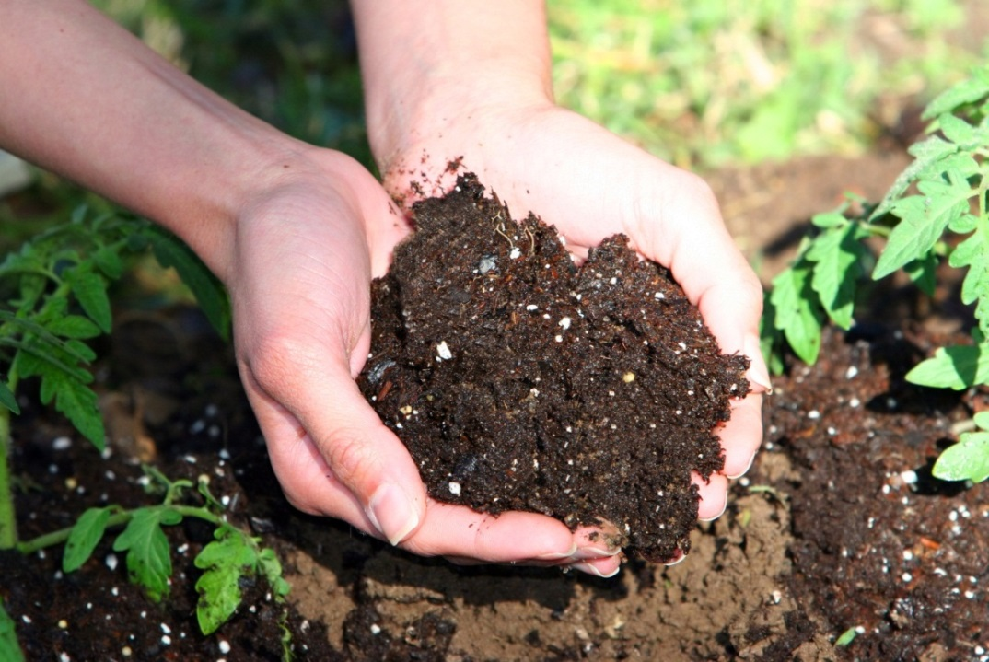

Cause and Effect
Earth Materials ─ Grade 2
Hook ─ Lesson 1

Slide 2

Have you ever wondered where soil comes from?

Slide 3
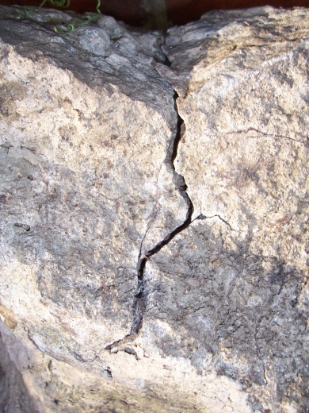

cause
effect
The sun heats up
the rock
The rock cracks

Slide 4
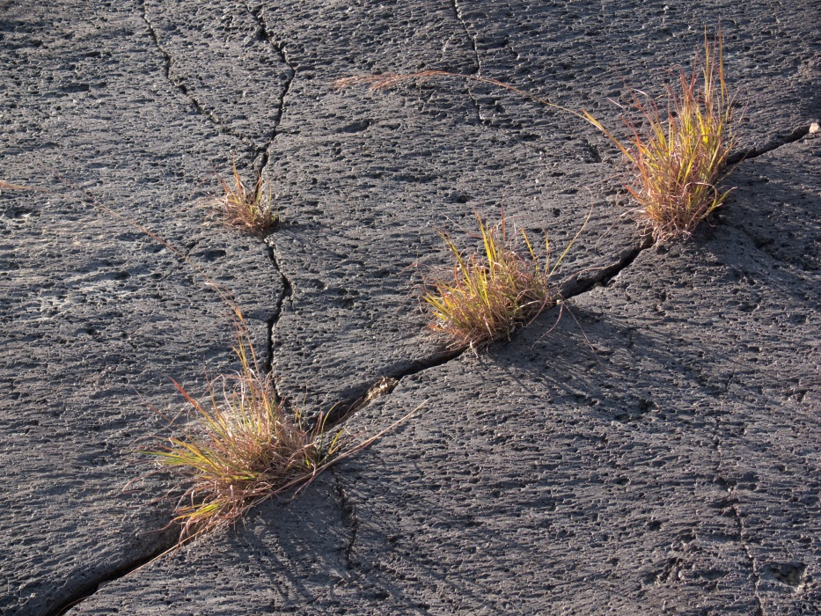
cause
effect
Pieces of the rock
are pushed further apart
Plants grow
in the
cracks

Slide 5
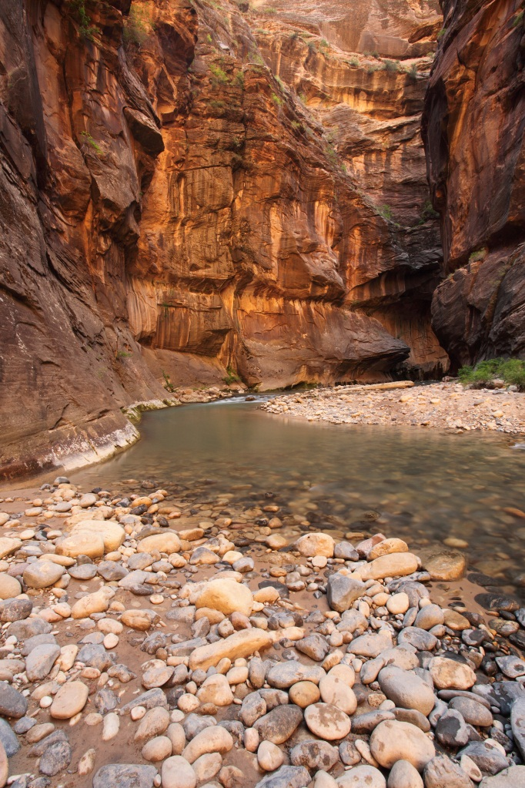
cause
effect
Water
gets
in the cracked rock
The rocks break
into small pieces

Slide 6
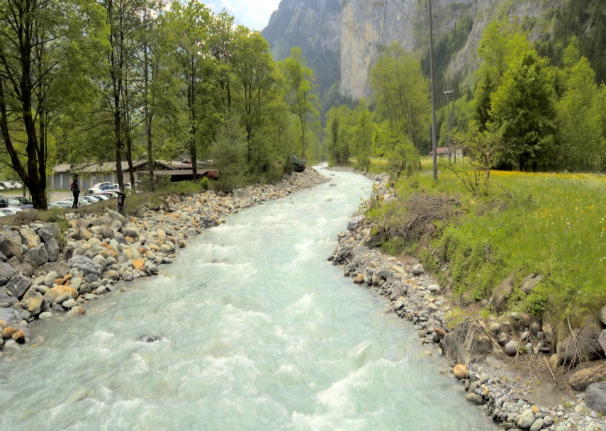
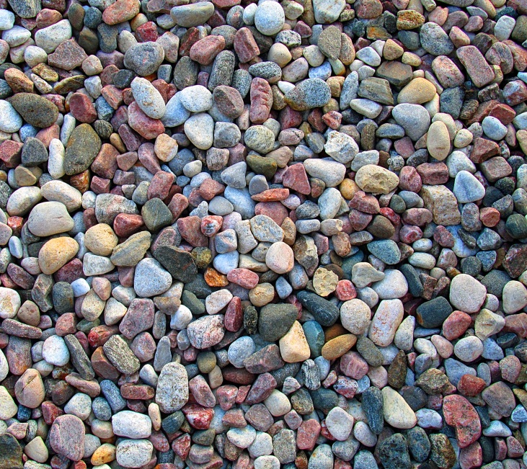
cause
effect
The rocks in the
river rub against each other
Tiny particles are formed and fall to the bottom

Slide 7

Soil is made up of tiny pieces of rock that have broken up. It is also made of pieces of plants and even tiny parts of animals.

