Slide 1
Text Structures Earth Materials ‒ Grade 2 Lesson 10 ‒ Text Mapping

Slide 2
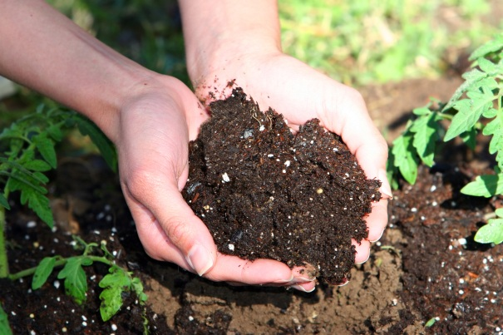
Description
Humus is dark brown or black. It contains bits of dead plants and animals.
Humus is made by bacteria. Bacteria eat dead plants and animals. They break the plants and animals into tiny pieces. The pieces become humus. Humus contains nutrients that had been inside the plants and animals.

Slide 3
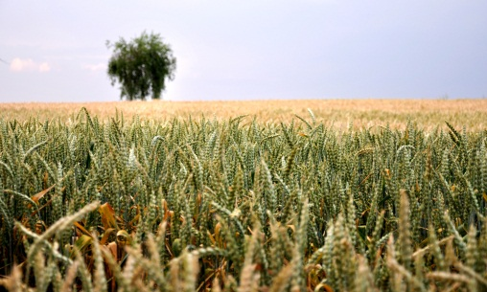
Sequence
Soil is formed from materials such as rock. First, rocks are broken into smaller pieces by wind, ice and water. Next, rushing water makes rocks roll and tumble, breaking into smaller pieces.
Then, small particles of rock and humus begin to pile up and finally, soil is formed.

Slide 4
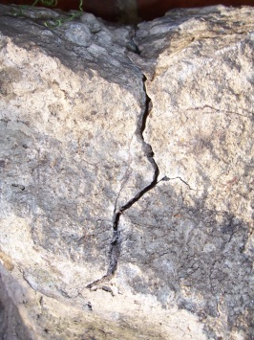
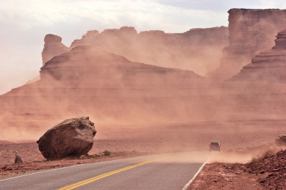
Compare and Contrast
Rocks can be broken into particles by different forces. One way rocks break apart is by water. When water seeps into cracks in the rock, it can freeze and break the rock into pieces.
Wind can also create particles of rock. Unlike water, wind blows sand grains against big rocks. The sand scrubs off particles of rock.

Slide 5
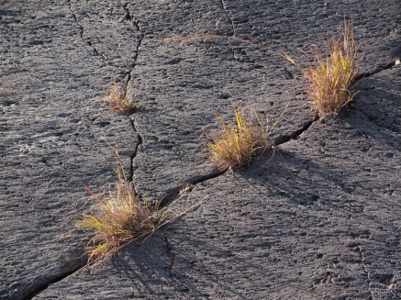
?
The sun shines on rocks and causes them to expand and crack. When the cracks form, water seeps into the cracks and freezes, so the cracks grow even larger. Small pieces of rock can break off because of plants growing in the cracks.

Slide 6
Cause and Effect
The sun shines on rocks and causes them to expand and crack. When the cracks form, water seeps into the cracks and freezes, so the cracks grow even larger. Small pieces of rock can break off because of plants growing in the cracks.

