Slide 1
Earth Materials – Grade 3
Lesson 1 – Hook

Slide 2
WHAT IS Pollution?
Pollution is any substance or object put into nature that causes negative changes. It exists in many different forms and is produced by a variety of sources.
In fact, there are four main types of pollution.
How many of them can you think of?
Where did they come from?
Who produced them?
2 of 15

Slide 3
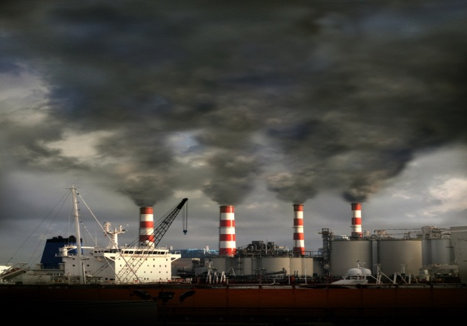
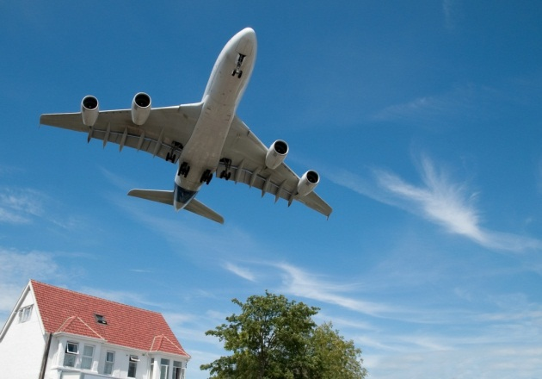
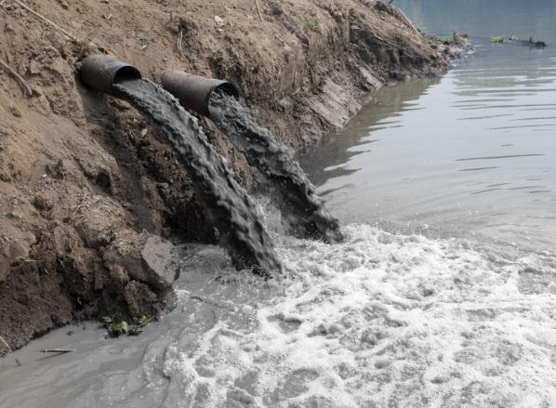
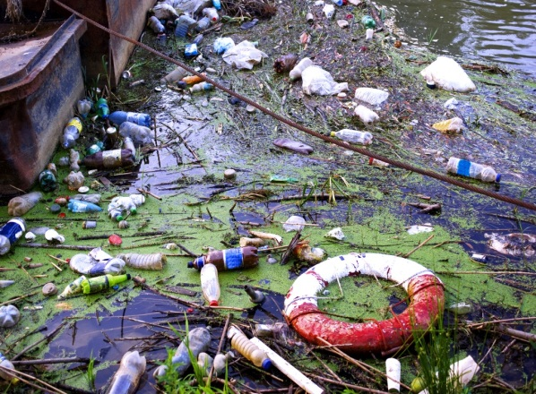
How many did you think of?
The four different types are…
Air pollution
Water pollution
Soil (also known as land) pollution
Noise pollution
3 of 15

Slide 4
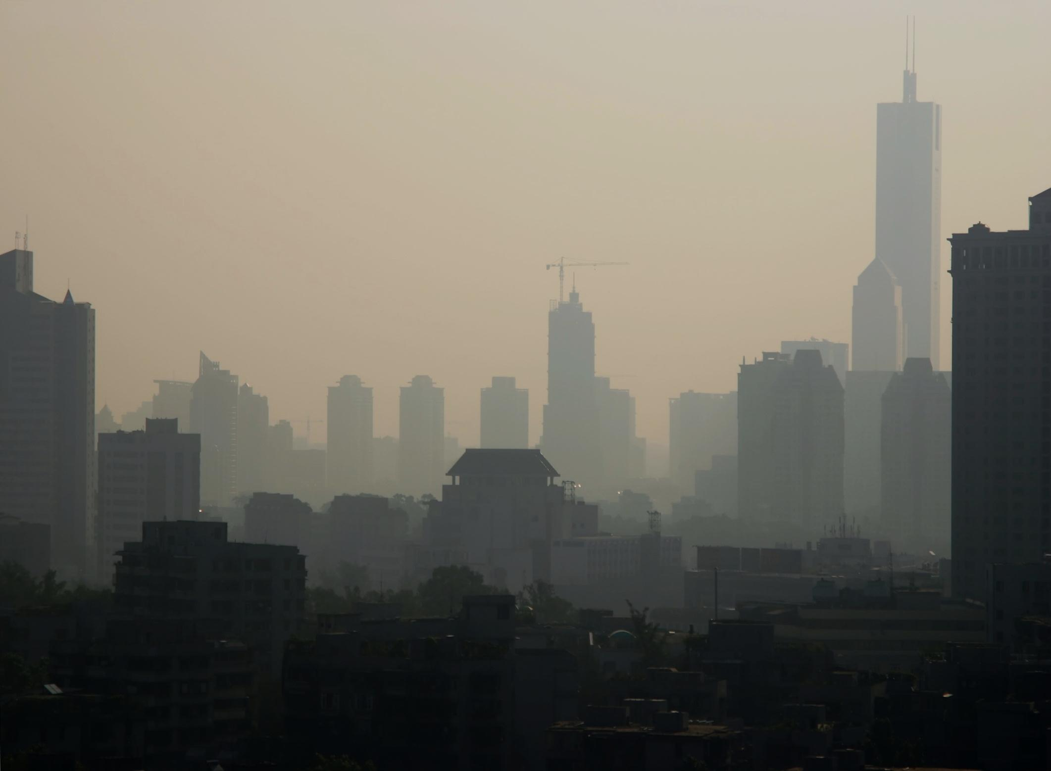
Air Pollution
Air pollution is anything that contaminates
(or dirties) the natural makeup and chemistry of the air.
It is produced by:
Manmade sources such as vehicle exhaust and building construction
Natural sources such as forest fires, volcanic eruptions and dry soil wearing away (erosion)

Slide 5
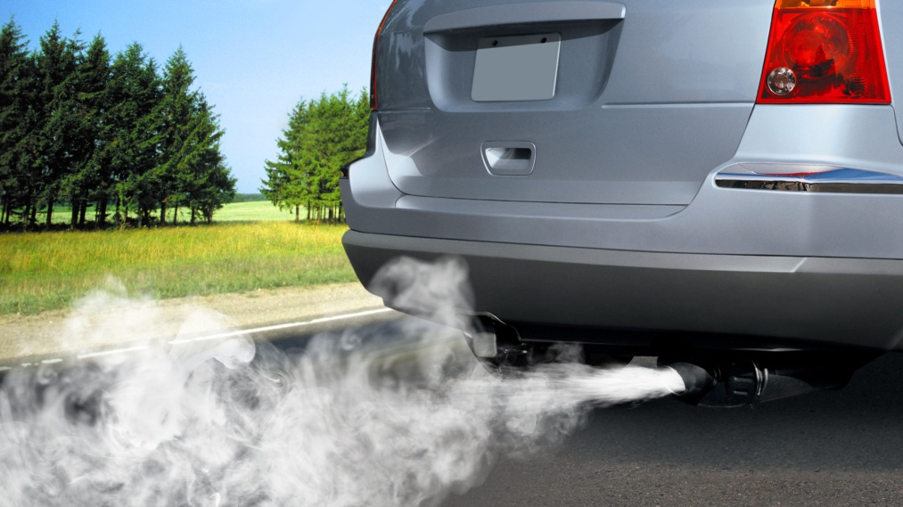
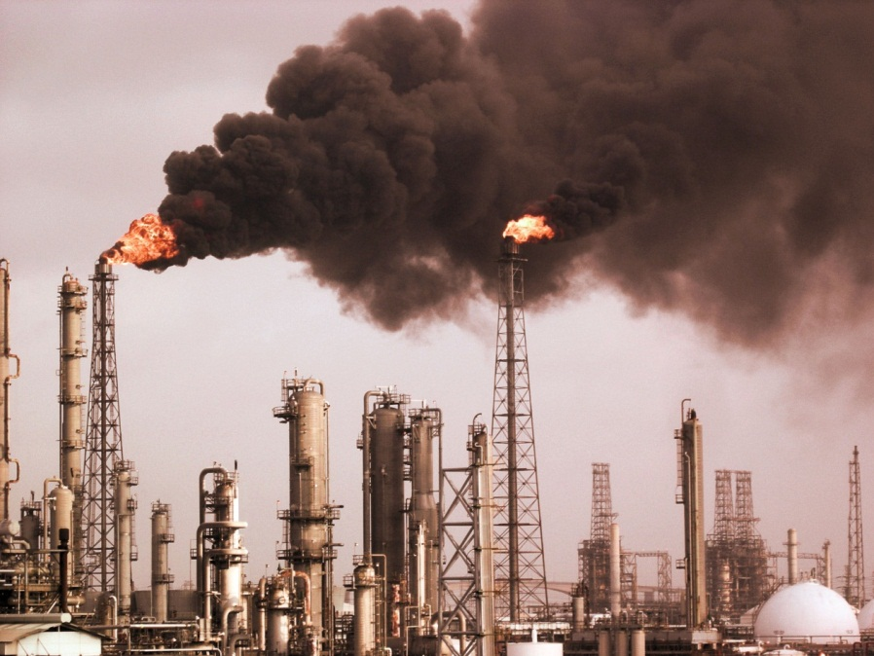
Manmade Air Pollution
Car Exhaust
Factory Smoke
Aerosol
5 of 15
Notes:
Aerosol picture needs purchased

Slide 6
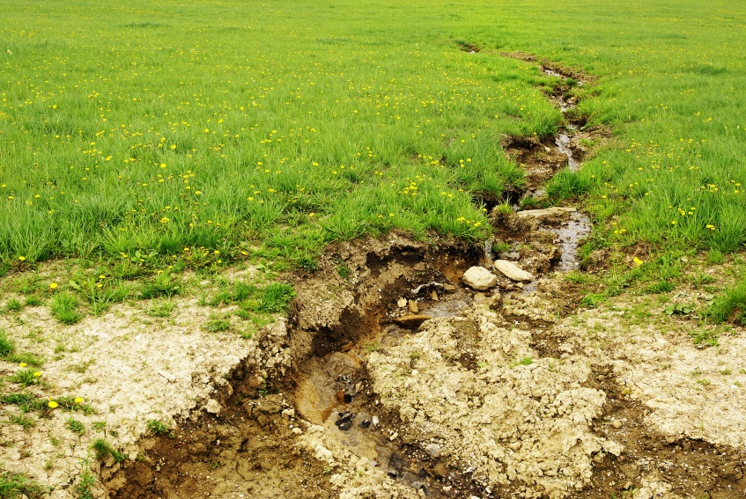
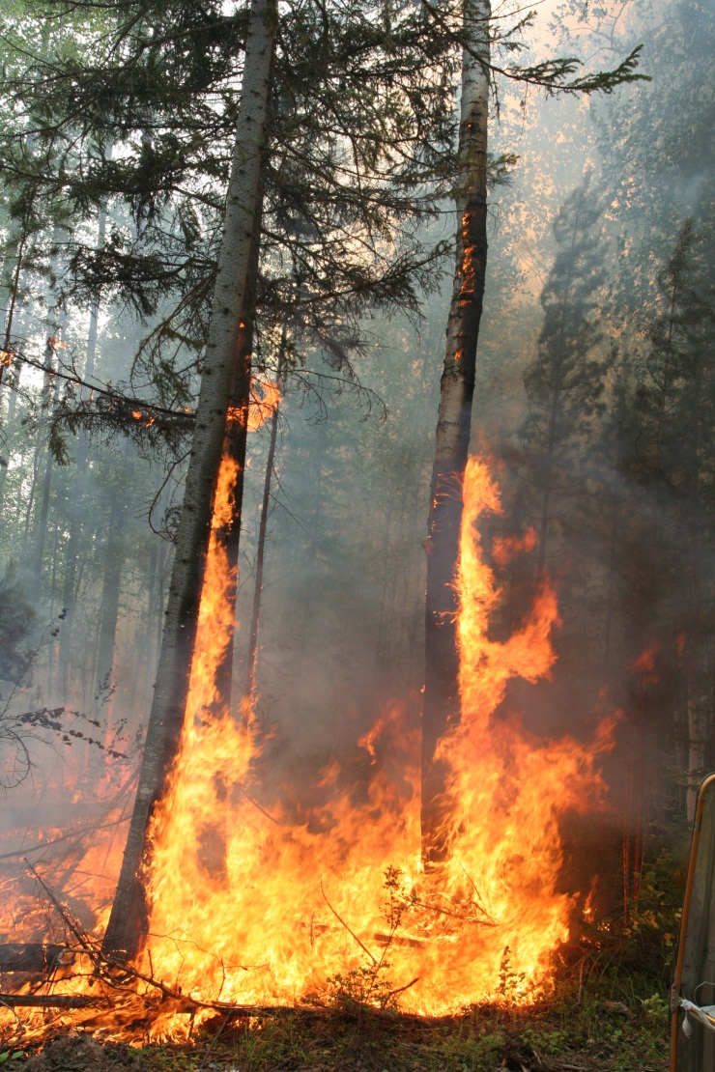
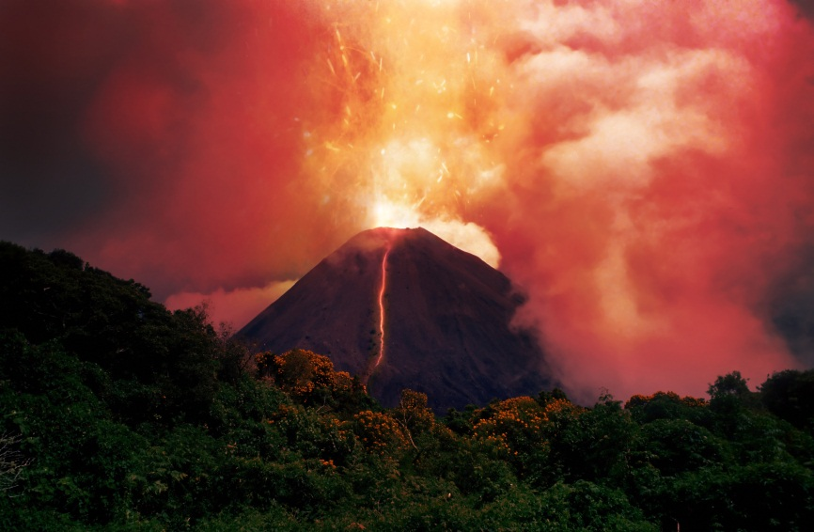
Natural Air Pollution
Soil Erosion
Forest Fires
Volcanic
Eruptions

Slide 7
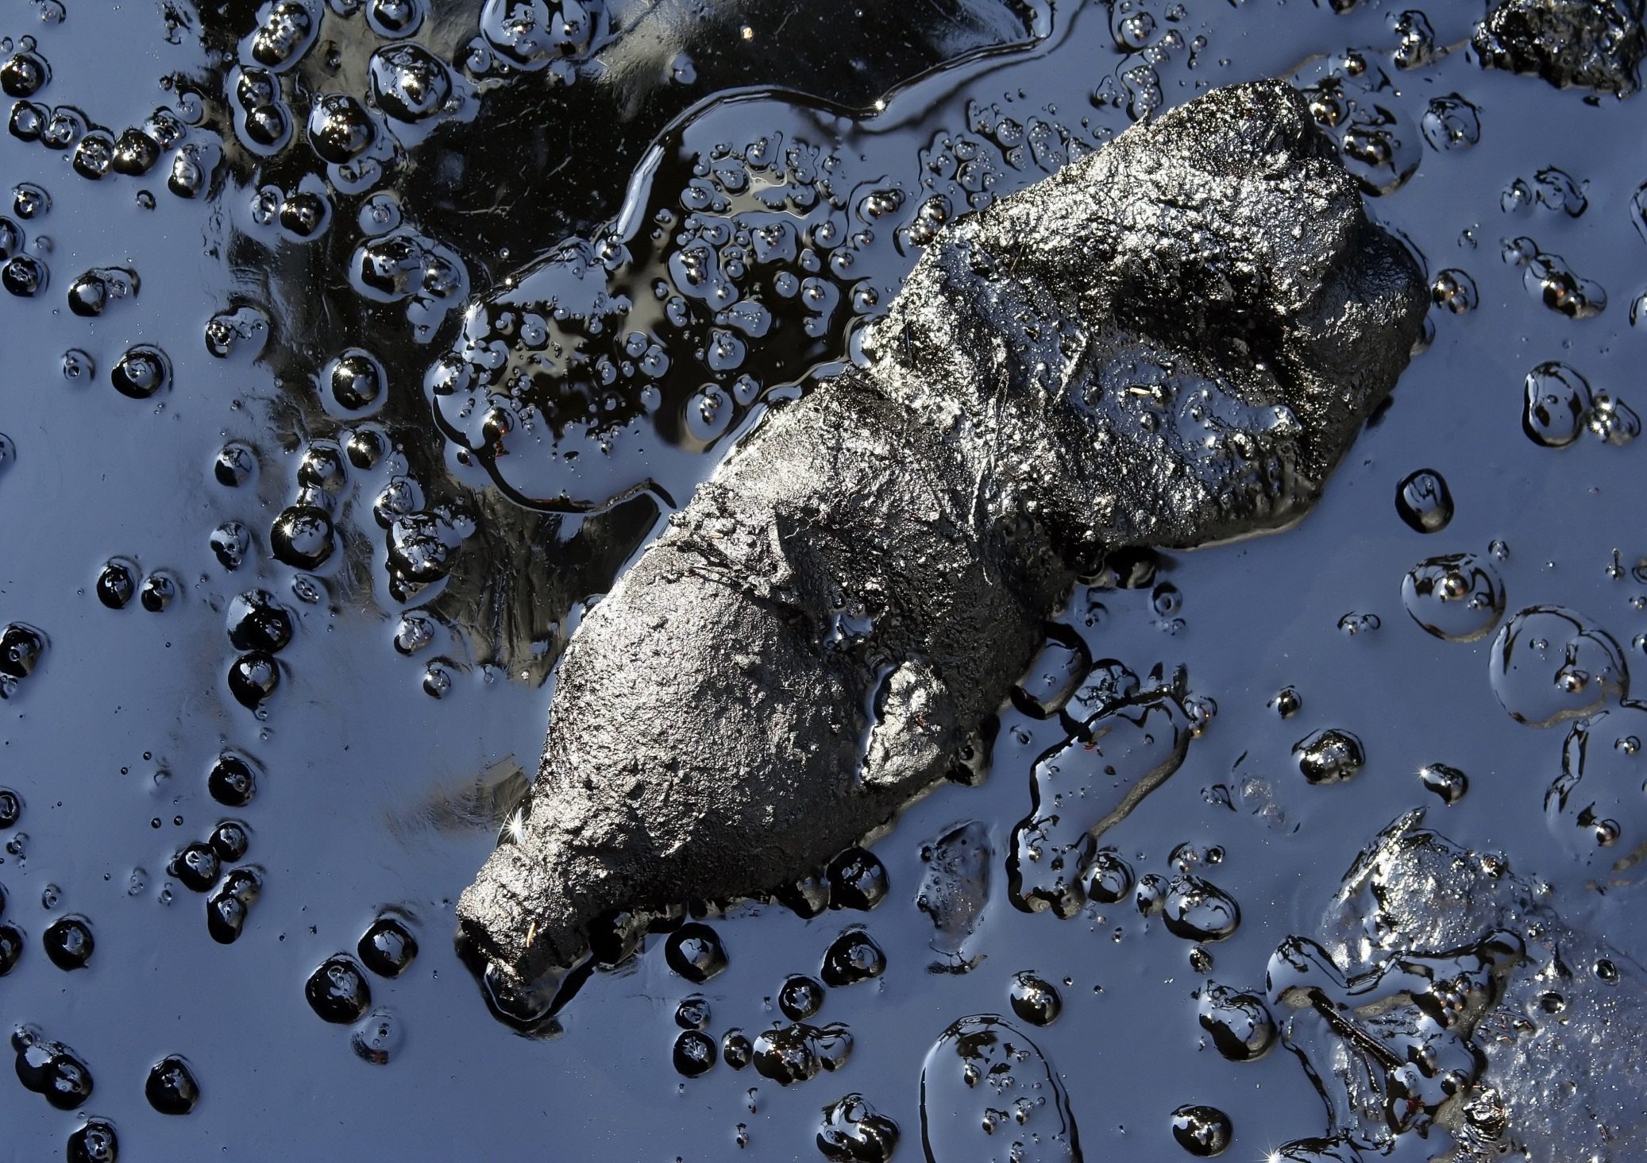
Water Pollution
Water is polluted when it is no longer pure (or clean) because of chemicals or bacteria.
It is produced by many sources including…
Litter (garbage)
Sewage
Soil fertilizers
Oil spills from tankers and ships
Chemical spills from companies
7 of 15

Slide 8
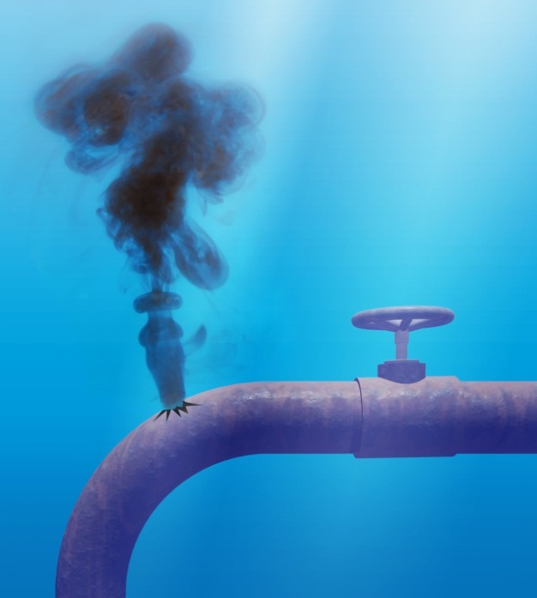
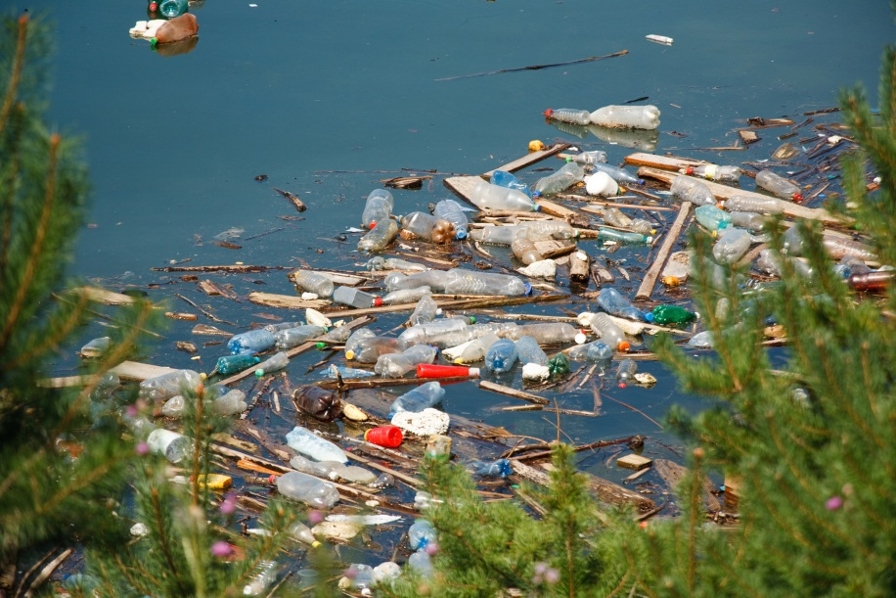
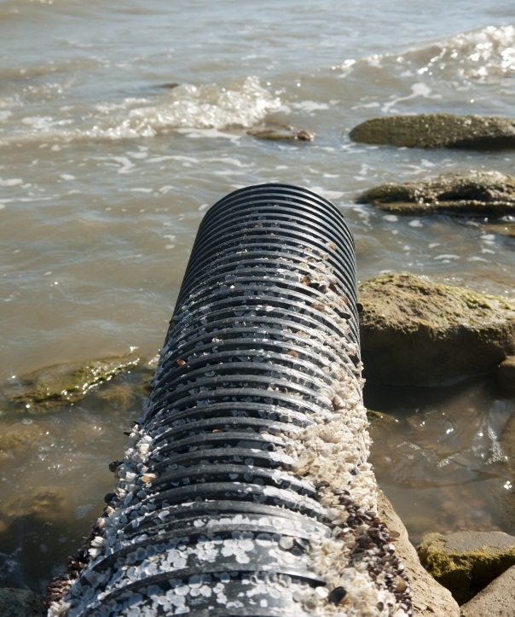
Water Pollution
8 of 15

Slide 9
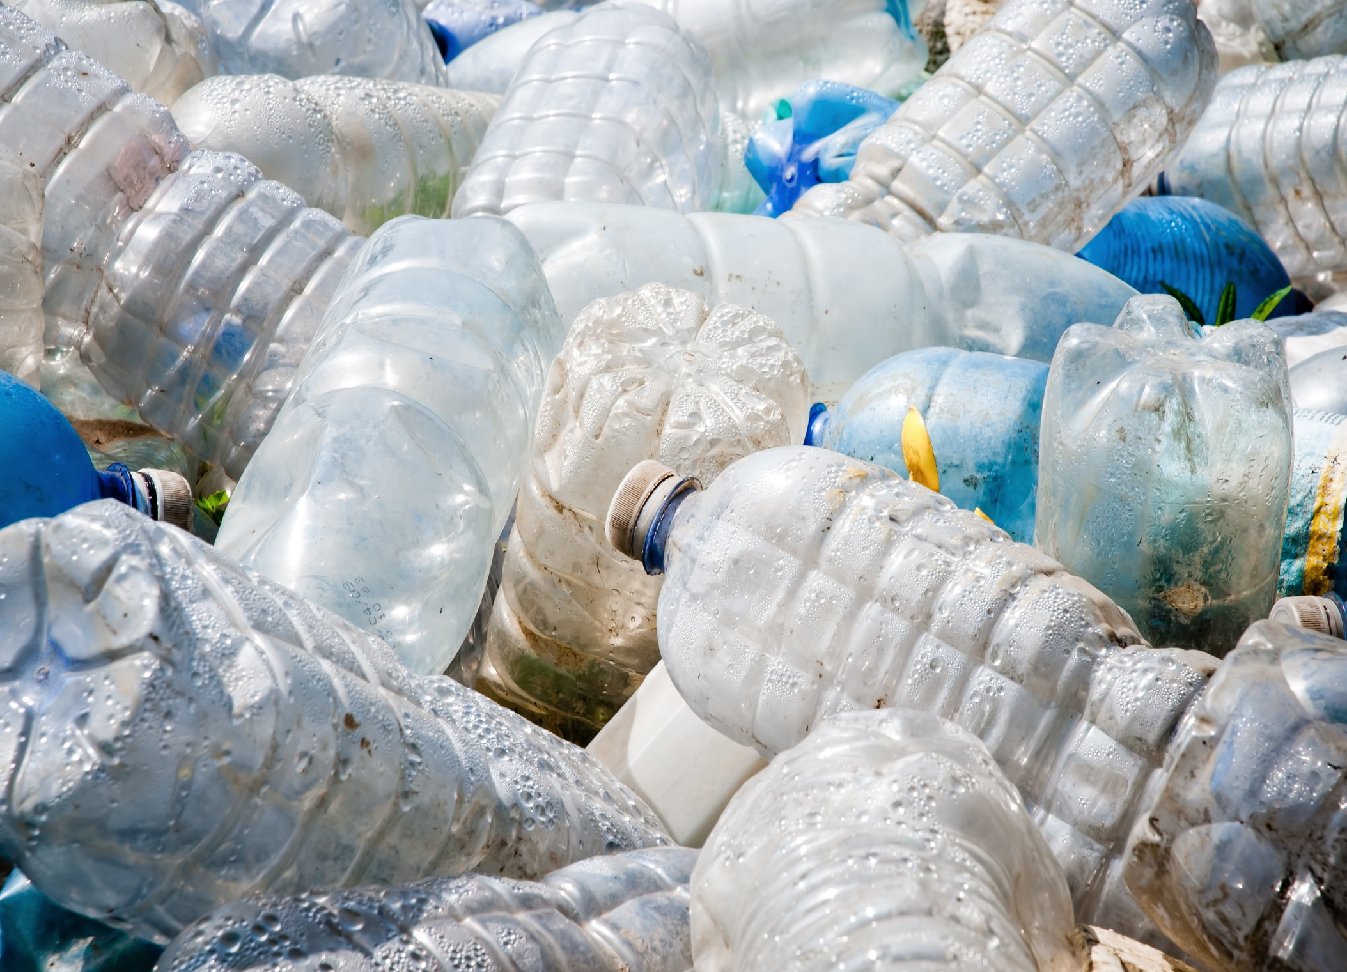
Soil Pollution
Soil pollution is contamination of earth that stops or slows down natural growth and balance to the land
9 of 15

Slide 10
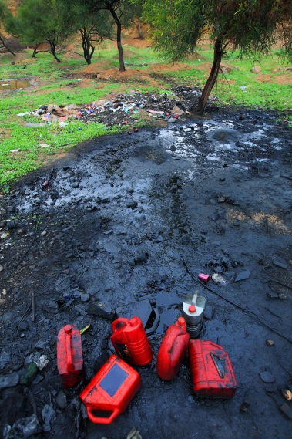
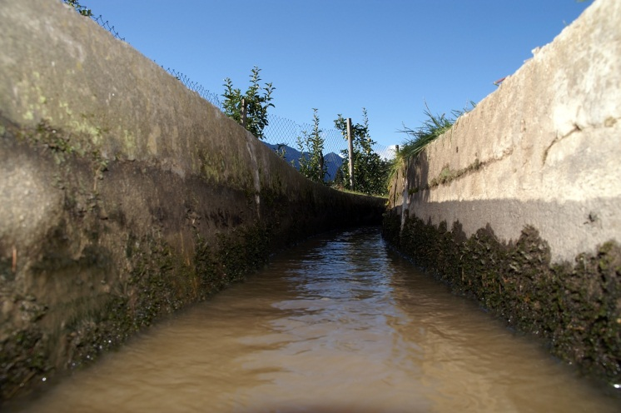
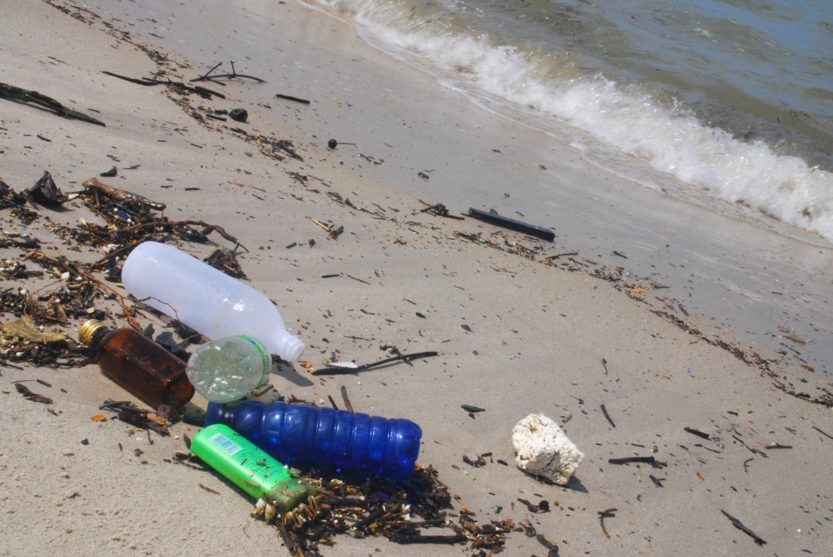
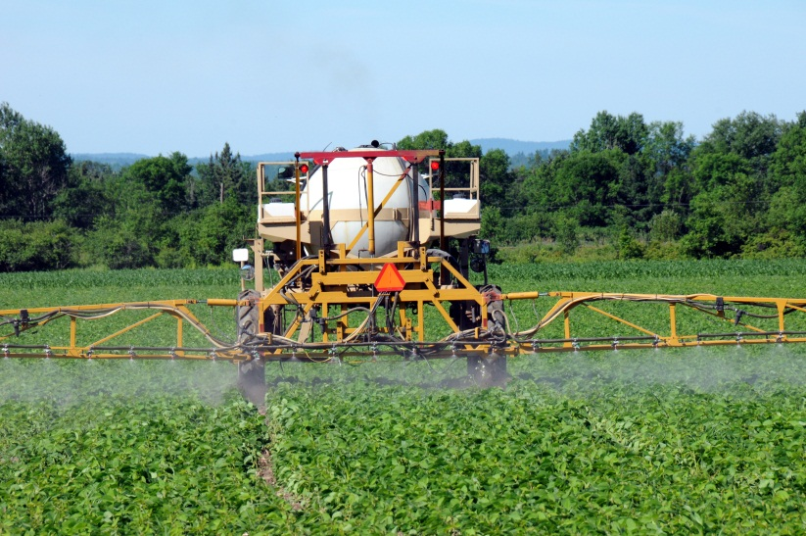
Four Causes of Soil Pollution
Sewage
Oil Spills
Litter
Pesticides
10 of 15

Slide 11
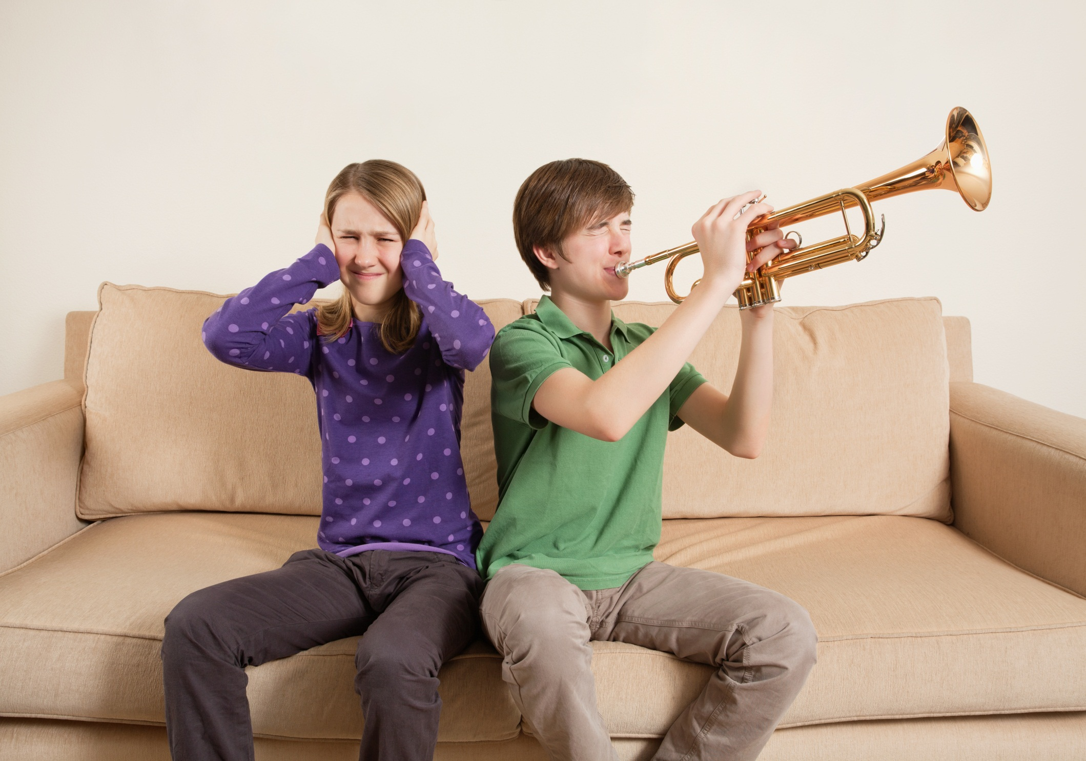
Noise Pollution
Noise pollution is when humans, animals or machines make high levels of noise.
This can cause hearing loss in humans AND animals.
11 of 15

Slide 12
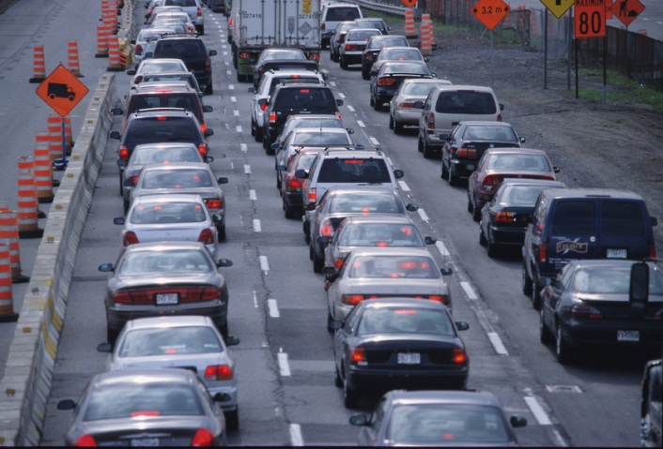
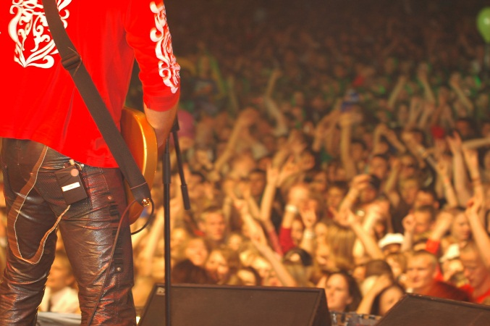
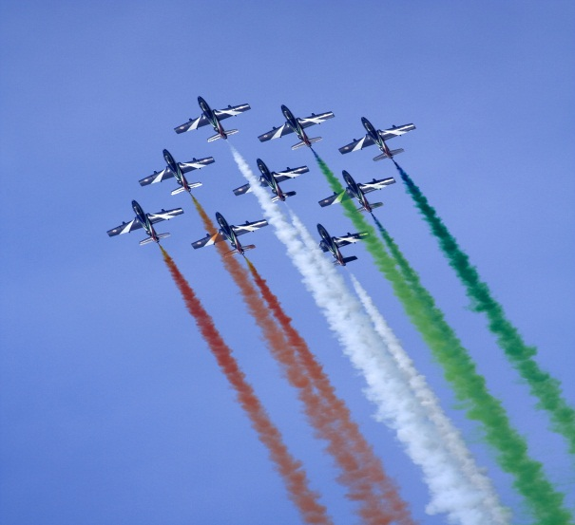
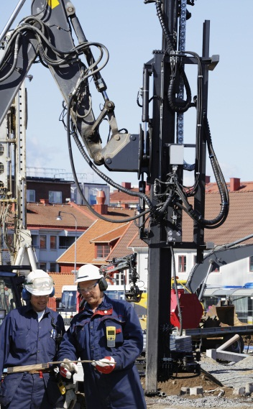
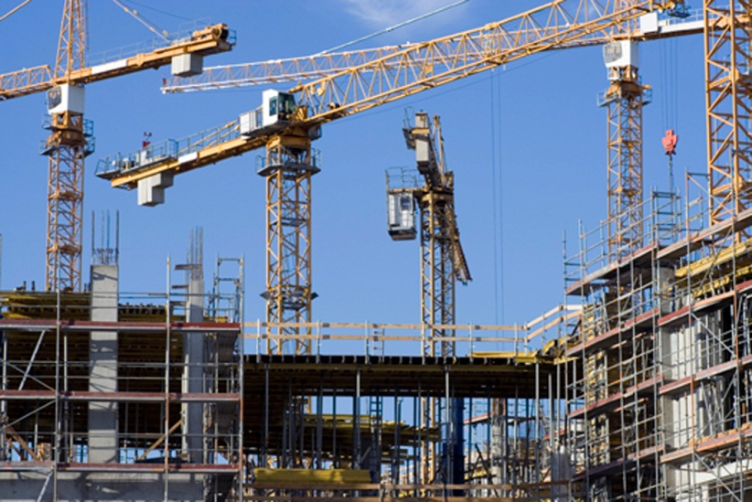
What produces noise pollution?
Traffic
Concerts
Airplanes
Industrial
Machinery
Construction
and demolition
12 of 15

Slide 13
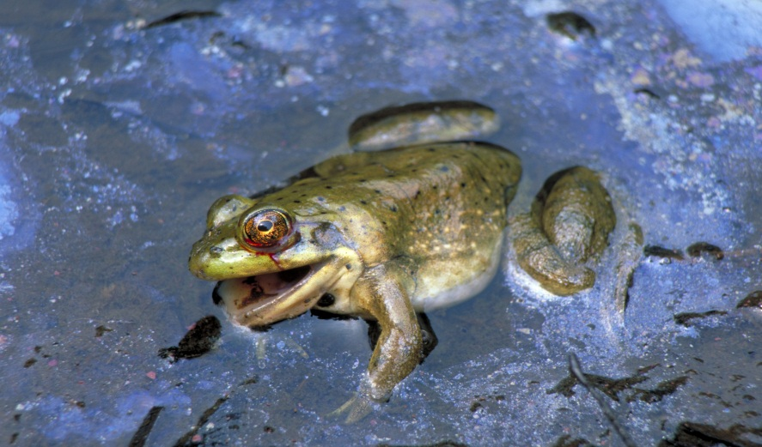
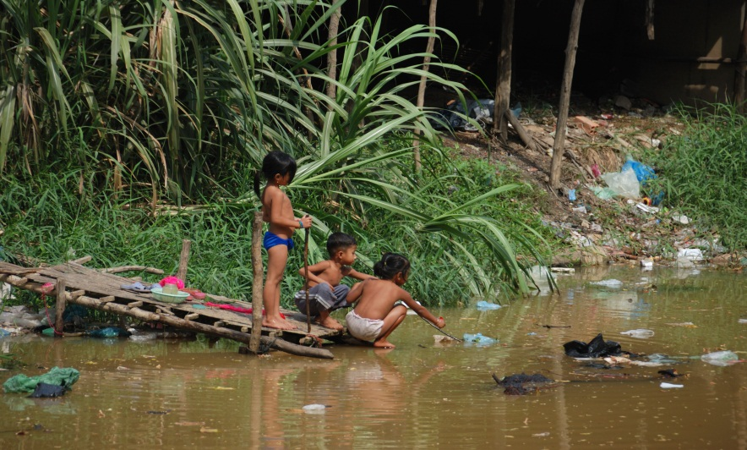
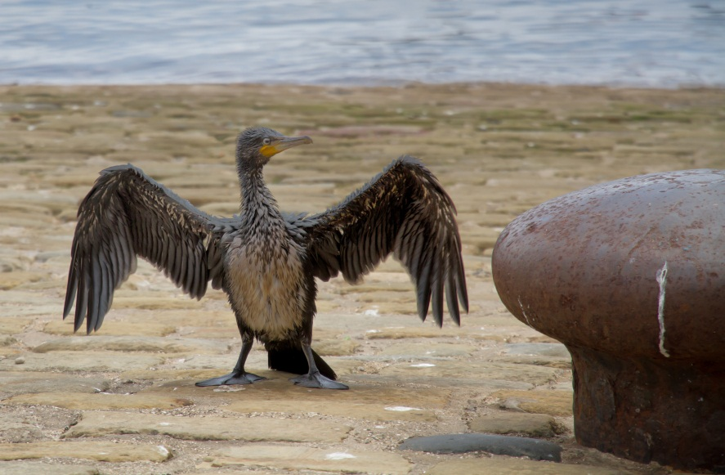
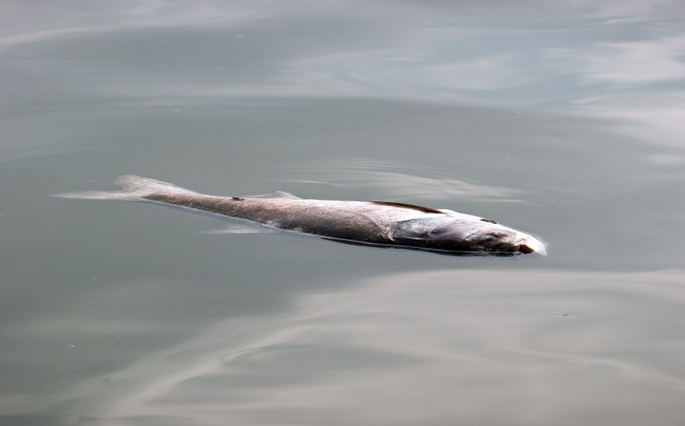
Who or what does pollution affect?
EVERYONE and EVERYTHING!
13 of 15

Slide 14
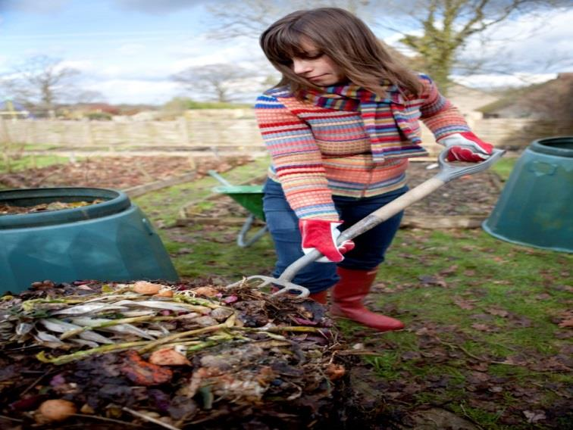
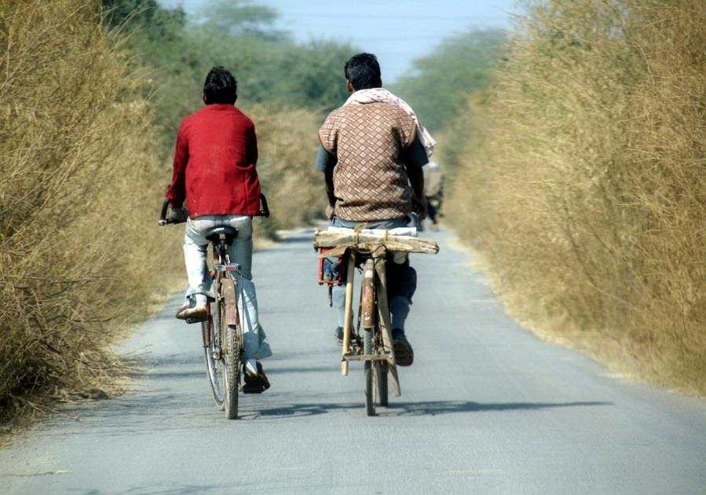
What can you do to help?
Walk or bike, rather than driving, whenever possible!
Make a compost for garbage to make fresh clean soil!
Recycle, Recycle, Recycle!
What else can you think of to help reduce pollution?
14 of 15

Slide 15
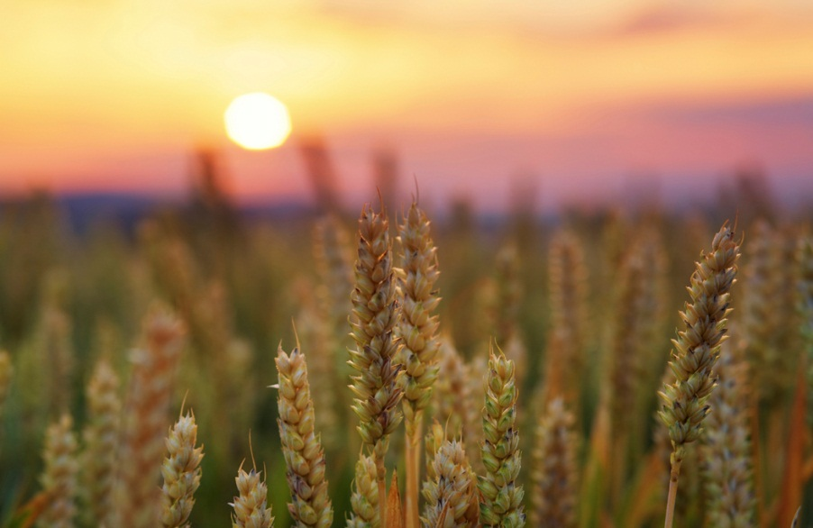
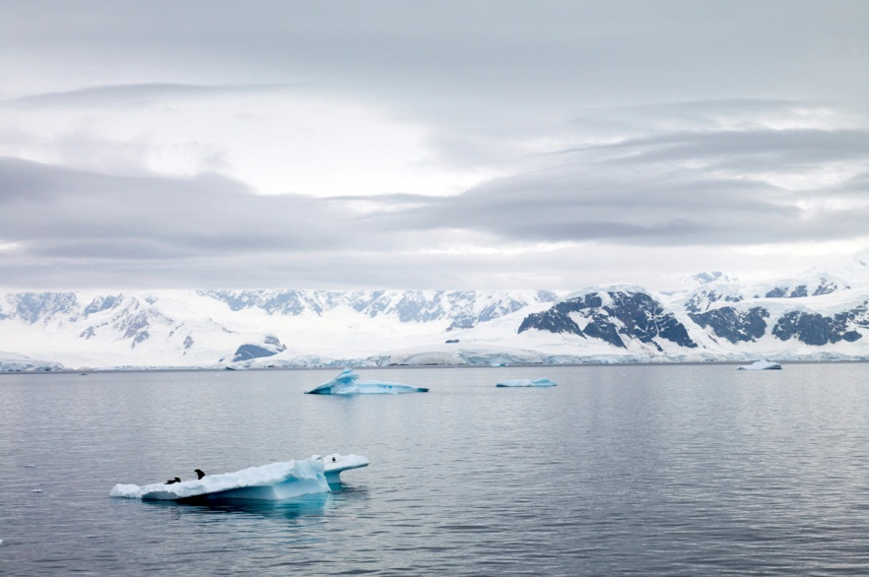
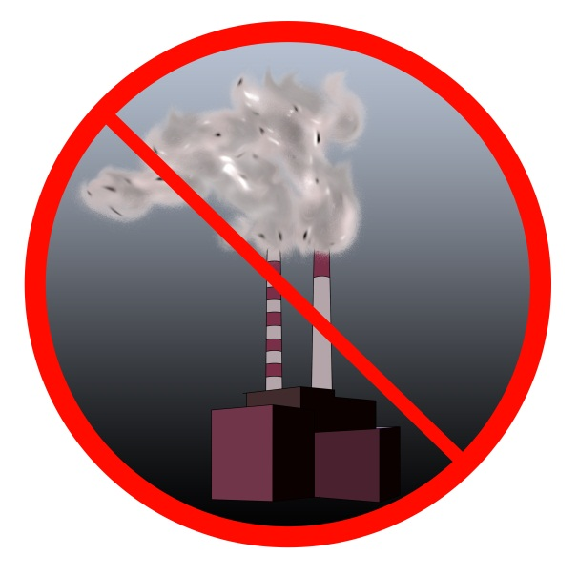
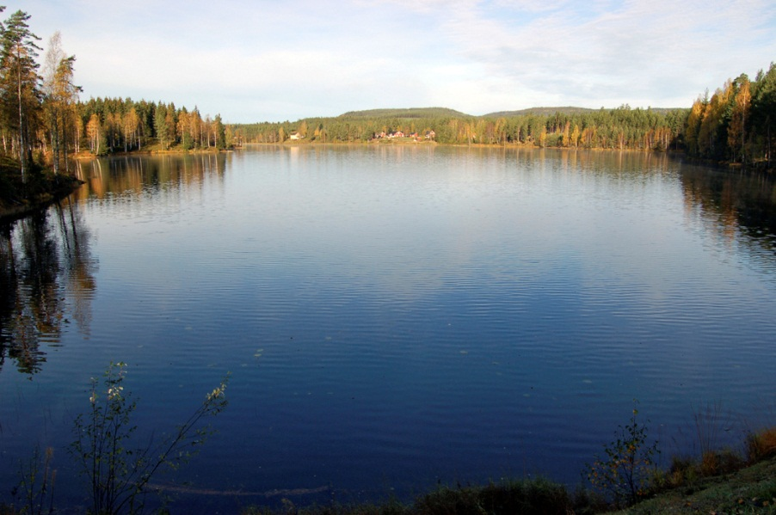
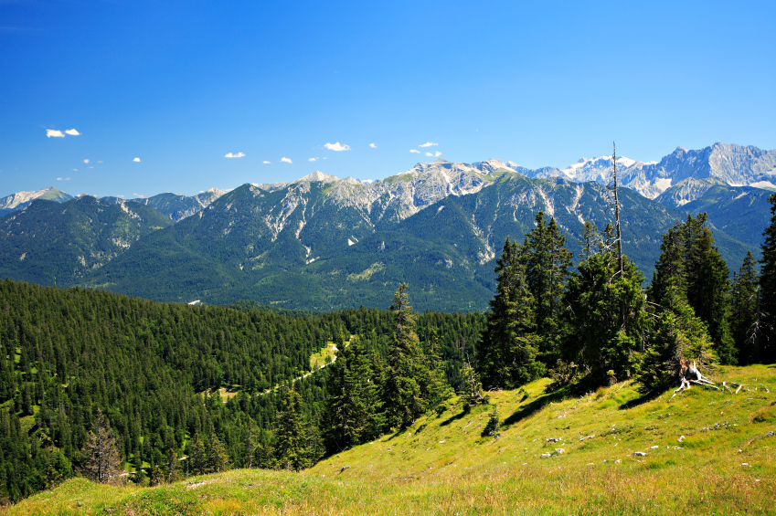
15 of 15

