Slide 1

Fiction and Nonfiction
Animals–Grade 1
Lesson 5–Text Mapping
Notes:
Today we are going to talk about fiction and nonfiction. Let’s see if you can tell the difference.

Slide 2
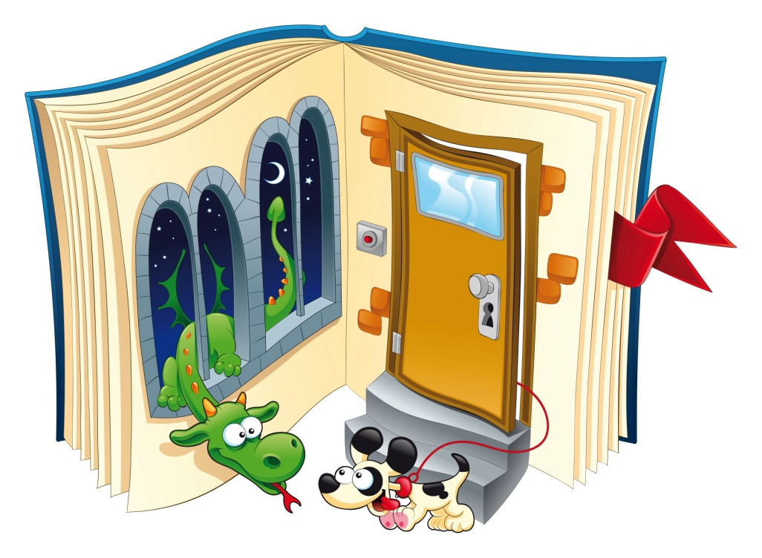
Fiction
Story isn’t true
Make-believe
Illustrations are not realistic
Animals can talk
Story might include magic
Notes:
In a fiction book, the story isn’t true. It is make-believe. The illustrations are not realistic—they are drawings or cartoons. In many fiction books, animals talk and the story includes magic.

Slide 3

Nonfiction
Is true
Gives facts and information
Tells about things that happened
Pictures are realistic
Rainforests
Notes:
A nonfiction book is true. It provides facts and information about a topic. For example, it might tell about real events that happened. The pictures in the book are realistic—often they are photographs.

Slide 4
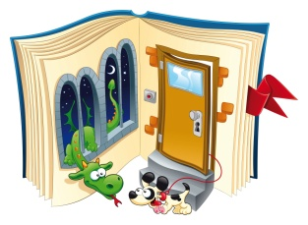
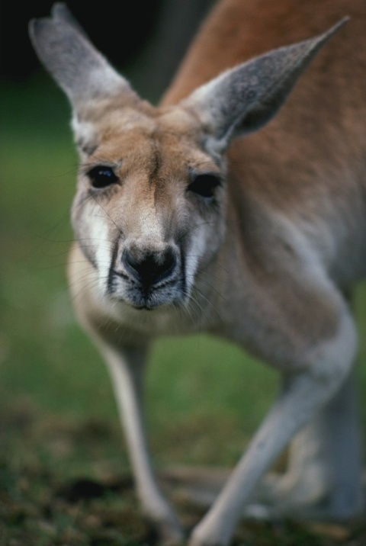

Fiction or Nonfiction?
An adult kangaroo can weigh over 175 pounds and grow to be 7 feet tall.
Fiction
Nonfiction
Rainforests
Notes:
Now we’re going to decide if some examples come from a fiction book or a nonfiction book. Choose the storybook picture if you think the selection comes from a fiction book, or the girl reading a nonfiction book if you think it comes from a nonfiction book. The book says that an adult kangaroo can weight over 175 pounds and grow to be 7 feet tall. Would that come from a fiction book or a nonfiction book?

Slide 5
CORRECT!
Notes:
CORRECT!

Slide 6

TRY AGAIN…
Notes:
Sorry, try again..

Slide 7
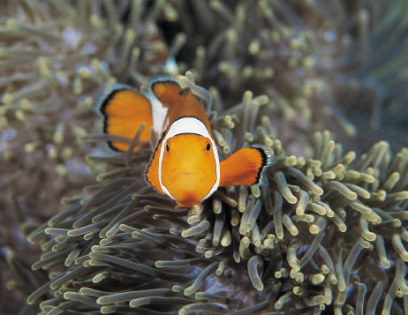
Fiction or Nonfiction?
The sea anemone can sting fish with its tentacles. Clown fish hide in sea anemone.
Fiction
Nonfiction
Rainforests
Notes:
This is a picture of a clown fish hiding in sea anemone. The sea anemone can sting fish with its tentacles. Clown fish hide in sea anemone. Would that come from a fiction book or a nonfiction book? Choose either the storybook or the nonfiction book.

Slide 8
CORRECT!
Notes:
CORRECT! Now it’s your turn. I will give you another example. With your groups, decide if the example would come from a fiction book or a non-fiction book.

Slide 9

TRY AGAIN…

Slide 10
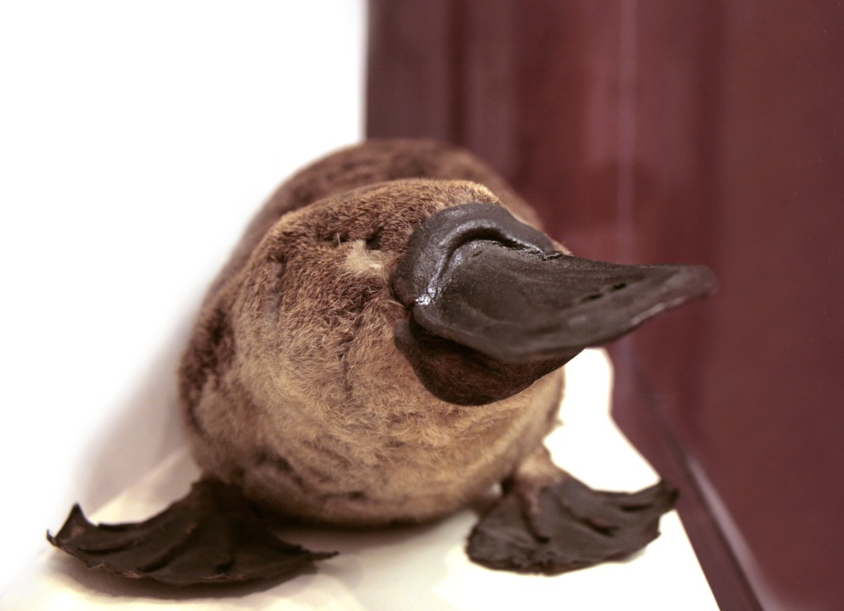
1) The duck billed platypus lives in a lake habitat.
The male platypus has a poisonous stinger on its back feet that it can use for protection.
Notes:
Let’s look at some more examples. Work with your group to decide if each one comes from a fiction book or a nonfiction book. When your group has reached a decision, mark an X under the correct picture on your student journal. Choose the storybook picture if you think the selection comes from a fiction book, or the girl reading a nonfiction book if you think it comes from a nonfiction book.
Let’s look at number 1. This says, ‘The duck billed platypus lives in a lake habitat. The male platypus has a poisonous stinger on its back feet that it can use for protection.’
Talk with your group and mark your answer.

Slide 11
2) Every day the selfish crocodile shouted to the creatures of the forest, “Stay away from the river! It’s MY river! If you come into my river, I’ll eat you up!”
Notes:
Let’s look at number 2. This says, “Every day the selfish crocodile shouted to the creatures of the forest, ‘Stay away from the river! It’s MY river! If you come into my river, I’ll eat you up!”
Mark an X under the correct picture. Choose the storybook picture if you think the selection comes from a fiction book, or the girl reading a nonfiction book if you think it comes from a non-fiction book.

Slide 12

3) I am a prince, not a frog.
Notes:
This is number 3. Decide with your group, and mark your answer.

Slide 13
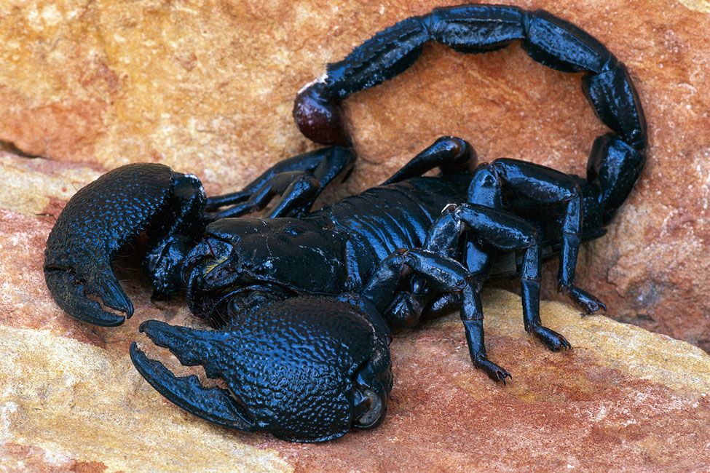
4) Scorpions use their pincers to catch prey. They inject insects with poison using their stingers.
Notes:
Let’s take a look at number 4. Read it with your group and select fiction or nonfiction.

Slide 14
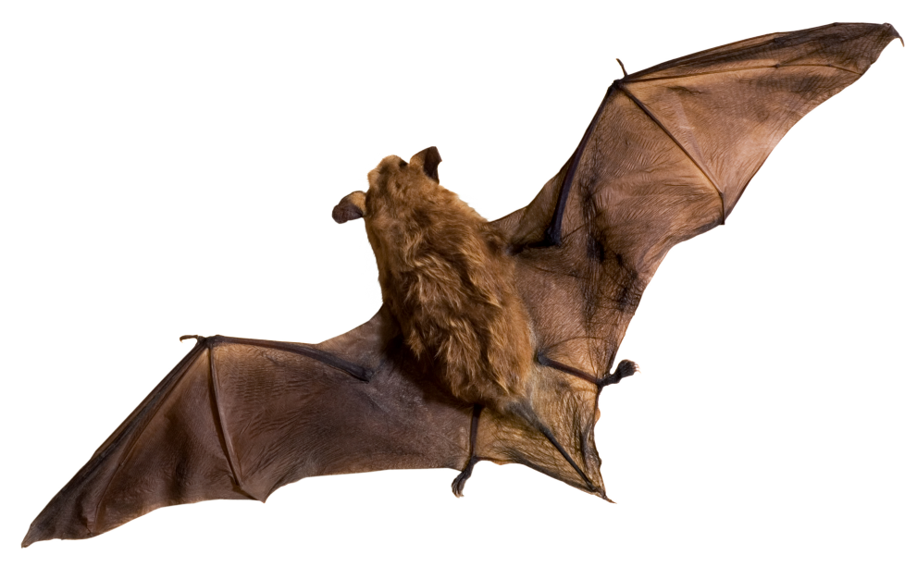
5) Some bats live in caves. They often live in large groups called colonies.
Notes:
Finally, we have number 5. Read it and mark your answers.

Slide 15
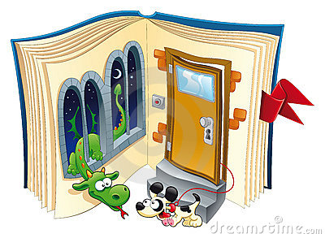


Fiction or Nonfiction?
The duck billed platypus lives in a lake habitat.
The male platypus has a poisonous stinger on its
back feet that it can use
for protection.
Fiction
Nonfiction
Rainforests
Notes:
Now we will look at the pictures once more and check our answers. “The duck billed platypus lives in a lake habitat. The male platypus has a poisonous stinger on its back feet that it can use for protection.”
Is this fiction or nonfiction?

Slide 16
CORRECT!

Slide 17
TRY AGAIN…

Slide 18
Fiction or Nonfiction?
Every day the selfish crocodile shouted to the creatures of the forest,
“Stay away from the river! It’s MY river! If you come into my river, I’ll eat you up!”
Fiction
Nonfiction
Rainforests
Notes:
“Every day the selfish crocodile shouted to the creatures of the forest, ‘Stay away from the river! It’s MY river! If you come into my river, I’ll eat you up!”
Is this fiction or nonfiction?

Slide 19
CORRECT!

Slide 20
TRY AGAIN…

Slide 21
Fiction or Non-fiction?
I am a prince, not a frog.
Fiction
Nonfiction
Rainforests
Notes:
Here’s another one for you. This book says, “I am a prince, not a frog.” Fiction or nonfiction?

Slide 22
CORRECT!

Slide 23
TRY AGAIN…

Slide 24
Fiction or Non-fiction?
Scorpions use their pincers to catch prey. They inject insects with poison using their stinger.
Fiction
Nonfiction
Rainforests
Notes:
How about this one? “Scorpions use their pincers to catch prey. They inject insects with poison using their stinger.”
Fiction or nonfiction?

Slide 25
CORRECT!

Slide 26
TRY AGAIN…

Slide 27
Fiction or Non-fiction?
Some bats live in caves. They often live in large groups called colonies.
Fiction
Nonfiction
Rainforests
Notes:
“Some bats live in caves. They often live in large groups called colonies.”
Fiction or nonfiction?

Slide 28
CORRECT!

Slide 29
TRY AGAIN…

Slide 30

Great Job!
Notes:
What an awesome job you did today! We can tell fiction from nonfiction!

