Slide 1
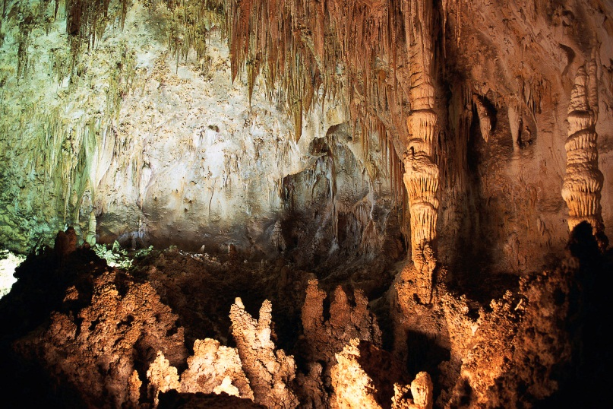
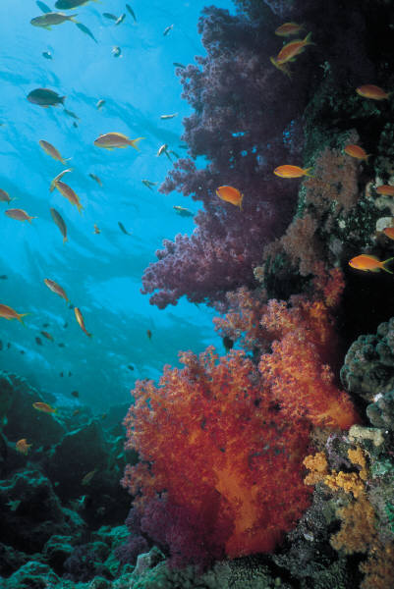
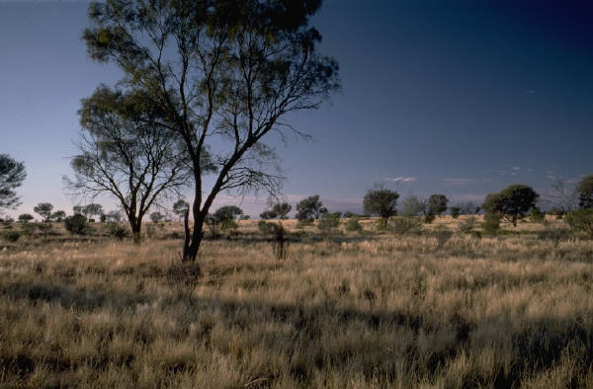
Animal Habitats
Animals – Grade 1 Lesson 1 – Hook
Notes:
Today is the first lesson in our unit on animal habitats. Let’s take a look and see what we find.

Slide 2
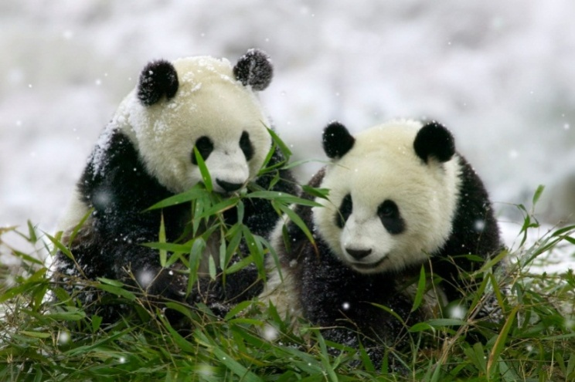
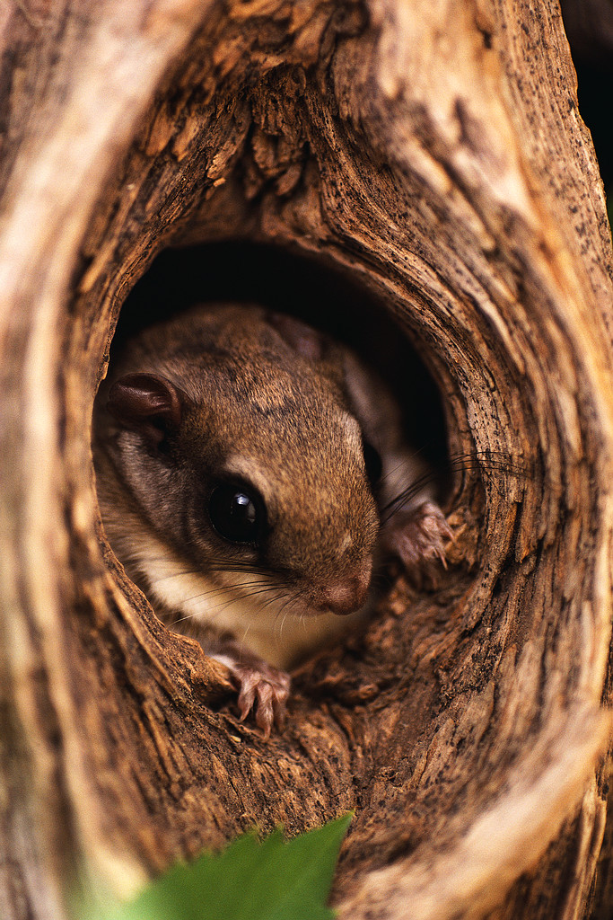
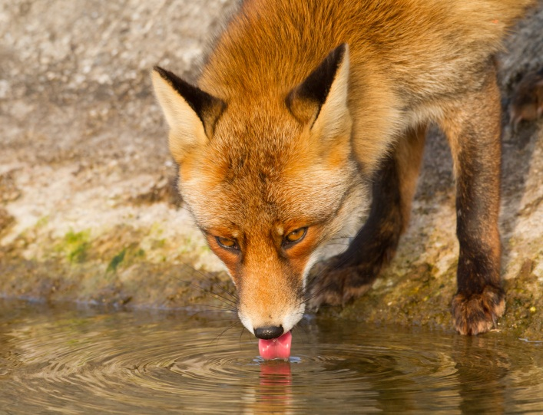
All animals need food, water, and a way to stay safe.
Notes:
We know that all animals need food, water, and a way to stay safe. These pandas are eating bamboo. This fox is drinking water. This squirrel is hiding in a tree. All animals find ways to get what they need.

Slide 3
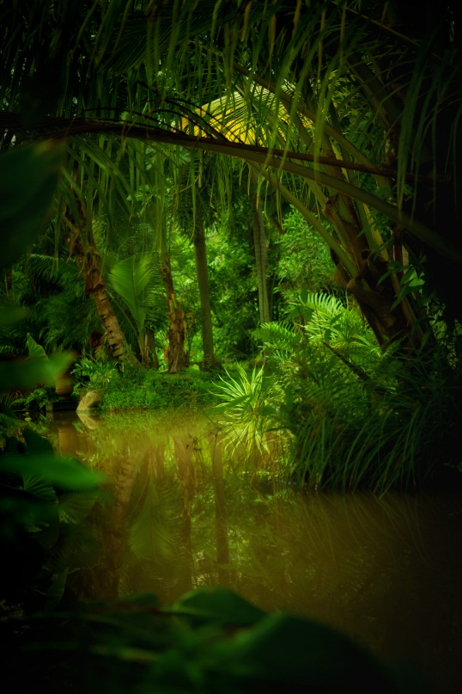
What animals need is related to their habitat.
Notes:
What animals need is related to where they live or their habitat. Even though animal habitats are very different, all animals find a way to get what they need. Look at all these habitats. I wonder what’s special about each one.

Slide 4
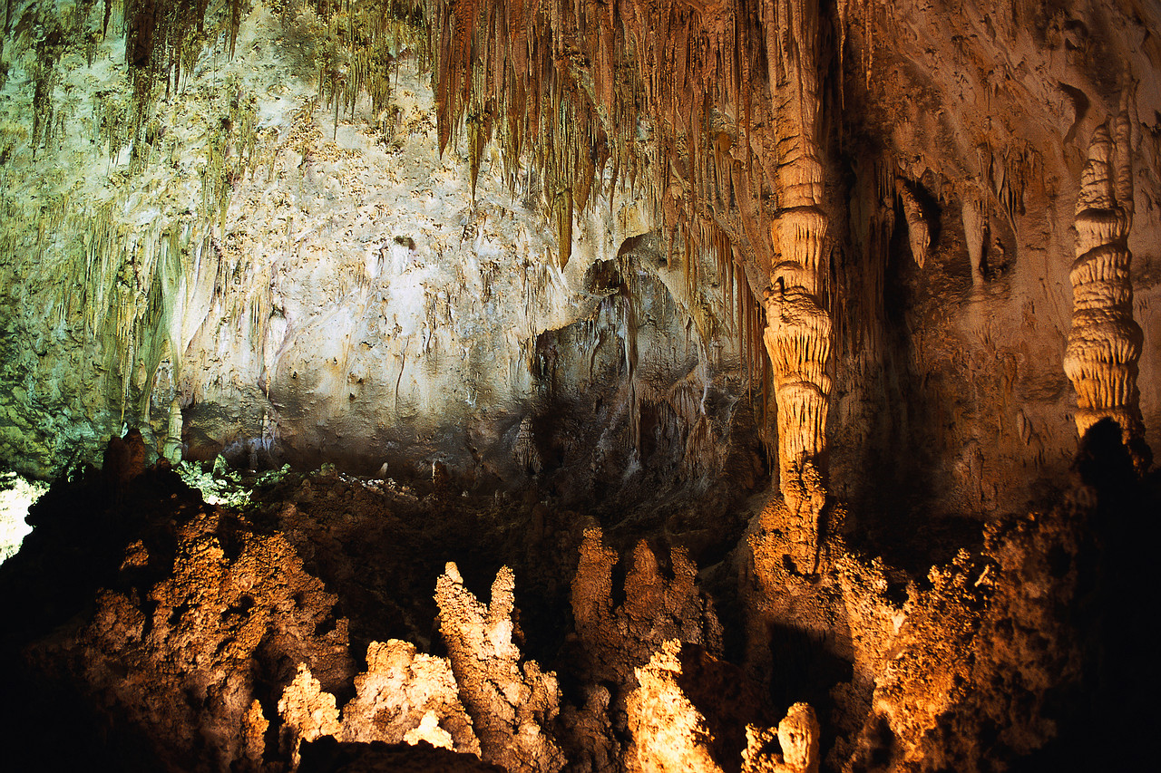
Cave habitat
Notes:
In caves, animals don’t have a lot of light, so it’s hard to see. Some animals have to feel their way around. There are very few plants that grow inside caves, so animals have to leave to find food and water. It’s cool inside caves, so many animals like bats huddle together to stay warm.

Slide 5
Outback habitat
Notes:
The Outback habitat has few trees and dry grasses. The Outback habitat is very dry and hot. Animals rest during the day when it’s hot and eat when it is cool. It’s hard to find water in the Outback, but animals can eat plants that hold water. To stay safe, animals can hide in the grasses or use camouflage so predators can’t see them. Camouflage means that animals can look like their environment so they become hard to see. We just learned about two habitats, let’s compare them.

Slide 6
How do you compare things?
How is a Tennis Ball different?
How are they the same?
How is a Golf Ball different?
Big
Made of rubber and felt
Feels fuzzy
Yellow
Balls
Round
Used in sports
Little
Made of plastic
Feels bumpy
White
Notes:
When you compare things, you show how the are they same and different. Look at these two balls, at their shape, size, color, and the way we use them. We know they’re both balls, they’re round, and they’re used in sports. That’s how they are the same. But we can also think about what makes them special and different from each other. The sports that use the balls are different, the size is different, what they’re made of is different, and what they feel like is different. Just like we can compare two different balls, we can also compare animal habitats and think about how they’re the same and different. So let’s compare our cave habitat and our Outback habitat.

Slide 7
Compare a cave habitat and an outback habitat.
How is a cave habitat different?
How are they
the same?
How is an Outback habitat different?
Dark
Few plants
Some animals are blind
Both have places for animals to hide
Animals can find food in both habitats
Light
Dry grasses and shrubs
Animals use eyes to spot predators and prey
Notes:
Let’s see how a cave habitat and an Outback habitat are alike and different. Both have many places for animals to hide and animals can find the food they need in both habitats. How are they different? A cave habitat is dark and there are few plants. In caves, many animals can’t see or are blind so they have to feel their way around. An outback habitat has lots of light. It’s also very dry. Animals in the outback have good eyesight so they can spot a predator or prey from far away.

Slide 8
Coral Reef habitat
Notes:
A coral reef looks like a plant or rock, but it is made from the shell of animals called coral. All animals that live in the coral reef depend on one another. Some animals eat plants, some eat other animals, and some animals eat leftovers. Animals work together to stay safe. The coral reef has lots of places for animals to hide.

Slide 9
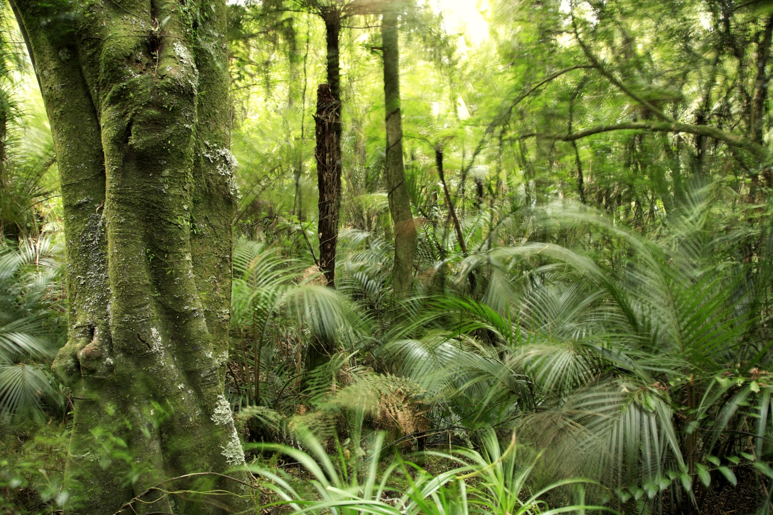
Tropical Rainforest habitat
Notes:
A tropical rainforest habitat is warm. It rains all the time in the tropical rainforest, so it is also wet. There are lots of trees and other vegetation in the tropical rainforest. Vegetation means the plants growing in an area. In the tropical rainforest, some animals eat other animals and some eat fruit and plants. To stay safe, animals hide high in the trees. In some tropical rainforests, you can even find people that live there! We just learned about two more habitats. Let’s compare them. This time, I want you to help me.

Slide 10
Compare a coral reef habitat and a tropical rain forest habitat.
How is an coral reef habitat different?
How are they the same?
How is a tropical rainforest different?
Notes:
“Let’s compare a coral reef habitat and a tropical rainforest habitat. How are they the same?”
Allow students chances to provide answers. If students have difficulty providing answers, give choice and ask them to pick. Possible answers include:
Both have lots of water
Both have lots of places for animals to hide
“How are they different?”
Allow students chances to provide answers. Possible answers include:
Coral reefs are made up of coral.
Coral reefs have lots of different fish.
Tropical rainforests have trees.
Tropical rainforests have lots of different animals including people.

Slide 11
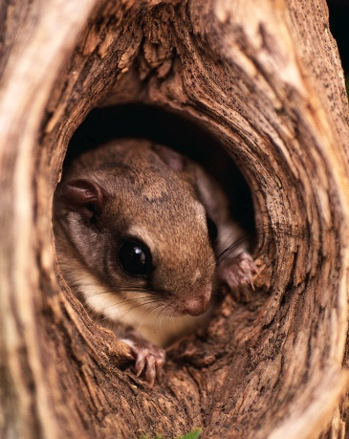
Habitats can be
similar OR different.
food water shelter
Notes:
We have learned about many habitats today. Habitats can be similar or different. But all habitats provide the things that animals need. These things are food, water, and shelter.

Slide 12
Now it’s your turn…
How are these habitats the same or different?
Notes:
Now it’s your turn to compare habitats.

