Slide 1


Prefixes and Suffixes
re-
-ing
un-
Animals – Grade 1
Lesson 18 – Text Mapping
-ed
-y

Slide 2
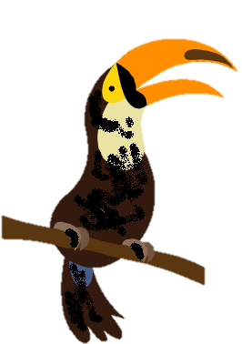
= not
un
un
=
Notes:
Our language is flexible. We can change the meaning of words by adding letters. For example, we can add letters to the beginning of a word. This is called a prefix. If we put the tiny part of a word UN in front of a word, it means NOT. Here is a clean toucan. If I put the word part UN in front of clean, I get the word unclean. Unclean is another word for not clean. An Unclean toucan is dirty.

Slide 3
re
= again
re
Notes:
There’s another prefix or small word part that we can use, re. Re means again. Here’s a circle or cycle. If we re cycle, what word to we get?

Slide 4
re
Notes:
Right recycle. We cycle things over again. We turn in our cans and bottles and they’re made again into new things. Recycling help conserve the rainforest.

Slide 5
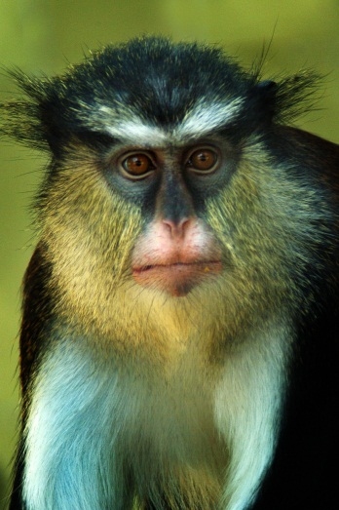

monkey
monkeys
Notes:
We can also change the meaning of words by adding letters to the end of words. This is called a suffix. For example, here is a picture of one monkey. What happens if we have more than 1 monkey? We add the letter s at the end of monkey and now the word means more than 1 monkey.

Slide 6
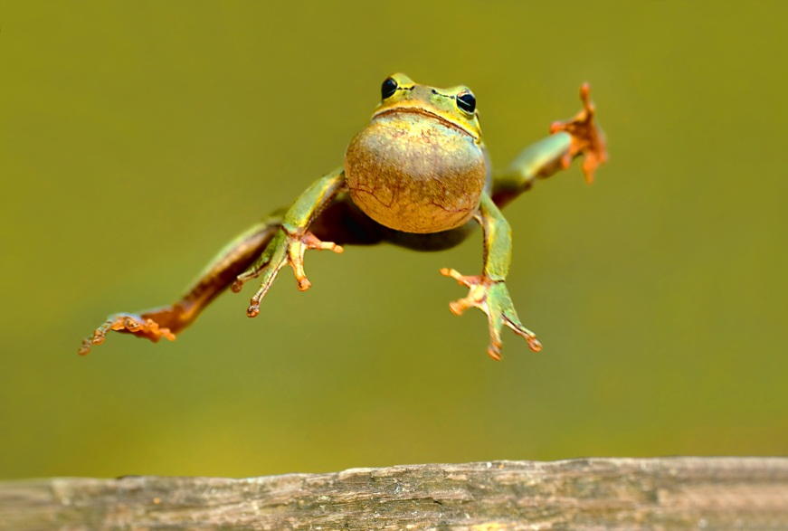
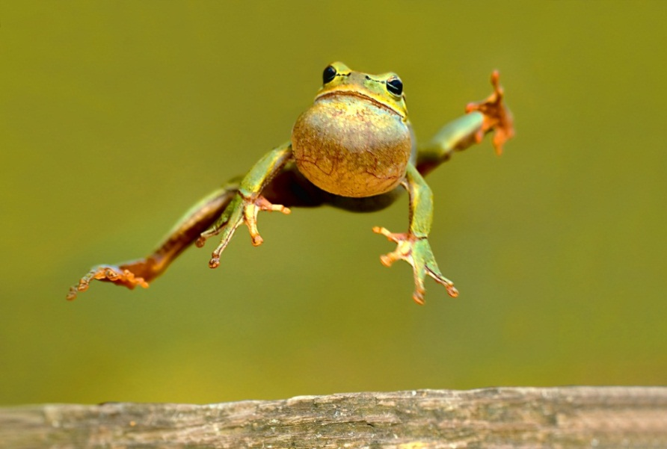
jumping
jumped
Notes:
Look this frog is jumping. We can add ing to jump to talk about what the frog is doing right now. What if we want to talk about something that already happened? What if this happened yesterday? Then we can add ed at the end of jump. We can say the frog jumped yesterday.

Slide 7
raining
rained
Notes:
Here’s another example. Today it is raining. If this happened yesterday, we say it rained.

Slide 8
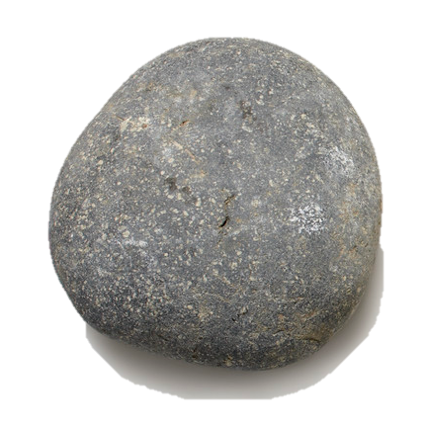
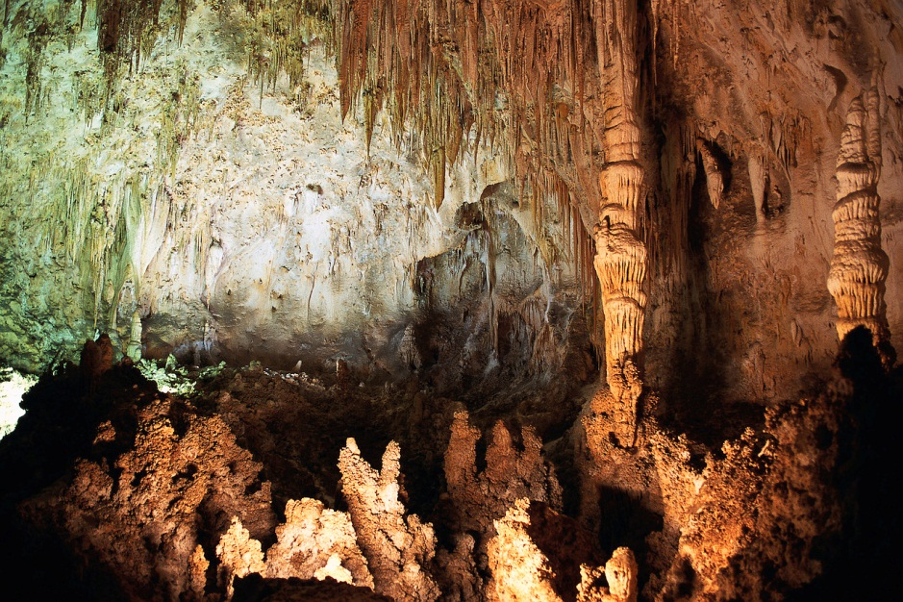
rock
+ y = rocky
Notes:
We can also add letters to the end of words that turn them into description words. For example, here is a picture of a rock. What if we want to talk about a place that has many rocks? We add y at the end and now we have rocky. We can say this cave has lots of rocks, or this cave is really rocky.

Slide 9
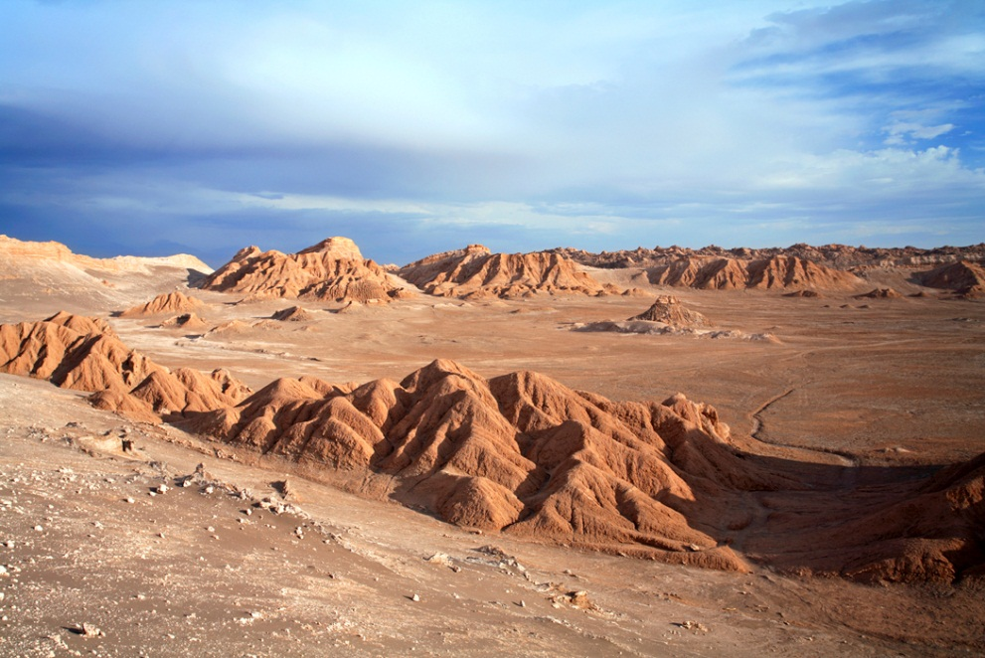
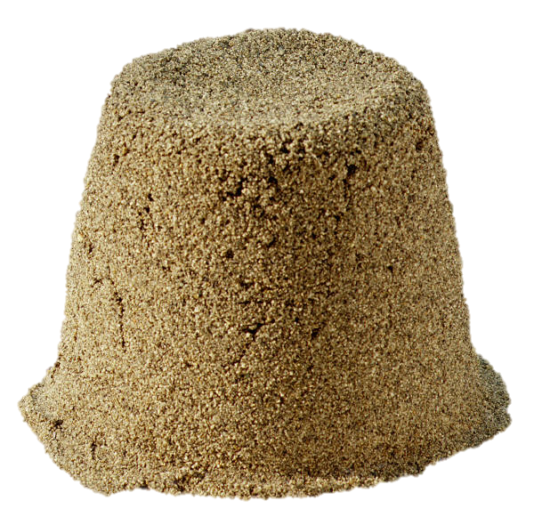
sand
+ y = sandy
Notes:
Here is some sand. Places like the desert habitat of the Outback have lots of sand, that means they are sandy.

Slide 10
Now it’s your turn!
un + fold =
unfold
Notes:
Now it’s your turn. I will show you a prefix and a word. I want you to combine the two and form a new word. This means to open something that was folded.

Slide 11
re + tie =
retie
Notes:
Let’s try another one. What word do you get when to add re and tie? That’s right, retie! This means to tie again. When your shoelaces come undone, you have to retie them.

Slide 12
cook + ed =
cooked
Notes:
How about this one. Cook + ed = cooked

Slide 13
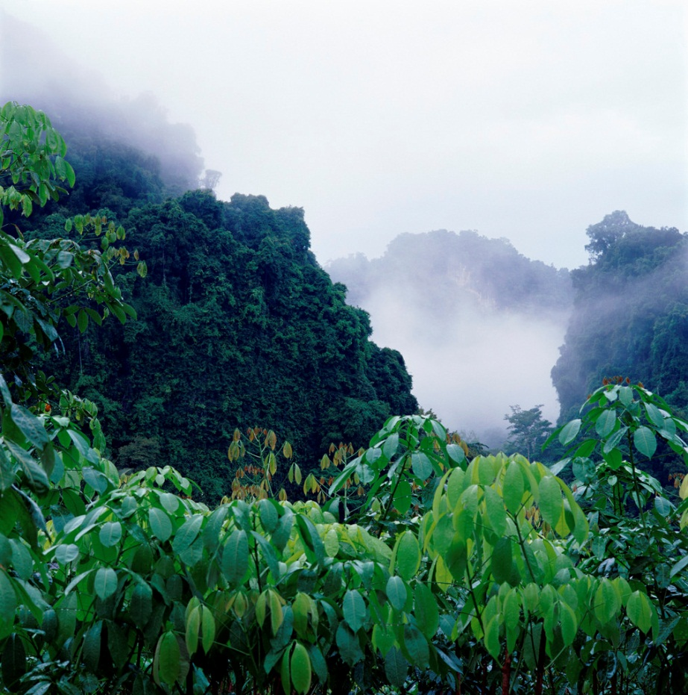
rain + y =
rainy
Notes:
The rainforest gets a lot of rain. That means it is very _______? That’s right, rainy.

Slide 14

Great Job!

